Slide 1
Design Process
Conceptual Design Components and Ethics

Slide 2
Contents
Difficulty with Conceptual Design
Conceptual Design
  Ideation
  Brainstorming
  Function Means Tree
  Morphological Chart
    Design Interpretation for Next Generation Products
    Flexible Design for Families
Ethics at the Conceptual Design Stage
Embodiment Design
✓
✓

Slide 3
Conceptual Design
Conceptual Design (noun) is the definition of ‘means’ groups (subsets) of functions from the overall list of functions which the product has to perform as given in the product concept or specification.
Conceptual Design (verb) is the process of defining the sub groups of requirements and the means to provide them.
It is achieved in two steps:
  Grouping the functions for each sub-means
  Establishing the sub-means which would integrate with other sub-means in harmony
Conceptual design involves creativity

Slide 4
Difficulty with Conceptual Design
Example - Two Conceptual Designs

Slide 5
Difficulty with Conceptual Design
The means proposed may not be self-sufficient to provide the functions which are to be performed.
They may need extra functions (secondary functions) to perform its original intended functions.
The secondary functions may need secondary means.

Slide 6
Difficulty with Conceptual Design
Example – Washing Machine Drum
Rotating Drum of a Washing Machine
Principal function is to agitate the clothes at specified speeds for specified times.
Two secondary functions necessary are
  A measuring function to sequence and control activities
  A power regulating function to give the current required to get the speed.

Slide 7

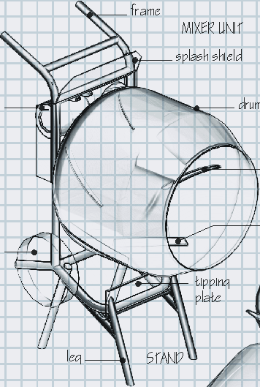
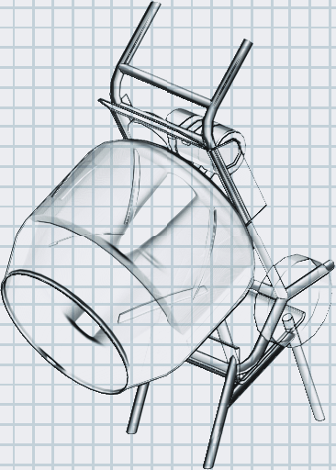
Difficulty with Conceptual Design
Example – Concert Mixer
frame
MIXER UNIT
splash shield
motor
drum
blades
Tilt Mixer
wheel
& Frame
by pushing
tipping
on Handles
plate
leg
STAND
Concrete
pivot
Mix spills
out of drum

Slide 8
Difficulty with Conceptual Design
Example – Concert Mixer

Slide 9
Function Means Tree
Function Means Tree when completed is an effective way of showing the conceptual design.
It is a useful method to develop conceptual designs
It essentially has two components ‘Functions’ and ‘Means’

Slide 10
Function Means Tree
It helps to go beyond the terminology and to know what you’re really trying to do.
Think of the “functions” as what you must do.
Think of the “means” as how you might do it.
The Function-Means Tree is a tool for listing the primary functions of a design and various means of achieving those functions.

Slide 11
Function Means Tree
Before you start too far down the path of “brainstorming” various design alternatives…
Determine the primary functions that are required.
  Show these on the top level of the tree
List various means by which each function may be implemented.
  Show these on the next level of the tree
Determine secondary functions that would result from implementing each of the means.
  Show these on the next level of the tree
The tree continues to alternate between means and functions until you reach a reasonable termination point.

Slide 12
Function-Means Tree
Example – Lighter
IGNITE LEAFY MATERIALS
Electrically Heated Wire
Flame
Store fuel
Focused Sunlight
Laser
Apply heat to leafy materials
Generate electric current
Convert electricity to heat
Protect users from post-usage burns
Wall-outlet-based system
Battery-based system
Control electrical current
Convert chemical energy to electrical current
Store electricity
Miniature heat pump
Resistive wire
Control flame
Ignite fuel
Supply fuel for flame
Butane
Gasoline
Spark
Electrical resistance
Protect electric current from flame
Generate electric current
Primary function
Secondary functions
Possible means of achieving
the primary function
Secondary means
Function
Tertiary functions
Means
Notes:
This is from an example for a cigarette lighter (found in Dym & Little). Each function is shown in a rectangle, and the means for achieving that function are shown in trapezoids. This is not a complete tree, but it shows that employing a particular means to achieve a function results in secondary functions…and secondary means. There may be quite a bit of “fallout” for particular means. Visualizing the means in this manner may help students see the complexity of various design choices.

Slide 13
Morphological Analysis
Aims to generate the complete range of alternative design solutions for a product and hence to widen the search for potential new solutions.
List the features or functions that are essential to the product.
For each feature or function list the means by which it might be achieved.
Draw up a chart containing all the sub-solutions.
Identify feasible combinations of sub-solutions.

Slide 14
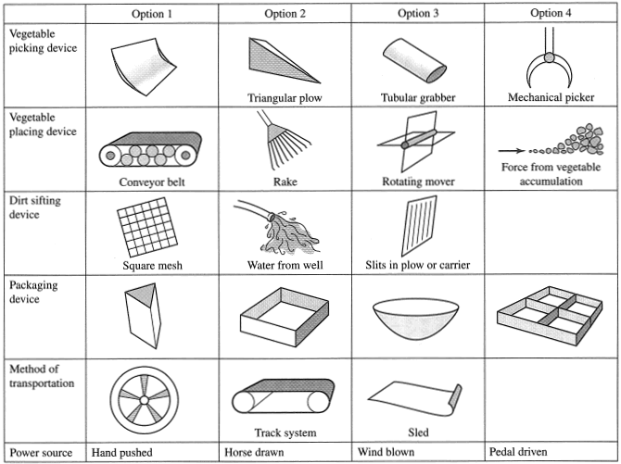
Morphological Analysis
Example

Slide 15
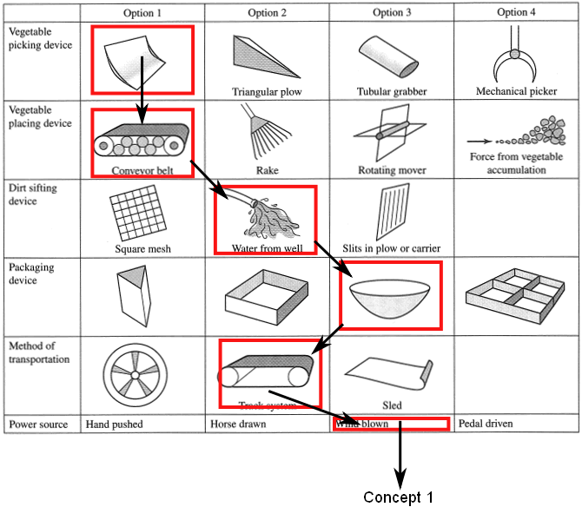
Morphological Analysis
Example

Slide 16
Morphological Analysis
Example – Forklift Truck

Slide 17
Embodiment Design
Product architecture
Configuration design of parts and components (feature present like holes, ribs, splines, and curves are configured). Modeling and simulation may be performed. The generation of physical model of the part with rapid prototyping processes may be appropriate)
Parametric design of parts and components (exact dimensions and tolerances, materials and processes, robustness)
The Embodiment Design phase is the part of the design process which is concerned about the production of the product concept, the engineering and the economical feasibility. The production contains the parts making and the product assembling.

Slide 18
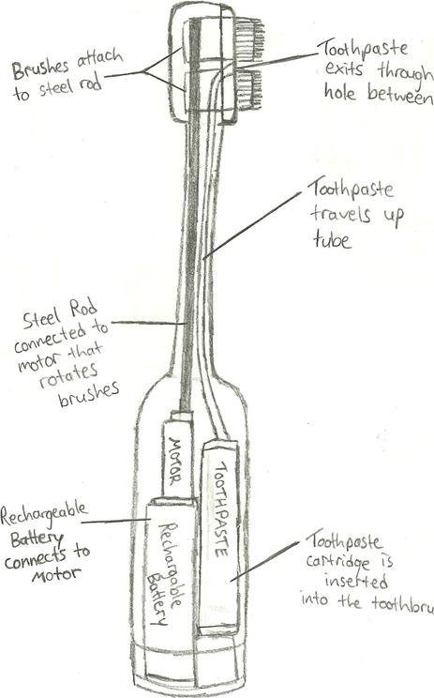
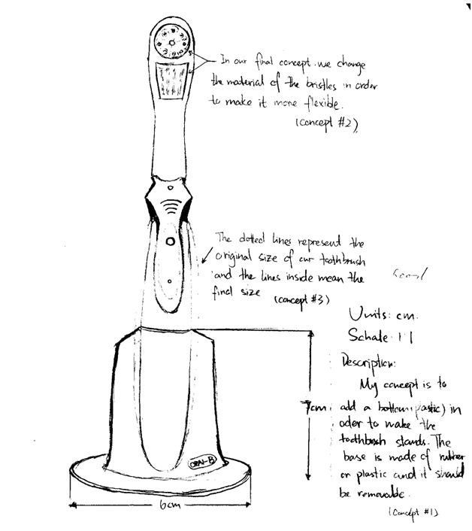
Embodiment Design
Example – Electric Toothbrush
2
1

Slide 19
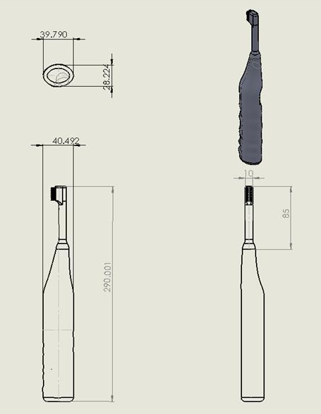
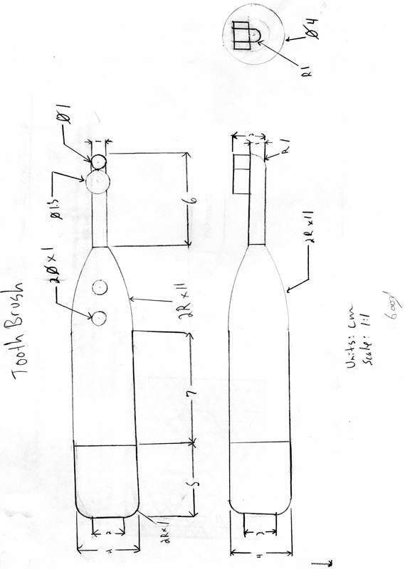
Embodiment Design
Example – Electric Toothbrush
4
3

Slide 20
Ethics at the Conceptual Stage
In your groups discuss how ethical issues or moral theories could be relevant at the conceptual stage
Make a list of your findings and try to think of some examples
We shall discuss it after you complete your group discussion

Slide 21
Summary of the Lecture
Difficulty with Conceptual Design
Conceptual Design
  Ideation
  Brainstorming
  Function Means Tree
  Morphological Chart
    Design Interpretation for Next Generation Products
    Flexible Design for Families
Ethics at the Conceptual Design Stage
Embodiment Design

Slide 22
Backup

Slide 23
