Slide 1
Design Process Tools
Ideation & Brainstorming
Dr. Mohammad O. Hamdan

Slide 2
Contents - Objectives
Ideation
Brainstorming
Ethics at Ideation State

Slide 3
Review of Last Lecture
Why Design is important?
Why Design is difficult?
What are the Design Schools of thoughts?

Slide 4
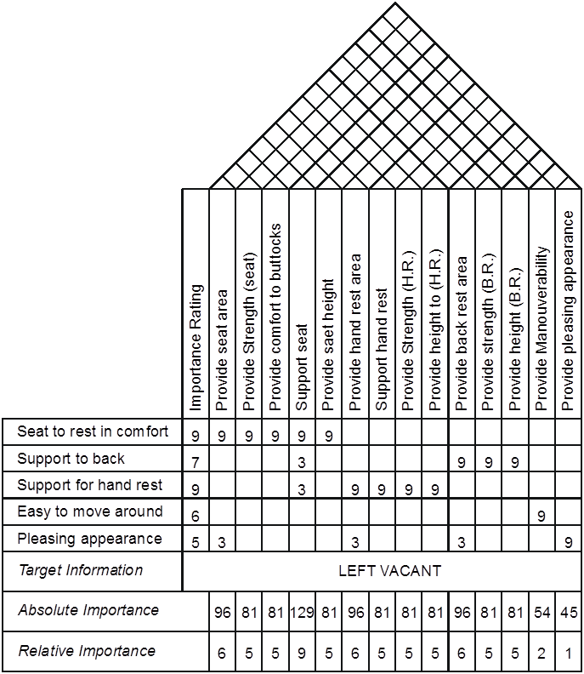
Systematic Design Process
QFD
Requirements
Specifications
Conceptual Design
Embodiment Design
Detailed Design
Prioritize requirements
Specifications
Requirements

Slide 5
Ideation and Brainstorming
Conceptual Design Tools:
Ideation.
Brainstorming.
Morphological Analysis.
Design Interpretation for Next Generation Products.
Flexible Design for Families.

Slide 6
Ideation
Ideation is the process of creating more ideas for a design solution by asking structured questions.
Ideation relies on the fact that when there are several ideas the chances for it to have a good one is higher than the chances when the number of ideas are few.

Slide 7
Ideation Questions
What is wrong with it?
Make a list of all things that you feel are wrong with the present product, idea or task.
(Coke can).
How can I improve it?
Forgetting feasibility list all the ways you would improve the present product, idea or task.
(Dyson Hoover).
Other uses: What other uses does it have in its present form? What other uses are there if the idea is modified? Can it perform a function that was not originally intended?
Food processor and mill.

Slide 8
Ideation Questions
Modify: Change, trim, shape, description, weight, sound, form, contours etc.
(Toothpaste tubes).
Magnify: Make larger, higher, longer, wider, heavier, stronger.
Large aircraft as a solution to traffic congestion.
Minify?: Make smaller, shorter, narrower, lighter, subtract something, miniaturize.
E.g. Old electric motors were huge in size. Modern motors are relatively very small.

Slide 9
Ideation Questions
Adopt? Is there something similar? What can be copied? Can it be associated with something else? Is there something in stock or surplus that can be used?
(E.g. Sausage, Aluminium).
Reverse? Try a twist: opposites, upside down, turn around, rearrange, opposite pattern, opposite sequence.
E.g. Lifting wheel barrow and push down wheel barrow. Heat from outside to heat from inside kettles.
New Look? Change, colour, form, or style, streamline, use new package or new cover.

Slide 10
Ideation Questions
Old Look? Copy a period, antique, parallel a previous winner, look for prestige features, Trade on ‘They don’t build them like that any more.
E.g. Old models and new models of cars (Volkswagen Beetle).
Rearrange? Try a different order, interchange components, piece together differently, change places.
Cars with engines at the rear. Cars with front wheel drive as opposed to rear wheel drive.
Substitute? – What can take its place? Plastic for metal, metal for plastic, light instead of dark, round instead of square, what other process, principle, theory or method can be used?
Metal bumpers were replaced by plastic bumpers.

Slide 11
Ideation Questions
Combine? Combine ideas, principles, methods, groups, components, hardware, issues.
Computerized control is an example for integrated control.
Simplify? Make it easier, less work, easier to reach, disposable, simple to use, quicker.
Automatic drives instead of Gear Boxes.
Safety? What devices, properties, controls, or sensors, can be added to prevent injury, accident, explosion?
Automatic braking system for trains.
Interlocking of doors of washing machine.

Slide 12
Brainstorming
Brainstorming is a powerful and widely known creative tool.
It is used for generating a large number of ideas, most of which will subsequently discarded, but with perhaps a few novel ideas are being identified as worth following up.

Slide 13
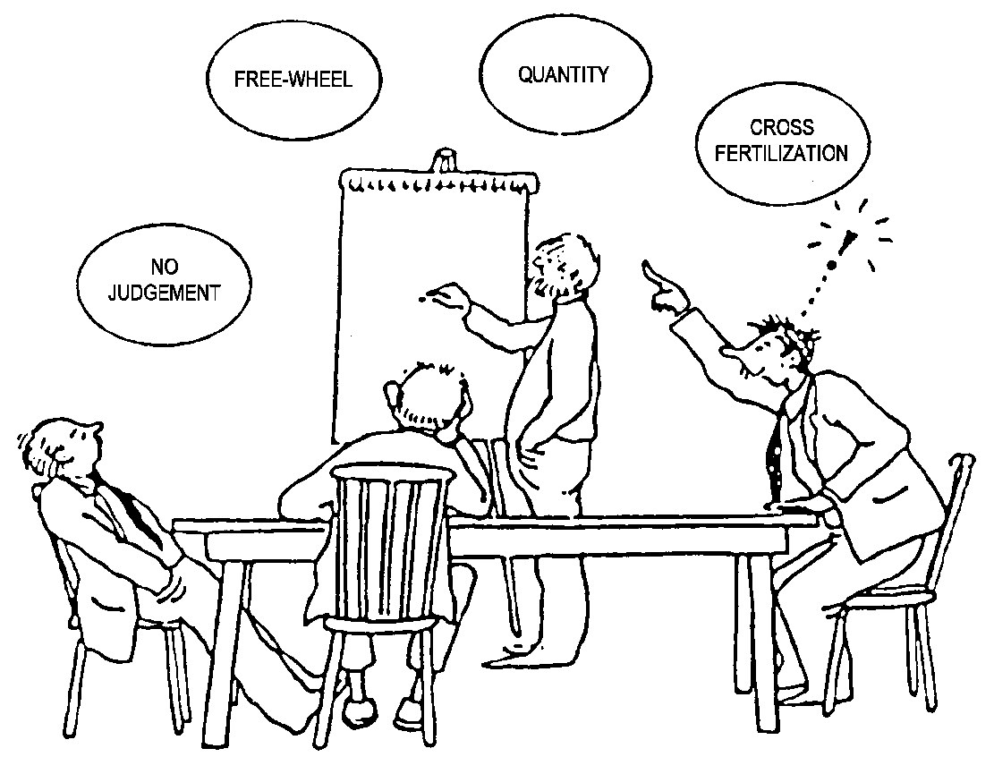
Pitfalls of Classical Brainstorming
Incompetent leaders
Dominating individuals
Passive individuals
Inability to cooperate
Fear of being foolish
Disturbing interruptions.

Slide 14
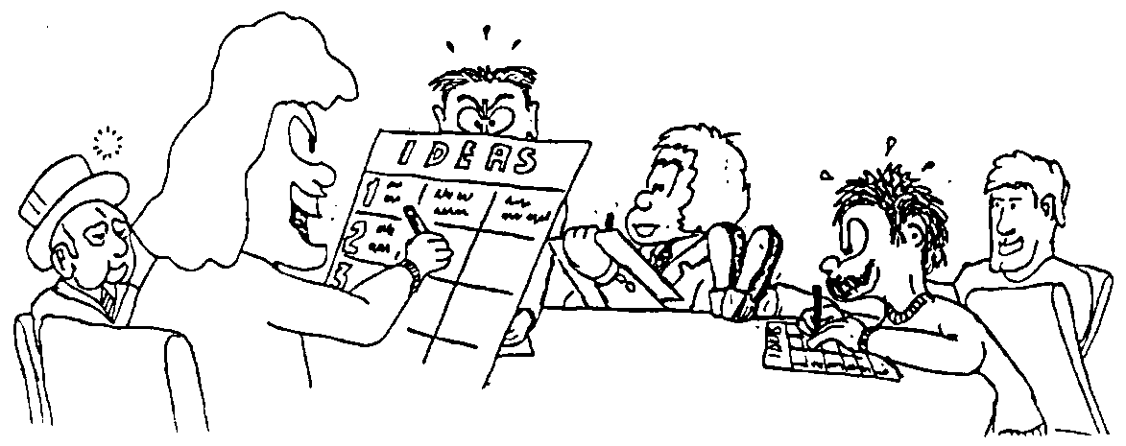
Brainwriting - Method 635
A form of written brainstorming.
Participants write ideas on special forms or cards that circulate within the group.
Gives more time to think than classical brainstorming where the ideas are expressed spontaneously.
Consists of 6 members, each generates and writes down 3 ideas during a 5 minutes period.
The forms are then passed to every participant.
As in the earlier method the leader collates the ideas and submits them for analysis.

Slide 15
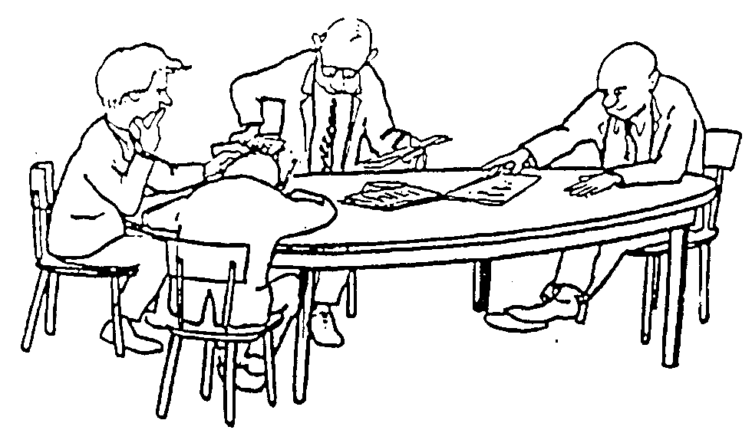
Brain-writing Pool
Each participant starts by writing one or a few ideas on a sheet of paper which is placed in the middle of a table
The writing of ideas is continued on another sheet.
Whenever a participant runs out of ideas or wants to be stimulated by ideas of others, he or she exchanges the sheet with one from the pool.

Slide 16
Ethics at the Conceptual Stage
In your groups discuss how ethical issues or moral theories could be relevant at the conceptual stage
Make a list of your findings and try to think of some examples
We shall discuss it after you complete your group discussion

Slide 17
Further Reading and References
http://www.stanford.edu/group/biodesign/cgi-bin/ebiodesign/index.php/concept-generation/ideation-and-brainstorming-menu
http://jcflowers1.iweb.bsu.edu/rlo/brainstorming2.htm
http://en.wikipedia.org/wiki/Ideation_(idea_generation)

Slide 18
Summary of the Lecture
Covered Design Methods for Conceptual Design
Covered the design method Ideation
Covered the design method Brainstorming

