Slide 1
Decision Matrix

Slide 2
Contents
Understand Decision Matrix
Identify Conceptual Design.
Identify Design Criteria.
Reminder on Representing each stage of the design process.

Slide 3
Decision Matrix
If you have several conceptual ideas, then the decision matrix helps you to select the best one, based on multiple evaluation criteria
The conceptual ideas are rated against criteria the designer decides as relevant to the task.
Conceptual Ideas go on the rows
Design Criteria on the columns

Slide 4
Decision Matrix
The designer decides on importance ratings for each design criteria.
E.g. 3 Criterias: Long, Fast, Strong
Long – 35%
Fast is very important so 50%
Strong is the least important so 15%
All criteria weightings must add up to 100%
This is just an example! You have to come up with your own criteria.

Slide 5
Decision Matrix - Example
This example studies several concepts for a garden leaf remover – to remove leaves that have fallen from trees in a garden. Here are the design criteria… The designer decides on this.
Use of standard parts 8%
Safety 12%
Simplicity and maintenance 10%
Durability 10%
Public Acceptance 18%
Reliability 20%
Performance 15%
Cost to develop 3%
Cost to buyer 4%

Slide 6
Concepts for the Leaf Remover
So the designer comes up with six conceptual ideas. Which one is better?
This is where the decision matrix is used.
For each concept, the designer tries to see how well it achieves each design criteria on a rating from 1 to 10.
So for example the leaf bailer can be 5 out of 10 safe whereas the vacuum collector can be 10 out of 10 safe and for a portable incinerator 4 out of 10 and so on.

Slide 7
Decision Matrix
Sum of (R.F x W.F)
highest number is the best design concept
Conceptual Design ideas
Design Criteria
R.F. x W.F.
e.g. 4 x 0.12 = 0.48
Rating for each concept against the design criteria (R.F)

Slide 8
Decision Matrix
So the chemical decomposer is 8.18 and the vacuum collector is 8.14. These are the two highest final ratings and as they are very close, either of these designs will do.
Possibly seeing ways to integrate the two designs to get the best of both is also an idea.
Remember there is no right or wrong, a lot of this is based on the designer’s decisions.

Slide 9
Decision Matrix
Design decisions should be based on analysis and logic, not personal opinion.
A decision matrix is a design tool that may be used multiple times throughout a design process.

Slide 10
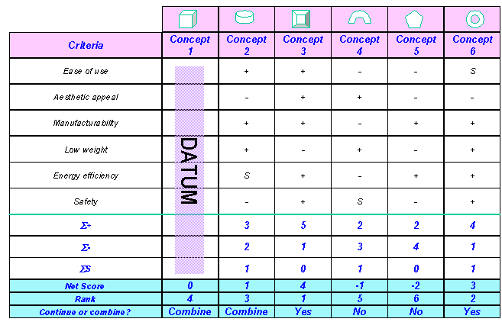
Pugh’s Concept Evolution Method
Aimed at selecting a solution concept, based on multiple evaluation criteria and to combine good features to develop a better concept.

Slide 11
Representing Each Stage
Customer
Specifications
Solution Concept
Embodiments
Details
Requirements
Geometric
Model
Function 1
Part 1
Requirement 1
Subsystem 1
Part 2
Geometric
Part 3
Model
Function 2
Part 4
Requirement 2
Function 3
Part 5
Geometric
Subsystem 2
Part 6
Model
Part 7
Requirement 3
Function 4
Part 8
Geometric
Requirement 4
Model
Function 5
Geometric
Requirement 5
Part 9
Model
Function 6
Subsystem 3
Part 10
Requirement 6
Part 11
Geometric
Function 7
Model

Slide 12
Term Project - Design Project
Development of an Engineering Product
Select a product or a project that you face in daily base and you think it is ethically problematic. Work with your team members (company) on modifying the project to enhance functionality and energy saving. Use systematic design process (first level QFD) to come with a modified design.
Criteria of evaluation depends on proper way addressing:
Design process.
Ethical dilemma and issues.
Team collaboration.

Slide 13
Term Project Structure
Design part: Apply the design process starting with stakeholders until you come up with minimum three concepts. One of the design concepts could be current method used in cleaning high rise building. The design part needs to include the following:
Requirements
Specifications (recommended to show function tree)
Conceptual Design (QFD and DM)
Embodiment Design
Detailed Design (No need)
Ethic part: Evaluate the highest two conceptual design you have developed in the design part. Choose one of these design based on moral basis by creating the following steps:
Ethical Dilemma: select proper design based on moral basis
Relevant Facts: for the highest two conceptual design
Involved Parties/factors: list the parties
Relevant code of ethics: Use NSPE
Moral framework: Select two frameworks that support your moral decision.
Conclusion: Indicate the Designer selection and the Ethic Engineer selection (indicate if they will agree on one design or not)

