Slide 1
Engineering Design Process
Systematic Design
Dr. Mohammad O. Hamdan
Mechanical Engineering Department

Slide 2
Objectives of this lecture
Systematic Design
Requirements
Specifications
Function Tree
QFD
Systematic Design process.
Understand Requirements and Specifications
Introduction to Function Tree.
Introduction to Quality Function Deployment (QFD).
Ethics at the Requirements, Specifications and QFD stages.

Slide 3
Outcomes
Systematic Design
Requirements
Specifications
Function Tree
QFD
By the end of this lecture, you will be able to:
Apply the design process using systematic design methods to develop engineering components [c, k].
Identify customer requirements.
Identify engineering specifications and constraints.
Create Function Tree and a stage 1 ‘QFD’ Chart

Slide 4
Review of Last Lecture
Systematic Design
Requirements
Specifications
Function Tree
QFD
Why Design is important?
Why Design is difficult?
What are the Design Schools of thoughts?
What are the pitfalls of classical Brainstorming?
Answer by True or False:
  [ ] The customers of a product are only the end-users.
  [ ] Conventional design has more opportunities for weakness Identification.

Slide 5
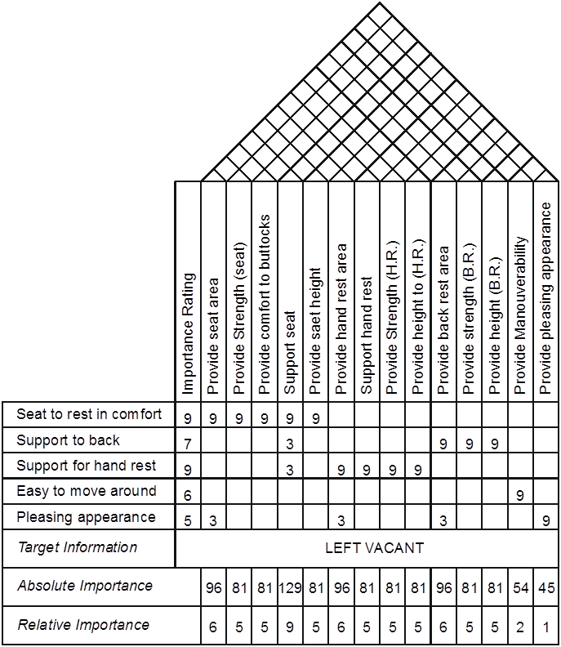
Systematic Design Process - Steps
Systematic Design
Requirements
Specifications
Function Tree
QFD
Requirements
Specifications
Conceptual Design
Embodiment Design
Detailed Design
QFD: Quality function deployment
QFD
Prioritize Specifications
Specifications
Requirements

Slide 6
(1) Requirements
Systematic Design
Requirements
Specifications
Function Tree
QFD
Requirements are a ‘wish list’ that the product needs to do (Expected).
This is usually given by the customers or sponsors or even as a list of requirements in the designer’s mind.
They are not usually technical.
E.g. for a coffee cup … ‘something that will hold coffee’ etc…
Let us find requirement for a “kettle”.

Slide 7
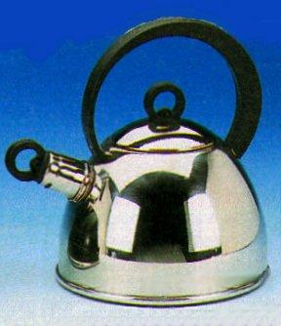
e.g. The Need for a Kettle
Systematic Design
Requirements
Specifications
Function Tree
QFD
The need of the society was a vessel that will transfer heat from an energy source to water, keep the temperature close to the boiling point and safely transfer the boiled water into the coffee mug or tea cup.
Resources of Requirements:
Market Segments
Economical/Political
Research & Development

Slide 8
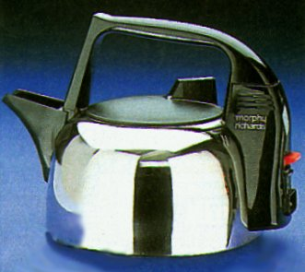
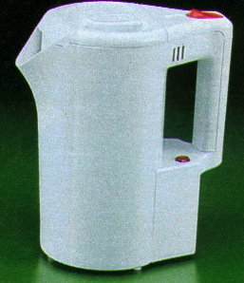
e.g. The Need for a Kettle
Market Segments
Systematic Design
Requirements
Specifications
Function Tree
QFD
Gas fire kettles.
Electric kettles for travel and small users.
Electric kettles for large and small number of cups with energy efficiency.
Electric kettles with aesthetically pleasing appearance for the affluent users.

Slide 9
e.g. The Need for a Kettle
Requirements for a Kettle
Systematic Design
Requirements
Specifications
Function Tree
QFD
List some requirements for a Kettle?!!
Heat varied amounts of water
Energy efficient
Easy to move around
Safe handling during pouring
Aesthetically (beauty) pleasing surface
Boil water fast
Automatic switching off from the energy source or alert user when water is boiling
- - - - - -
3
5
1
9
7
8
9
Importance Rating to rank the requirements

Slide 10
Problems of requirements analysis
Systematic Design
Requirements
Specifications
Function Tree
QFD
Stakeholders don’t know what they really want.
Stakeholders express requirements in their own terms.
Different stakeholders may have conflicting requirements.
Organizational and political factors may influence the system requirements.
The requirements change during the analysis process. New stakeholders may emerge and the business environment may change.

Slide 11
Requirements elicitation(clarification)
Systematic Design
Requirements
Specifications
Function Tree
QFD

Slide 12
Requirements elicitation
Systematic Design
Requirements
Specifications
Function Tree
QFD
Requirements discovery
  Interacting with stakeholders to discover their requirements. Domain requirements are also discovered at this stage.
Requirements classification and organisation
  Groups related requirements and organises them into coherent clusters.
Prioritisation and negotiation
  Prioritising requirements and resolving requirements conflicts.
Requirements specification
  Requirements are documented and input into the next round of the spiral.

Slide 13
(2) Specifications
Importance of Systematic Design
Requirements
Specifications
Function Tree
QFD
A specification is a description of the product that is generated beforehand to guide the development of the product.
It lays down the requirements in technical terms for the product to be designed.
It usually converts the ‘requirements’ into Engineering terms.
Specifications are what the product SHOULD DO.
Constraints are the opposite of specifications and describe what the product CANNOT OR SHOULD NOT DO.
They are usually defined in terms of functions.
Invest on the most important specifications
How to determine the most important one?
QFD

Slide 14
Coffee Cup Example
Systematic Design
Requirements
Specifications
Function Tree
QFD
The requirements of a Coffee cup
Reasonable size for sufficient quantity of hot coffee with minimum possibility of accidental spilling.
Carried by hand without burning the hand.
Aesthetically pleasing.
Specifications of a Coffee Cup (without measure)
Provide Storage for hot coffee
Provide Stability when placed on the tray or table
Allow Minimum heat loss
Allow For easy holding and tipping
Protect Hands from burning
Provide Easily washable surfaces (smooth, non-sticky)
Provide Aesthetically pleasing appearance

Slide 15

e.g. Khalifa Tower
Specifications and Constraints!!!
Systematic Design
Requirements
Specifications
Function Tree
QFD

Slide 16
Requirements vs. Specifications
Systematic Design
Requirements
Specifications
Function Tree
QFD
Requirements | Specifications
Wish list for the product EXPECT to do | What the product SHOULD DD What the product SHOULD NOT DO
From stakeholder (Customer, Designer, R&D, Political-Economical conditions) | From Designer
Not technical terms | Usually technical terms
There is many specifications. How to itemize them?
Function Tree

Slide 17
Systematising Functions To Function Tree
Systematic Design
Requirements
Specifications
Function Tree
QFD
Specifications describe the functions performed by the product in order to meet the requirements of the customer. They usually have a measure attached to them. e.g. power source should last more than 36 hours of continuous use.
Functions often have underlying law of physics or engineering.
Systematising Functions means drawing relationships between individual functions that need to be performed by the object of analysis, and then showing those relationships on a chart (Function Tree).

Slide 18
Function Tree
Systematic Design
Requirements
Specifications
Function Tree
QFD
Why we need Function Tree. To helps the designer:
  To identify the high order functions (Level One).
  To identify the links among functions of the product.
  To create alternatives to be designed or improved.

Slide 19
Components of Function Description
Systematic Design
Requirements
Specifications
Function Tree
QFD
Involves asking the question What is its action?
Example of Functions
  Glue A and B
  Separate C and D
Advantages:
  Makes it possible to identify each function clearly.
  Makes functions understandable to anyone.
  Makes it easier to come up with ideas.

Slide 20
Function Tree e.g. Light Bulb
Systematic Design
Requirements
Specifications
Function Tree
QFD
high order functions
Level Two
Level Three
Level One
There are many specifications. How to itemize them?
Function Tree

Slide 21
Systematic Design Process - Steps
Systematic Design
Requirements
Specifications
Function Tree
QFD
Requirements
Specifications
Conceptual Design
Embodiment Design
Detailed Design
QFD
What is a QFD?

Slide 22
QFD - Quality Function Deployment
Systematic Design
Requirements
Specifications
Function Tree
QFD
Know as a house of quality which is drawn to measure requirements against specifications.
This method allows each stage of the design process to be measured quantitatively on how well it is achieving the previous stage and hence how good the design is.
Prioritize Specifications
Specifications
Requirements

Slide 23
QFD - Quality Function Deployment
Systematic Design
Requirements
Specifications
Function Tree
QFD
QFD Around for Nearly 50 Years.
Japanese professors Yoji Akao and Shigeru Mizuno developed it in the late 1960s.
First implemented at Mitsubishi Heavy Industries, Kobe Shipyard in 1972
QFD was first introduced to America and Europe in 1983.
Toyota strongly influenced adoption of QFD in North America
  Between 1977-1984 achieved a 61% reduction in product development cost, a 33% reduction in product development cycle, and virtual elimination of rust related warranty problems.
American automotive manufacturers, Ford and GMC soon adopted it. Later, other American companies such as General Electric, IBM and AT&T.

Slide 24
QFD Chart 1 (House of Quality)
Systematic Design
Requirements
Specifications
Function Tree
QFD
5
CORRELATION MATRIX
3
SPECIFICATIONS
1
2
8
Let us build the HOUSE
4
Customer
Importance Rating
RELATIONSHIP MATRIX
REQUIREMENTS
BENCHMARKING
6
ABSOLUTE RATINGS
7
RELATIVE RATINGS

Slide 25
QFD Chart 1 (House of Quality)
Systematic Design
Requirements
Specifications
Function Tree
QFD
5
CORRELATION MATRIX
3
SPECIFICATIONS
1
2
8
4
Customer
Importance Rating
RELATIONSHIP MATRIX
REQUIREMENTS
BENCHMARKING
6
ABSOLUTE RATINGS
7
RELATIVE RATINGS

Slide 26
Stage 1 Chart – Requirements & Specifications
Systematic Design
Requirements
Specifications
Function Tree
QFD
Each requirement is given a rating from 1 – 9 (9 is the most important)
e.g. if safety is very important it can be rated 9 etc.
Each specification is then rated in relationship to each requirement. This is to find out how well each specification addresses each requirement.
If there is NO relationship, leave the grid space blank
If there is a slight or weak correlation, rate as 1
If there is medium correlation, rate as 3
If there is high/strong correlation, rate as 9
Specifications
e
s
c
k
n
c
a
o
)
)
y
r
)
t
a
.
.
)
t
a
t
t
a
.
i
e
a
R
R
l
u
e
.
e
R
)
i
p
e
b
t
r
.
H
r
.
.
b
p
s
h
a
H
(
a
B
R
a
g
a
(
o
t
t
(
t
(
.
r
a
n
h
t
g
s
s
h
o
s
B
e
g
i
e
t
t
i
e
e
t
t
h
(
v
t
r
g
r
e
r
r
g
e
t
u
n
a
a
o
h
t
r
g
t
o
i
R
t
n
f
t
t
d
d
n
h
k
n
h
n
s
a
e
m
a
e
n
n
e
g
c
e
g
a
e
r
e
a
a
r
i
r
i
a
e
c
e
t
o
s
a
h
t
e
a
t
e
M
l
n
s
S
c
t
s
h
t
S
h
b
s
h
p
a
e
e
e
r
e
e
r
e
e
e
e
e
e
e
t
d
d
d
o
d
d
o
d
d
d
d
d
d
d
r
i
i
i
p
i
i
p
i
i
i
i
i
i
i
o
v
v
v
p
v
v
p
v
v
v
v
v
v
v
p
o
o
o
u
o
o
u
o
o
o
o
o
o
o
m
r
r
r
r
r
r
r
r
r
r
r
r
I
P
P
P
S
P
P
S
P
P
P
P
P
P
P
Requirements
Relationship Matrix
Seat to rest in comfort
9
9
9
9
9
9
Support to back
7
3
9
9
9
Support for hand rest
9
3
9
9
9
9
Easy to move around
6
9
Pleasing appearance
5
3
3
3
9
Target Information
LEFT VACANT
Absolute Importance
96
81
81
129
81
96
81
81
81
78
81
81
54
45
Relative Importance
6
5
5
9
5
6
5
5
5
5
4
4
3
3

Slide 27
Stage 1 Chart – Requirements & Specifications
Systematic Design
Requirements
Specifications
Function Tree
QFD
Multiply each specification rating by it’s corresponding requirement importance rating and add up the column to get the absolute importance rating.
Eg for the first specification (Provide seat area):
(9 x 9) + (3 x 5) = 96
The highest absolute rating becomes the benchmark value and is given a relative importance of 9. All other specifications are then weighted to this value.
E.g. 129 is the maximum value - becomes 9
For 1st specification 96/129 x 9 = 6 rounded down
e
s
c
k
n
c
a
o
)
)
y
r
)
t
a
.
.
)
t
a
t
t
a
.
i
e
a
R
R
l
u
e
.
e
R
)
i
p
e
b
t
r
.
H
r
.
.
b
p
s
h
a
H
(
a
B
R
a
g
a
(
o
t
t
(
t
(
.
r
a
n
h
t
g
s
s
h
o
s
B
e
g
i
e
t
t
i
e
e
t
t
h
(
v
t
r
g
r
e
r
r
g
e
t
u
n
a
a
o
h
t
r
g
t
o
i
R
t
n
f
t
t
d
d
n
h
k
n
h
n
s
a
e
m
a
e
n
n
e
g
c
e
g
a
e
r
e
a
a
r
i
r
i
a
e
c
e
t
o
s
a
h
t
e
a
t
e
M
l
n
s
S
c
t
s
h
t
S
h
b
s
h
p
a
e
e
e
r
e
e
r
e
e
e
e
e
e
e
t
d
d
d
o
d
d
o
d
d
d
d
d
d
d
r
i
i
i
p
i
i
p
i
i
i
i
i
i
i
o
v
v
v
p
v
v
p
v
v
v
v
v
v
v
p
o
o
o
u
o
o
u
o
o
o
o
o
o
o
m
r
r
r
r
r
r
r
r
r
r
r
r
I
P
P
P
S
P
P
S
P
P
P
P
P
P
P
Seat to rest in comfort
9
9
9
9
9
9
Support to back
7
3
9
9
9
Support for hand rest
9
3
9
9
9
9
Easy to move around
6
9
Pleasing appearance
5
3
3
3
9
Target Information
LEFT VACANT
Absolute Importance
96
81
81
129
81
96
81
81
81
78
81
81
54
45
Relative Importance
6
5
5
9
5
6
5
5
5
5
4
4
3
3

Slide 28
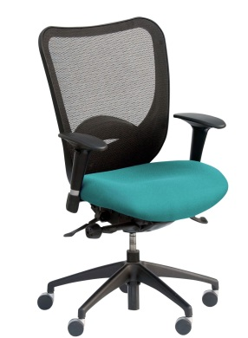
Desk Chair QFD
Specifications
 | Importance rating (weight 1 to 9) | Provide support to seating area | Use of cushion | Allow changing elevation | Use leather cover | Provide arm support | Allow arm location modification | Provide back support
Comfertable seat | 9 | 3 | 9 | 9 | 3 | 3 | 3 | 9
Support to back | 7 |  | 3 | 3 | 3 |  |  | 9
Change hight | 9 | 3 |  | 9 |  | 1
Pleasant look | 6 |  |  | 1 | 9 | 3 | 1 | 3
Arm support | 5 |  |  | 1 |  | 9 | 9
Absolute rating |  | 54 | 102 | 194 | 102 | 99 | 78 | 162
Relative rating |  | 2 | 4 | 9 | 4 | 4 | 3 | 7
Requirements

Slide 29

Desk Chair QFD
Specifications
 | Importance rating(weight 1 to 9) | Block UV radiation | Use none scratchable surfaces | Allow different color & shapes | Use nose pads | Provide strong support frame | Allow foldable frame | Provide ears sleeve support
Safe | 9 | 9 | 9 |  | 3 | 9 | 1 | 1
Easy to clean | 5 |  | 3 | 1 |  |  | 1
Convenient & easy to store | 8 |  | 1 |  | 9 | 1 | 9 | 3
Pleasant look | 9 |  | 3 | 9 | 3 |  | 3 | 3
Easy to ware | 6 |  |  | 1 |  |  | 3 | 9
Durable | 6 | 3 | 9 |  | 1 | 9 | 9
Absolute rating |  | 99 | 185 | 92 | 132 | 143 | 185 | 114
Relative rating |  | 4 | 9 | 4 | 6 | 6 | 9 | 5
Requirements

Slide 30
QFD Process
HOWs
HOWs
WHATs
WHATs
HOW MUCH
HOW MUCH

Slide 31
QFD Charts
Systematic Design
Requirements
Specifications
Function Tree
QFD
Specifications
House #1
Customers House
Conceptual Designs
House #2
Company House
Requirements
Embodiments
House #3
Process House
Specifications
Materials & Mfg. Processes
House #4
Process Control House
Conceptual...
Production Plans
Embodiments
Materials...

Slide 32
Benefits Of Adopting QFD
Systematic Design
Requirements
Specifications
Function Tree
QFD
Reduced time to market
Reduction in design changes
Decreased design and manufacturing costs
Improved quality
Increased customer satisfaction

Slide 33
Ethics & the early stages of design
Importance of Design
Difficulty of Design
Identifying Customers
Conventional Design
Systematic Design
Requirements
Specifications
QFD
Try to identify what ethical issues could arise during the requirements and specifications stage of the design process.
Discuss ethical issues related to the QFD.
In your groups, identify and list these down.

Slide 34
Ethics & the early stages of design
Ethics Case Study: An engineering working on designing an automobile. The engineer used QFD method to evaluate the product and come up with the most important specification in design. He found out that “providing robust engine” ranked 1st , and “Allow smooth transmission” ranked 2nd during QFD study. The engineer works for transmission department and have been asked by the CEO (chief executive officer )of the company to modify the numbers so the QFD lead to redesign of the of transmission.
What is the ethical dilemma to the engineer and the CEO?
What the claim should be for the engineer and the CEO?
What moral frameworks and NSPE code that support your answer.
Importance of Design
Difficulty of Design
Identifying Customers
Conventional Design
Systematic Design
Requirements
Specifications
QFD

Slide 35
Further Reading and References
Importance of Design
Difficulty of Design
Identifying Customers
Conventional Design
Systematic Design
Requirements
Specifications
QFD
http://www.clemson.edu/ces/cedar/images/6/6e/Systematic_Design_Process.pdf
http://www.sciencebuddies.org/engineering-design-process/engineering-design-process-steps.shtml#theengineeringdesignprocess
For QFD: http://www.isixsigma.com/tools-templates/qfd-house-of-quality/quality-function-deployment-competitive-advantage/
http://en.wikipedia.org/wiki/Engineering_design_process

Slide 36
Conclusions
Importance of Design
Difficulty of Design
Identifying Customers
Conventional Design
Systematic Design
Requirements
Specifications
QFD
You should now be able to:
Understand the importance and challenges of design
Appreciate the difference between conventional and systematic design
Describe the systematic design process
Identify all types of Customers and their requirements
Identify engineering specifications and constraints
Create a stage 1 ‘QFD’ Chart and calculate the importance ratings
Understand that the design process is there to help you but it will not make the design for you.
Your problem solving skills and creativity are STILL NEEDED!

Slide 37
QFD Summary
Orderly Way Of Obtaining Information & Presenting It
Shorter Product Development Cycle
Considerably Reduced Start-Up Costs
Fewer Engineering Changes
Reduced Chance Of Oversights During Design Process
Environment Of Teamwork
Consensus Decisions
Preserves Everything In Writing

Slide 38
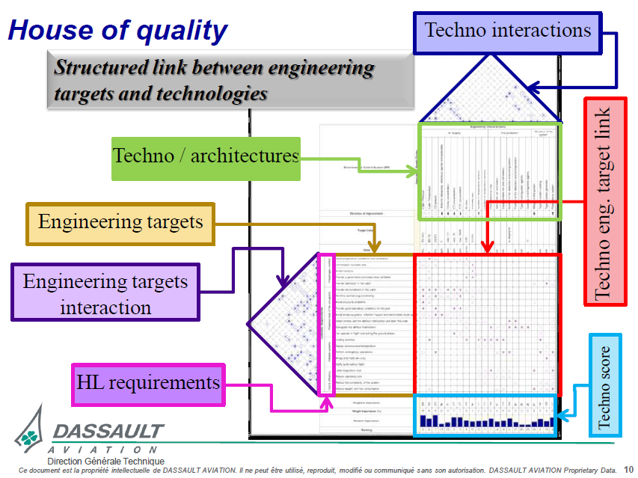
Advanced Example

