Slide 1
Engineering Design
Importance of Engineering Design

Slide 2
Objectives of this lecture
Importance and challenges of Engineering design
Introduction to Engineering Design Process

Slide 3
Outcomes
By the end of this lecture, you will be able to:
Understand the importance and challenges of design
Appreciate the difference between conventional and systematic design
Describe the systematic design process
Identify who your Customers are

Slide 4
Skills needed by a designer
Sketching, technical drawing, CAD
Creativity, problem solving, project management
Properties of materials, manufacturing
Applications of science, eg. Chemistry (e.g. corrosion protection, painting, plating)
Statics, structures, dynamics, strength of materials, kinematics, and mechanisms, stress analysis
Electrical and Electronics
Fluid Mechanics, thermodynamics, heat transfer
Fluid Power, electrical phenomena, industrial controls
Environmental Issues
Experimental Design, performance testing of materials
Oral Communication, listening, writing, teamwork skills
Awareness of feasibility and cost issues
Safety and Ethical Issues and legislations.

Slide 5
How this lecture fits in…
So far you have covered the essential skills a designer needs e.g.:
Team Work and forming companies
Research
Report writing
Communication skills (Presentations)
This lecture will give you the necessary tools and steps to enable you to start designing any engineering product.
Future lectures will focus on these steps in more detail as well as ethical aspects.

Slide 6
Why Design is Important?
Importance of Design
Difficulty of Design
Identifying Customers
Conventional Design
Systematic Design
Without Design, there is no product!
With a poor design, no matter how good the manufacturing methods are, or quality control, etc, the end product will still be a bad idea and no one will buy
Most people will buy something based on the design followed by the quality
What about cost?

Slide 7
Why Design is Important?
Importance of Design
Difficulty of Design
Identifying Customers
Conventional Design
Systematic Design
Most end-users do not know/care about the details or technical features of a product.
They look only at the design … both the functionality of the product and the way it looks.
Think about how people choose to buy a kettle or even a mobile phone.

Slide 8
Why Design is Important?
Importance of Design
Difficulty of Design
Identifying Customers
Conventional Design
Systematic Design

Slide 9
Why Design is Important?
Importance of Design
Difficulty of Design
Identifying Customers
Conventional Design
Systematic Design
Investing at the design stage has the biggest return on investment for a product.

Slide 10
Why Design is Difficult
Importance of Design
Difficulty of Design
Identifying Customers
Conventional Design
Systematic Design
Designers have to predict each step of the product’s life.

Slide 11
Identifying your Customers
Importance of Design
Difficulty of Design
Identifying Customers
Conventional Design
Systematic Design
Everyone has a different opinion / desire on how a product should be designed…
Customers of a product are NOT just the end-users.
Who do you think are customers of an airplane?
Customers include the people that manufacture, maintain, sell, dissassemble… etc.

Slide 12
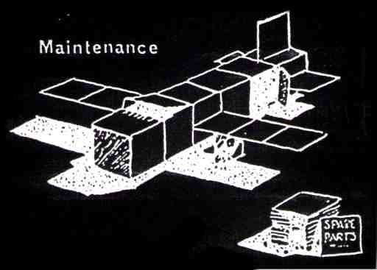
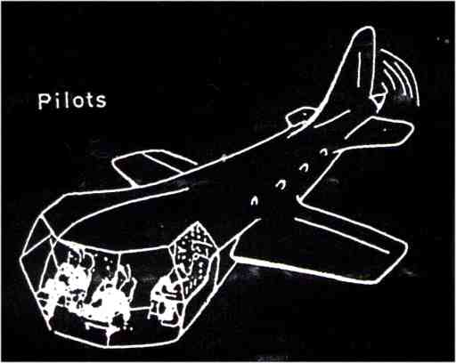
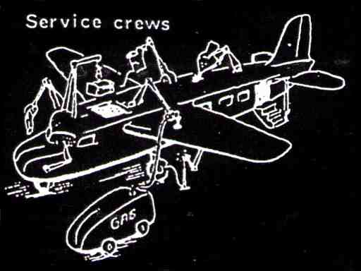
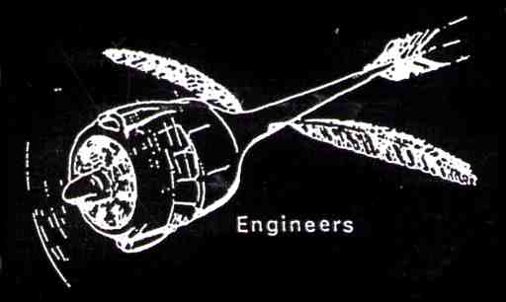
How an Airplane should be Designed – According to:
Accounts

Slide 13
Identifying your Customers
Importance of Design
Difficulty of Design
Identifying Customers
Conventional Design
Systematic Design
Each company… your task as a design team is to identify and list on a piece of paper as many customers as possible for a mobile phone…
You can use the internet to help you.
You have approximately 5mins!

Slide 14
The Design Process
Importance of Design
Difficulty of Design
Identifying Customers
Conventional Design
Systematic Design
Two Schools of thought:
Conventional Design
Systematic Design

Slide 15
Conventional Design
Importance of Design
Difficulty of Design
Identifying Customers
Conventional Design
Systematic Design
Back of the envelope approach
Come up with an idea, test it and improve on it
Successful… first space shuttle was built using conventional design
Usually inefficient way of designing and sometimes there are other better ideas that have not been thought of.

Slide 16
Systematic Design
Importance of Design
Difficulty of Design
Identifying Customers
Conventional Design
Systematic Design
Follows a number of clear predefined steps from the start of the project to its completion
Makes the design approach transparent, rational and independent of a specific branch of industry.
Clear steps
Definite starting and finishing points
More opportunities for weakness Identification
Shorter training time
Broader training
Notes:
In a similar consideration, the Systematic Design approach was introduced and pioneered by Pahl and Beitz and Hubka. Cross gave a good definition for systematic design.

Slide 17
Engineering Design Process
Importance of Design
Difficulty of Design
Identifying Customers
Conventional Design
Systematic Design
Requirements
Specifications
Conceptual Design
Embodiment Design
Detailed Design

