Slide 1
Chapter 9 Global Issues
Dr. Mohammad O. Hamdan

Slide 2
9.1 Multinational Corporations
Multinational corporations conduct extensive business in more than one country. Examples…
Globalization: refers to the increasing integration of nations though trade, investment, transfer of technology, and exchange of ideas and culture.
In the narrow sense: an accelerating integration and interweaving of national economies through the growing flows of trade, investment, and capital across historical borders.
In a more general sense: these flows include technology, skills and culture, ideas, news, information, and entertainment.

Slide 3
9.1 Multinational Corporations
The multinational corporations benefits to home country are:
Inexpensive labor
Natural resources
Favorable taxes
New markets

Slide 4
9.1 Multinational Corporations
The multinational corporations benefits to hosting countries are:
New jobs.
Higher pay rates.
Access to advanced technology.
Social benefits due to wealth-sharing.

Slide 5
9.1 Multinational Corporations
Moral Challenges arise, accompanying business and social complications.
Who loses jobs at home country when manufacturing is taken offshore?
What does the host country lose in resources, control over its own trade, and political independence and individuals?
What are the moral responsibilities of corporations and individuals operating in less economically developed countries?
We need to learn about the concepts Technology Transfer and Appropriate Technology.

Slide 6
Technology Transfer
Technology transfer: is the process of moving technology to a novel setting and implementing it there.
Technology includes both:
Hardware (machines and installations)
Techniques (technical, organizational, managerial skills and procedures)
A variety of agent may conduct the transfer of technology:
Government
Universities
Private volunteer organization
Consulting firms
Multinational Corporations
Transfer Technology is a complex process

Slide 7
Appropriate Technology
Appropriate Technology: refer to identification, transfer and implementation of the most suitable technology for a new set of conditions.

Slide 8
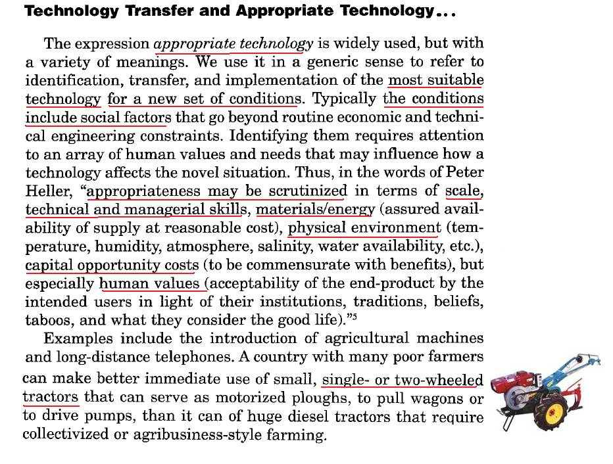

Slide 9
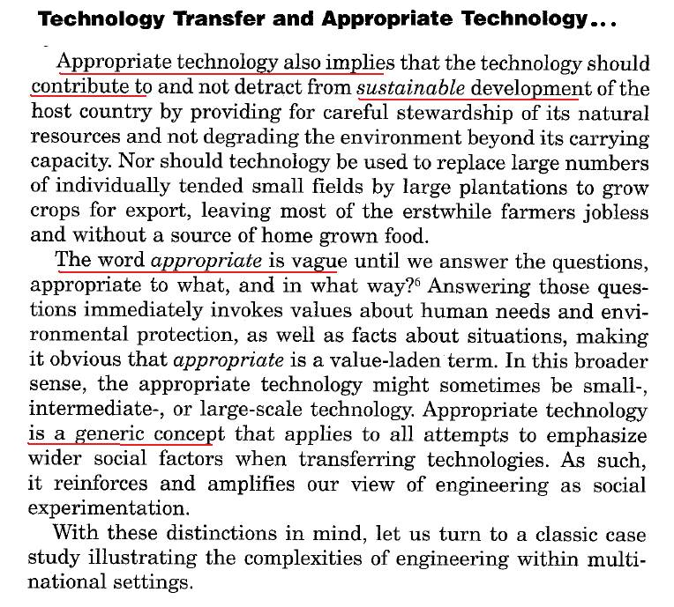

Slide 10
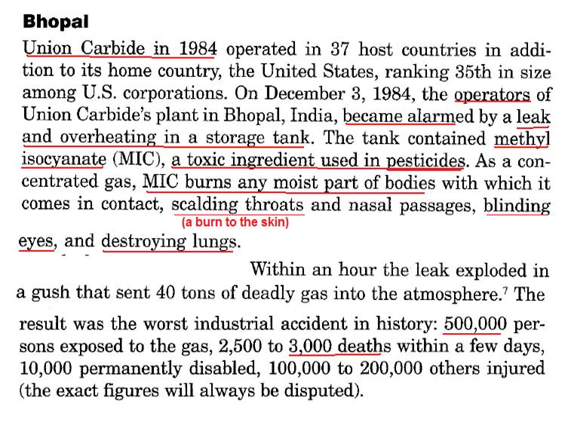
Bhopal Case

Slide 11
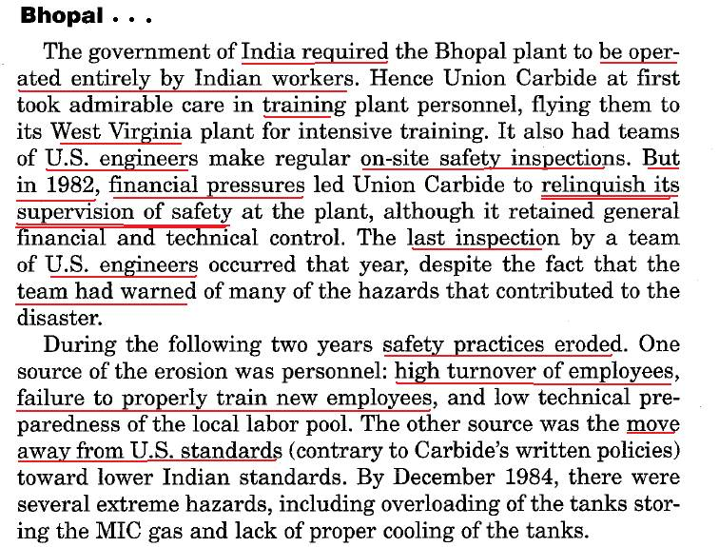

Slide 12
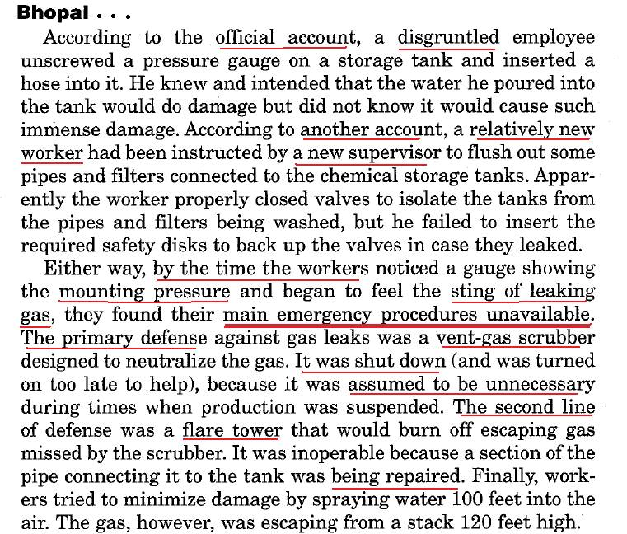

Slide 13
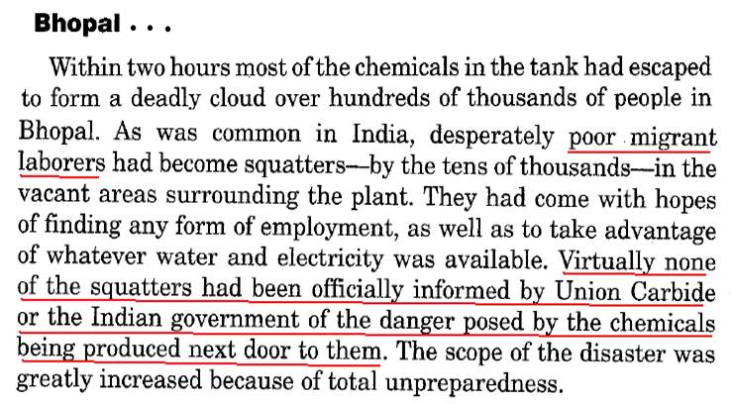

Slide 14
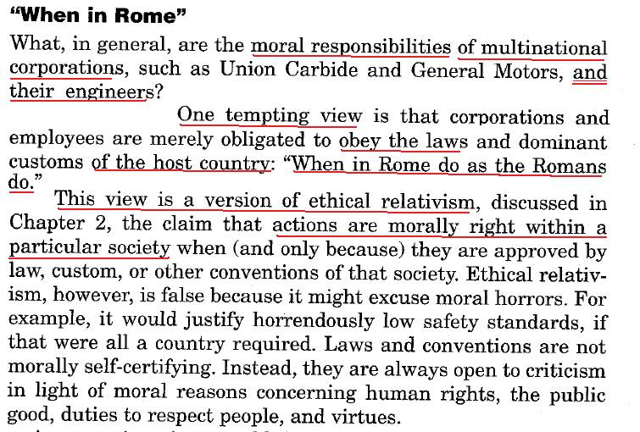
When in Rome do as the Romans do

Slide 15
When in Rome do as the Romans do
What should be the Multinational Corporations Ethics conduct:
Ethical Relativism
Ethical Absolutism
Ethical Relationalism
Ethical Pluralism

Slide 16
When in Rome do as the Romans do
What should be the Multinational Corporations Ethics conduct:
Ethical Relativism: The view that actions are morally right within a particular society when (and only because) they are approved by law, custom, or other conventions of the society.
Ethical Absolutism: The view argues that one should retain precisely the same practices endorsed at home, never making any adjustments to a new culture: whatever is morally true in one place should be morally true everywhere else.

Slide 17
When in Rome do as the Romans do
Ethical Relationalism: this view argues that moral judgments should be made in relation to factors that vary from situation to situation, which makes it impossible to formulate rules that are both simple and absolute. Foreign customs are certainly relevant but they are not decisive in determining what to do in a particular situation.
Ethical Pluralism: this view is consistent with the previous one (relationalism, or contextualism) in that it argues that there is more than one justifiable moral perspective, and a number of morally permissible variations in formulating, interpreting, and applying basic moral principles.

Slide 18
International Rights

Slide 19
International Rights

Slide 21
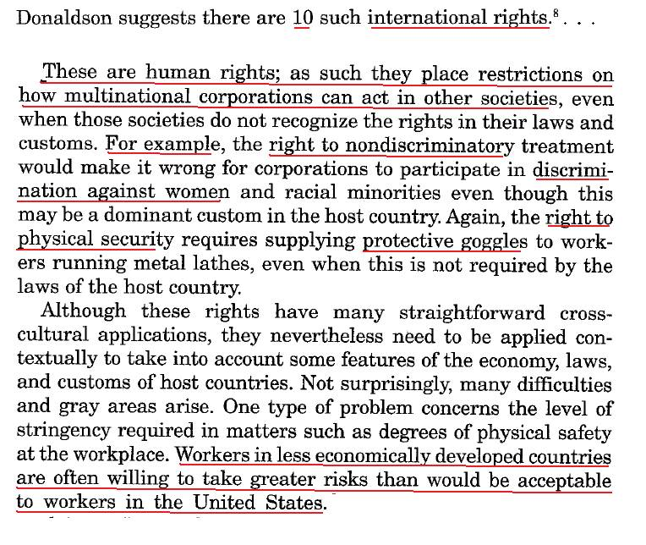

Slide 22
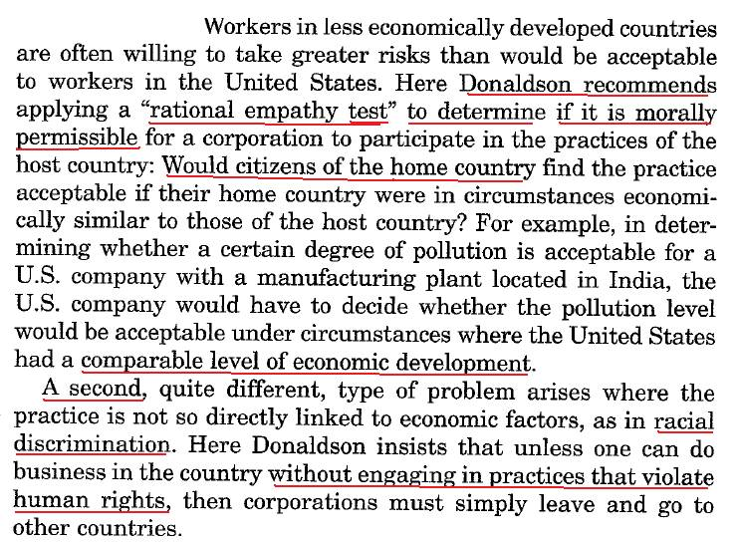

Slide 23
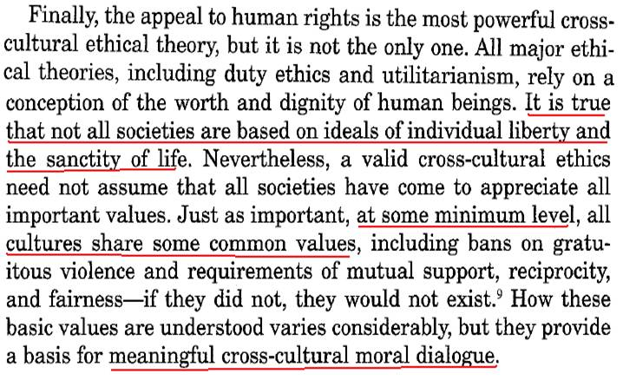
Human rights is the most powerful value across-cultural ethical theory. All ethical theory rely on a conception of the worth and dignity of human beings.
Not all societies are not based on ideals of individual liberty and sanctity of life.
A valid cross-cultural ethics (does not assume that all society have to appreciate all important values however all culture share some common values such fairness and mutual support

Slide 24
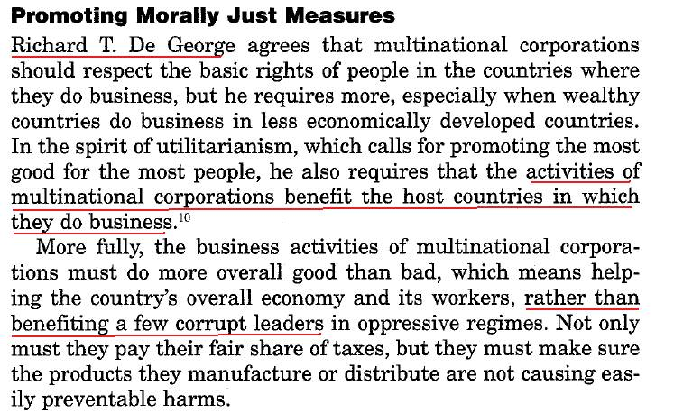
Promoting Moral Just Measures

Slide 25
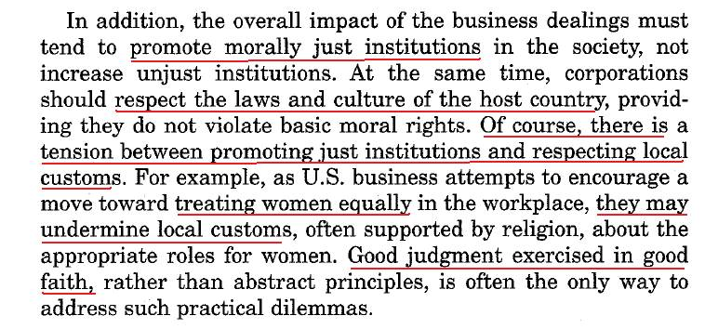

Slide 26
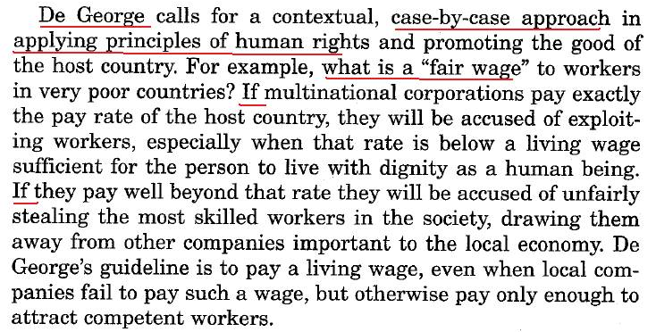

Slide 27
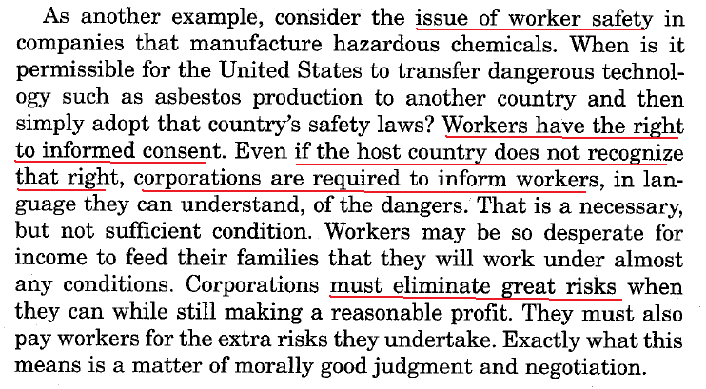

Slide 28
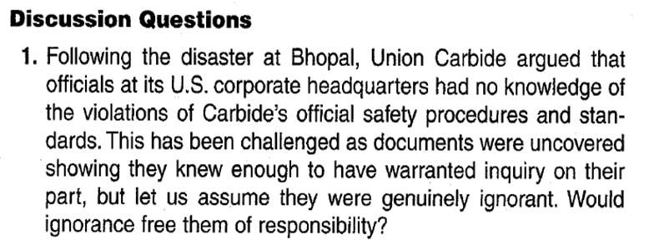

Slide 29
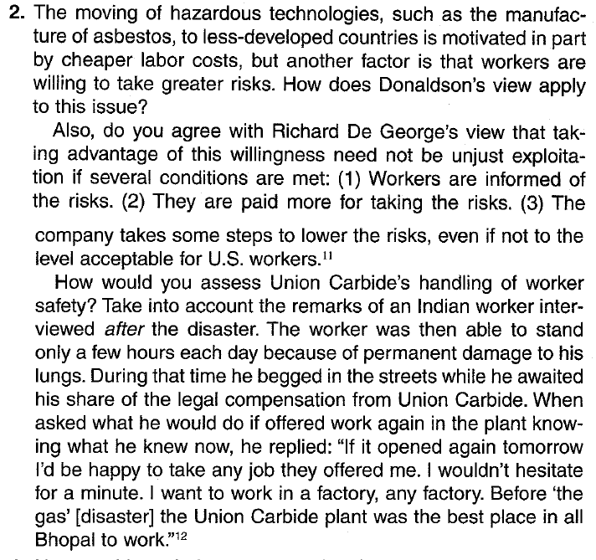

Slide 30
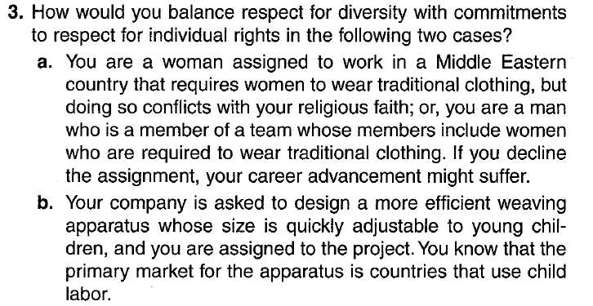

Slide 31
Conclusion
A human right is a moral entitlement that places obligations on other people to treat one with dignity and respect which is a cross cultural moral judgment.

