Slide 1
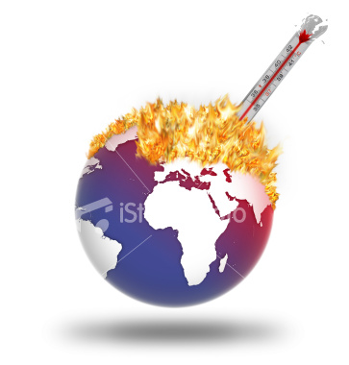
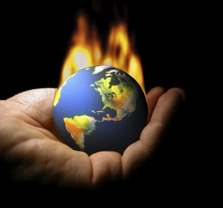
Chapter 8 Environmental Ethics
Dr. Mohammad O. Hamdan

Slide 2
We will learn about:
Sec 8.1: Engineering, Ecology, and Economics.
Sec 8.2: Environmental Ethical Frameworks.

Slide 3
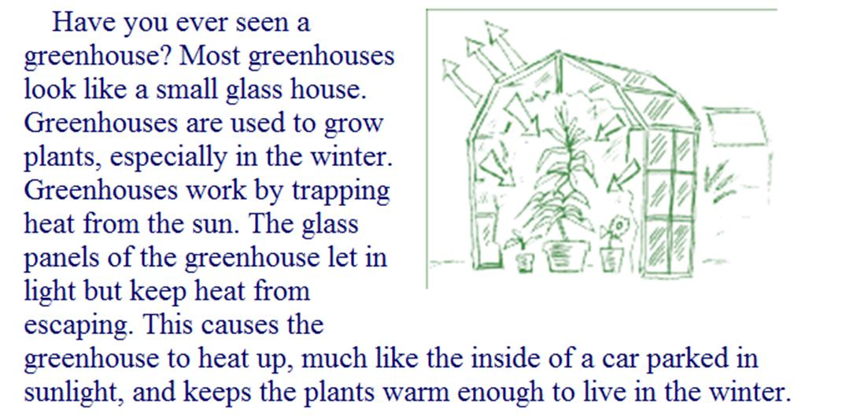

Slide 4
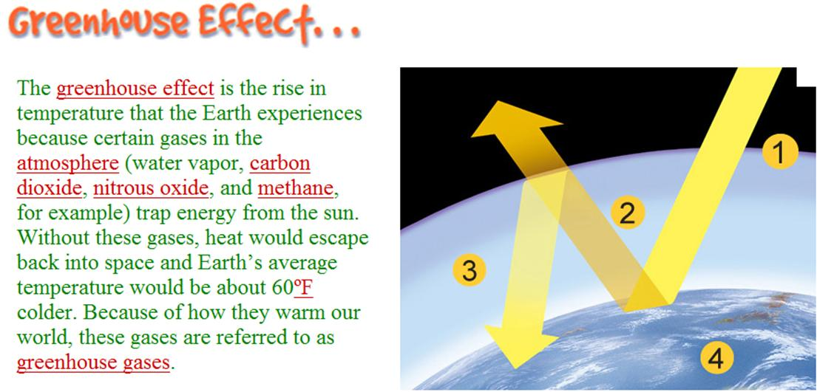

Slide 5
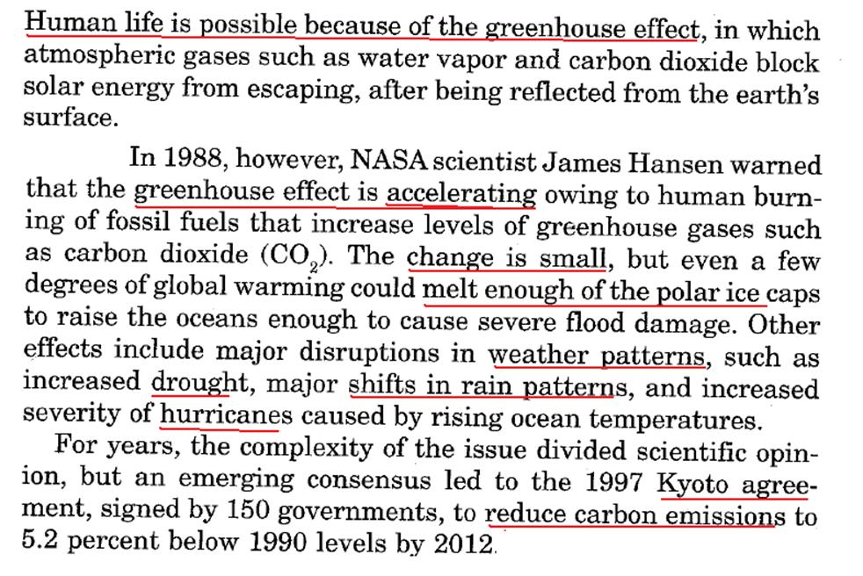

Slide 6
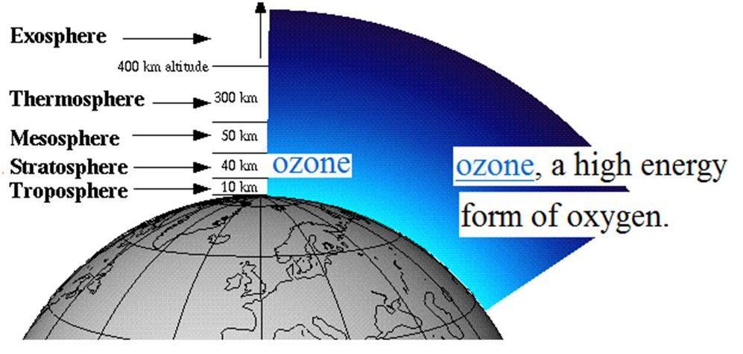

Slide 8
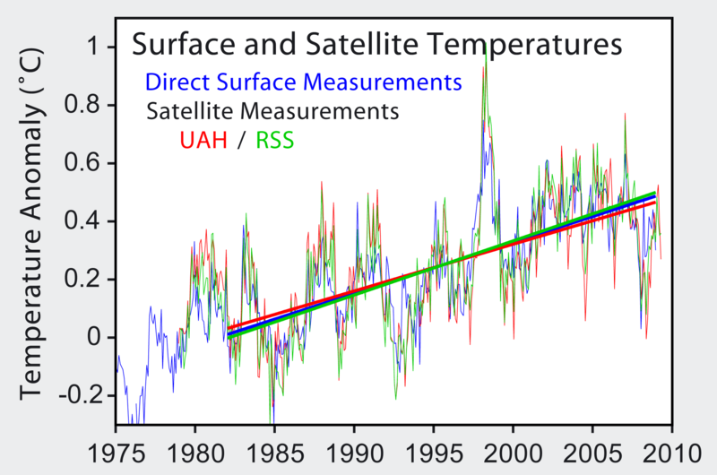
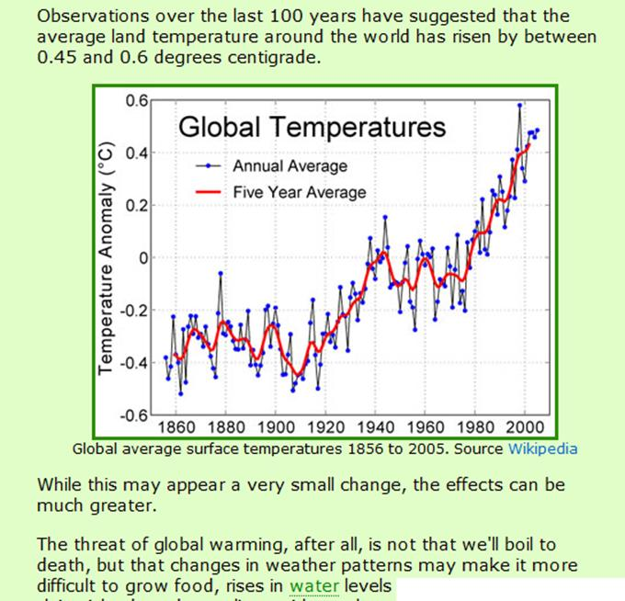

Slide 9
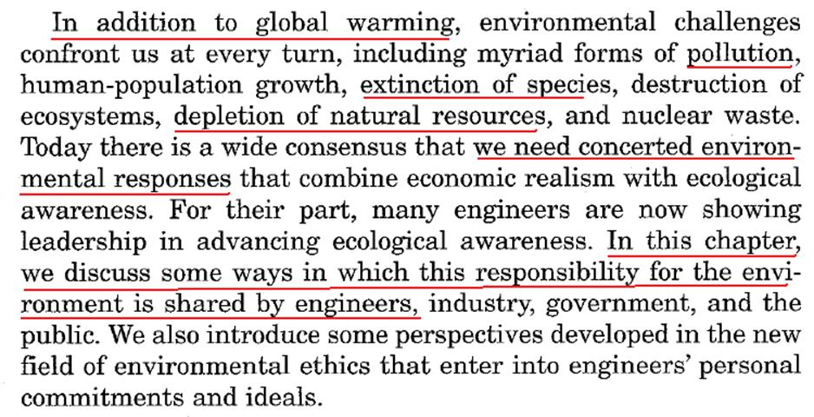
Environmental Challenges
Global warming.
Population rapid growth.
Extinction of species.
Acidic Rain
Destruction of ecosystems.
Depletion of natural resources.
Nuclear waste
Ozone depletion (CFC-Freon)

Slide 10
8.1 Engineering, Ecology and Economics
Ecology: The science of the relationships between organisms and their environments.
The expression Environmental Ethics can have several meanings. We use the expression to refer to:
The study of moral issue concerning the environment
Moral perspective, belief, or attitude concerning these issues.

Slide 11
8.1 Engineering, Ecology, and Economics
Two powerful metaphors have dominated thinking about the environment:
Invisible Hand
Tragedy of the Commons
Both metaphors are used to highlight unintentional impacts of the marketplace on the environment, but one is optimistic and the other is cautionary about those impact. Each contains a large part of the truth and they need to be reconciled and balanced.

Slide 12
(1) The Invisible Hand
The ways in which pursuing self-interest in the competitive marketplace promotes the public good, for example, by providing quality products at lower cost, job, and wealth and philanthropy.

Slide 13
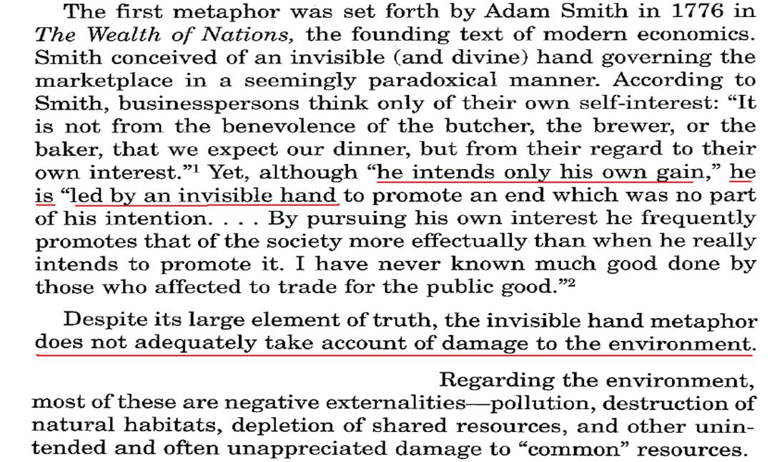
(1) The Invisible Hand

Slide 14
(2) The Tragedy of the Commons
The ways in which the marketplace harms public goods (such as clean air and water) by creating unintended “externalities” that is, harmful effects such as pollution that are not factored into the cost products.

Slide 15
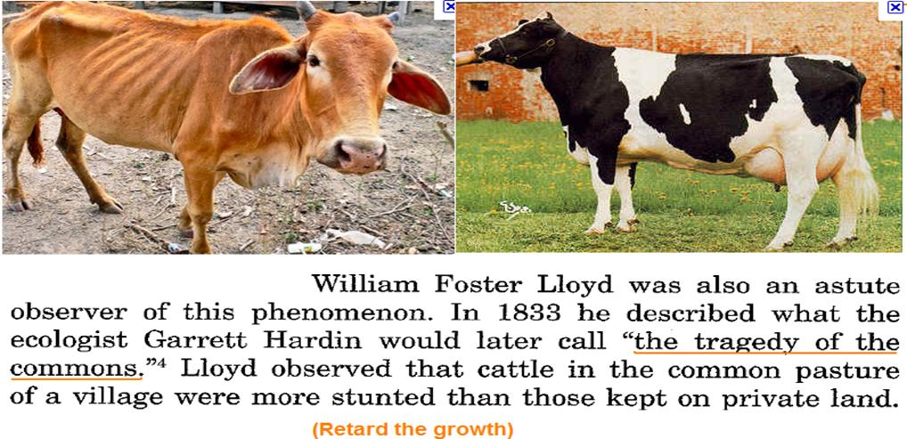

Slide 16
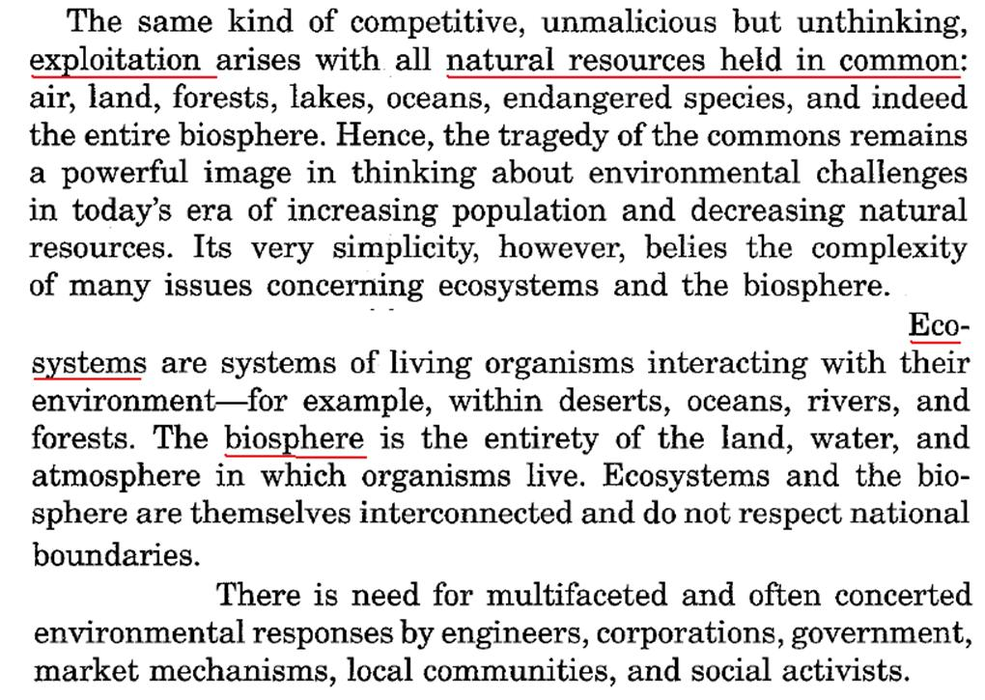

Slide 17
8.1.2 Engineers: Sustainable Development
Defined as economical and technological patterns that are compatible with preserving environmental capacities to sustain future generations.
Sustainable Development (Sustainability): is the development that meets the needs of the present without compromising the ability of future generation to meet their needs.

Slide 18
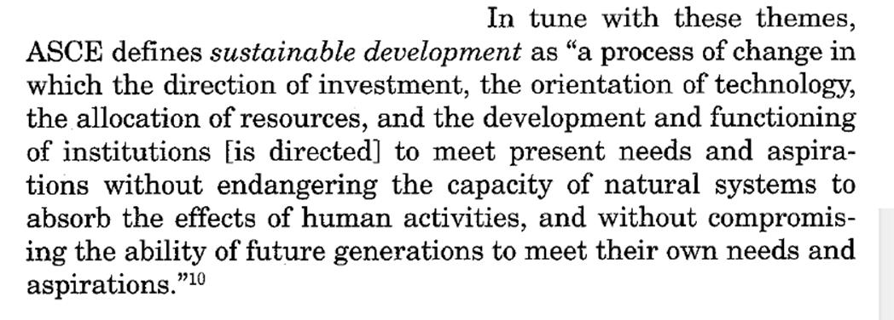
8.1.2 Engineers: Sustainable Development

Slide 19
8.1.2 Engineers: Sustainable Development

Slide 20
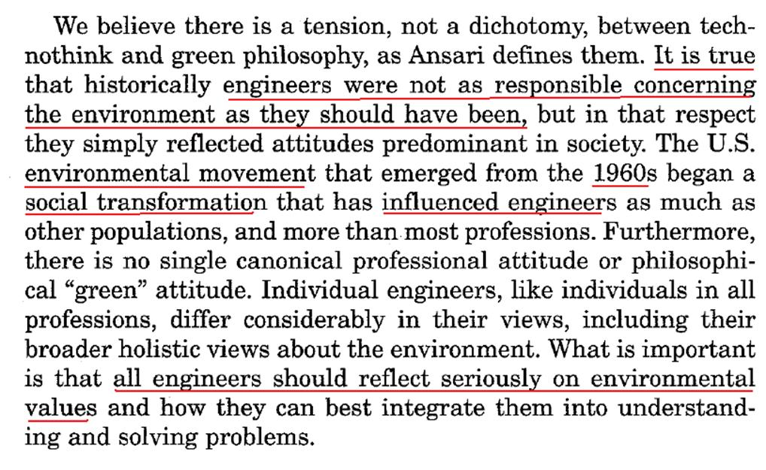
8.1.2 Engineers: Sustainable Development

Slide 21
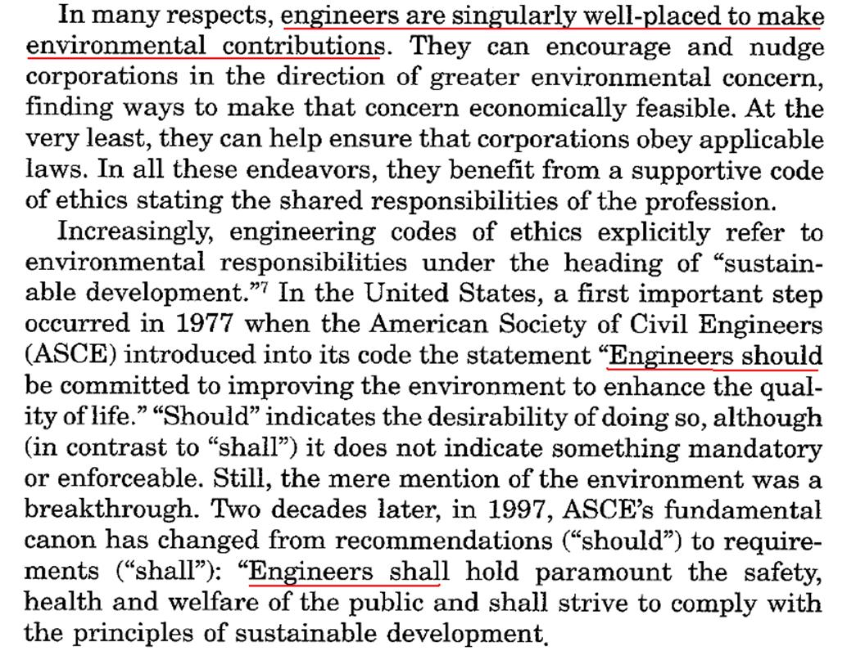

Slide 22
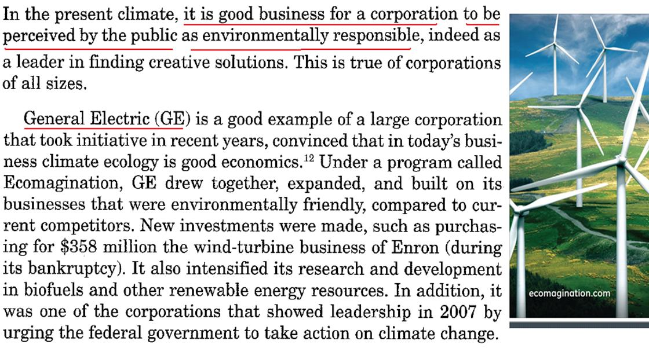
8.1.3 Corporations: Environmental Leadership

Slide 23
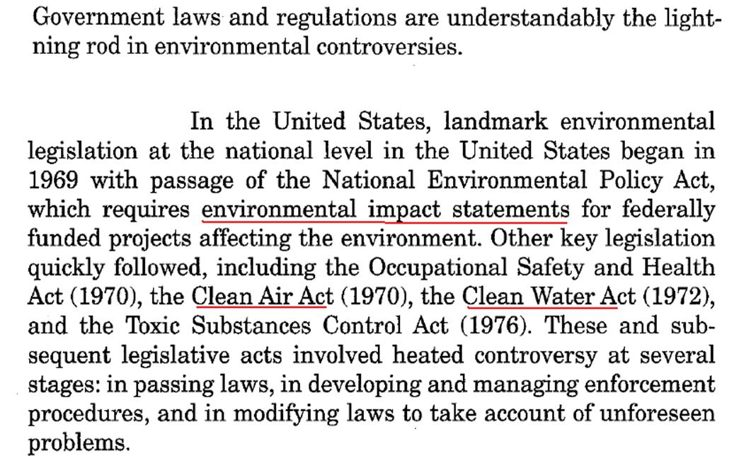
8.1.4 Government: Technology Assessment, Incentives, Taxes

Slide 24
8.1.5 Communities: Preventing Natural Disasters
There is four sets of measures communities can take to avert or mitigate disasters:
Defensive measure
Strengthening the lifelines for essential utilities
Encompasses special-purpose defensive structures
Safe exit in the form roads and passages.
Turkey Earthquake 1999
Awareness campaign in California 2003

Slide 25
8.1.6 Market Mechanisms: Internalizing Costs
The cost of products and services is made to include indirect costs such as the effect of pollution (ex. car battery disposal).

Slide 26
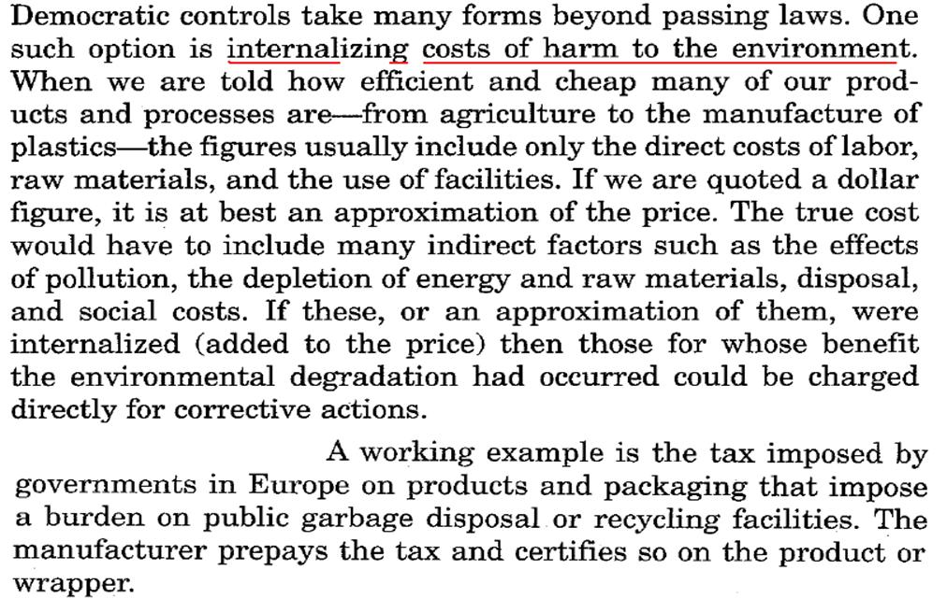
8.1.6 Market Mechanisms: Internalizing Costs

Slide 27
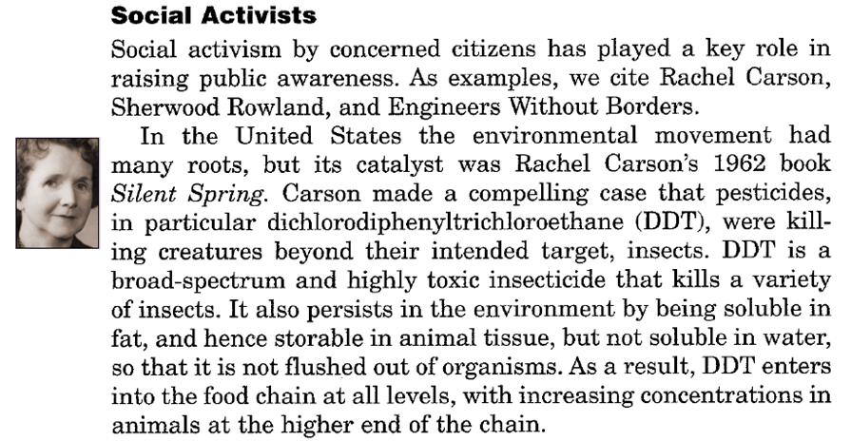
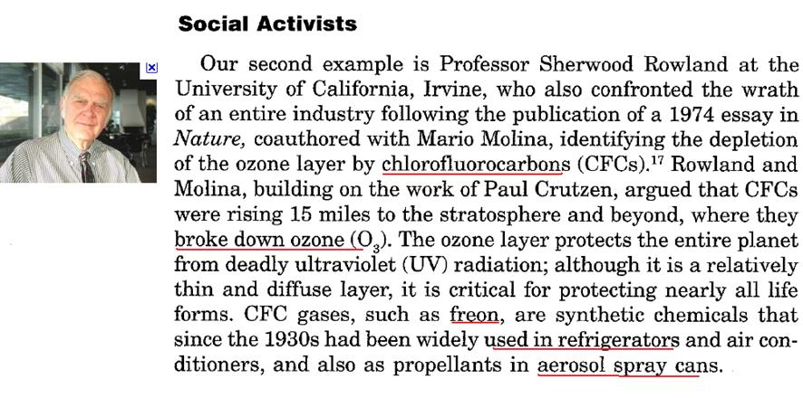
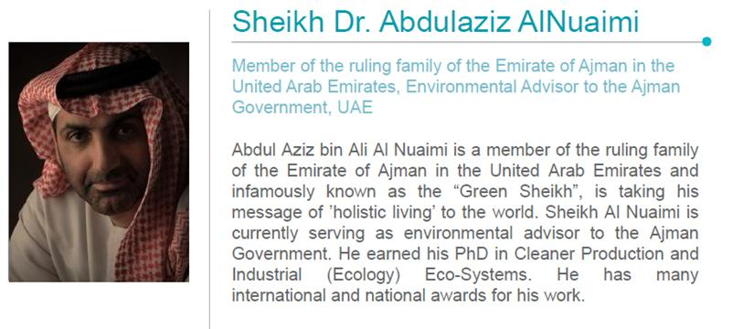
8.1.7 Social Activists

Slide 28
Two Case Studies

Slide 29
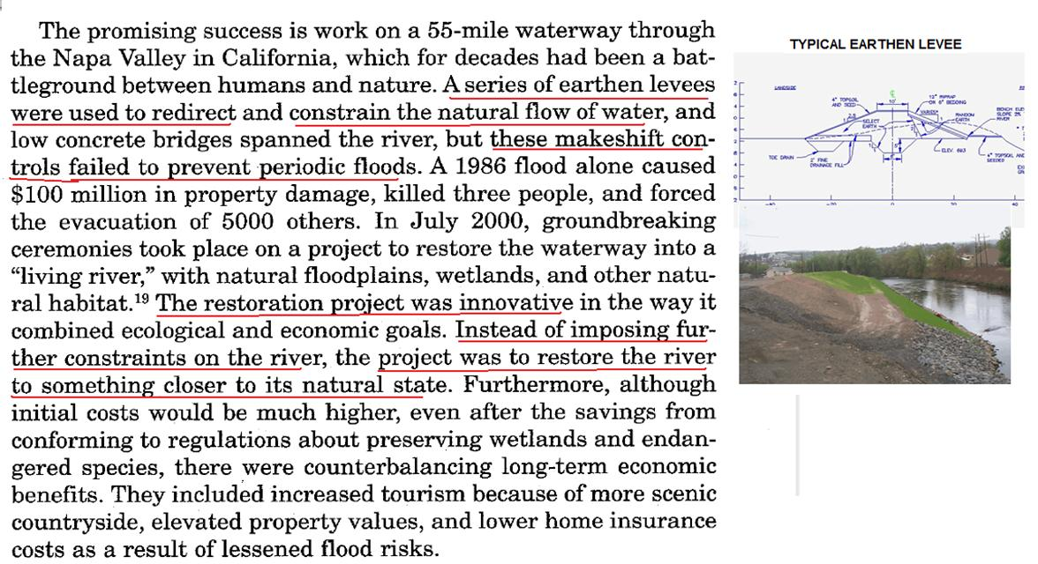
Case (1)

Slide 30
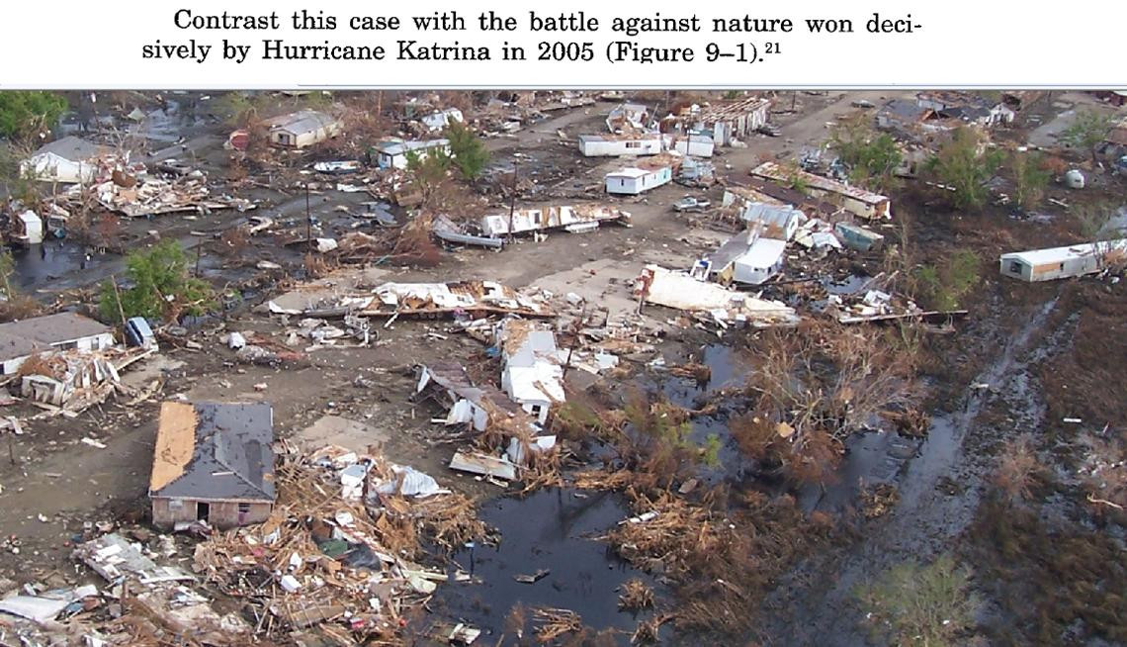
Case (2)

Slide 31
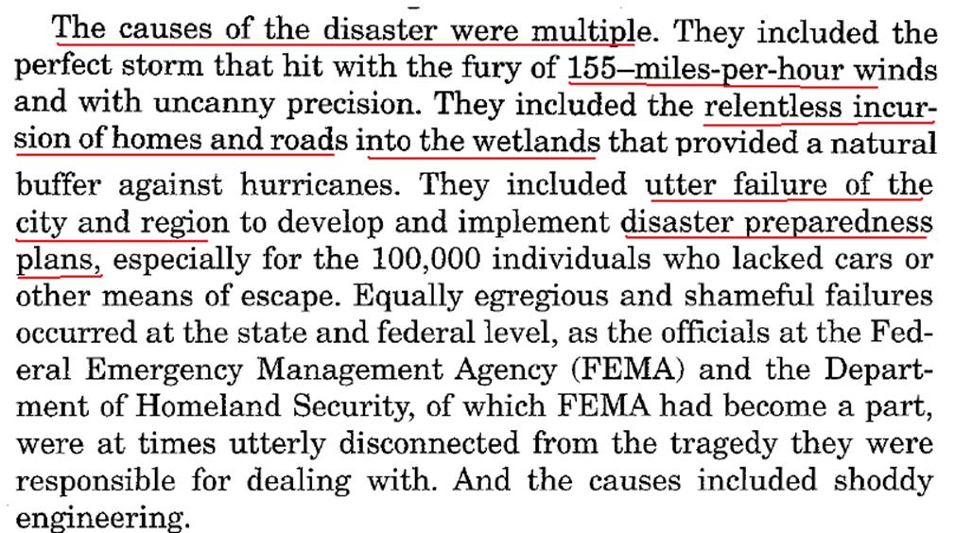

Slide 32
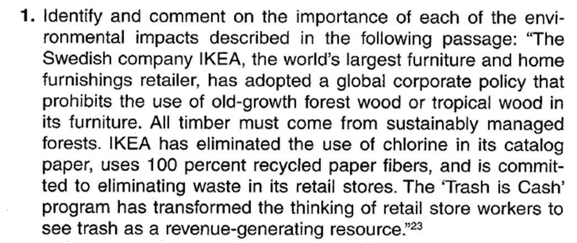
Discussion Question

Slide 33
Environmental and Moral Frameworks
Section 8.2

Slide 34
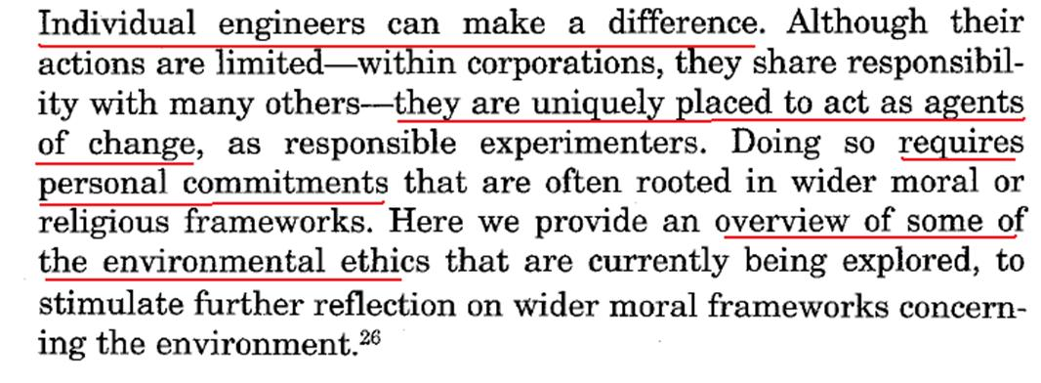
Environmental and Moral Frameworks

Slide 35
Environmental and Moral Frameworks
8.2.1 Human Centered Ethics
8.2.2 Sentient-Centered Ethics
8.2.3 Biocentric Ethics
8.2.4 Ecocentric Ethics
8.2.5 Religious Prospectives
Nature Center Ethics

Slide 36
8.2.1 Human Centered Ethics
The view that only humans have inherent worth and that other creatures and ecosystems have at most “instrumental value” as means to promoting human interest.
Utilitarianism
Right Ethics
Duty Ethics
Virtue Ethics

Slide 37
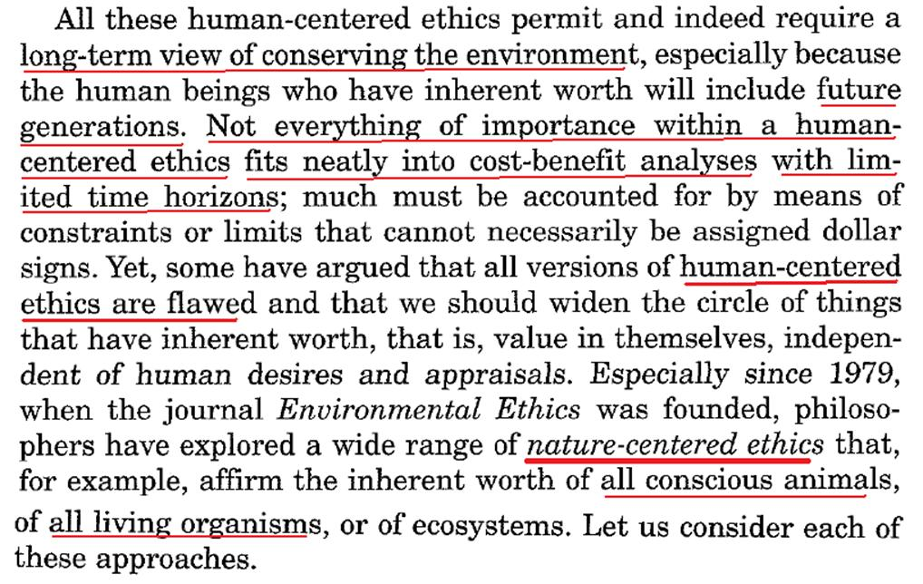
8.2.1 Human Centered Ethics

Slide 38
8.2.2 Sentient-Centered Ethics
The view that all sentient (conscious) animals have inherent worth.
Sentient animals are those that feel pain and pleasure and have desires.

Slide 39
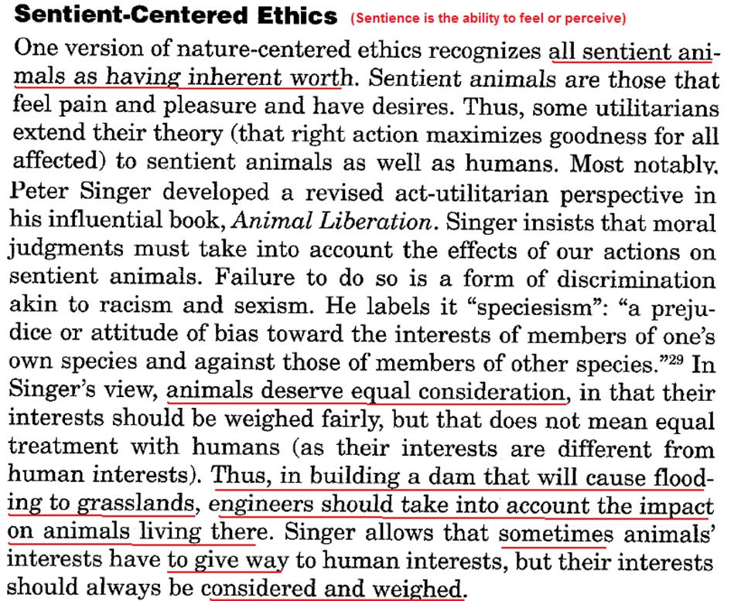

Slide 40
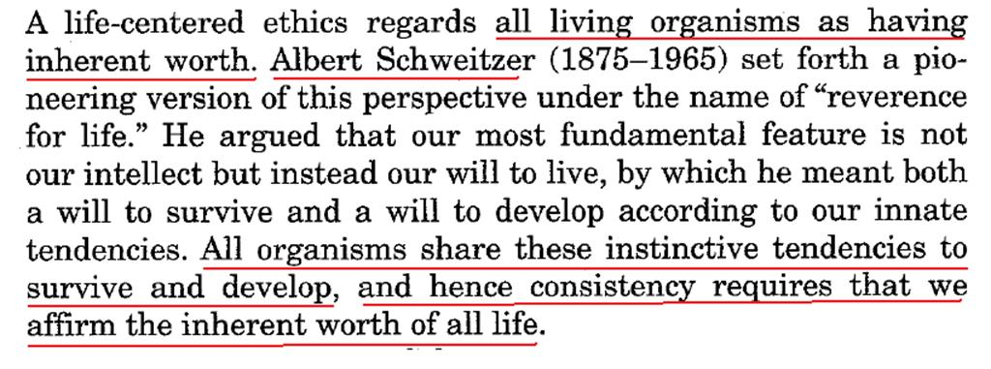
8.2.3 Biocentric Ethics
The view that all living organism have inherent worth.

Slide 41
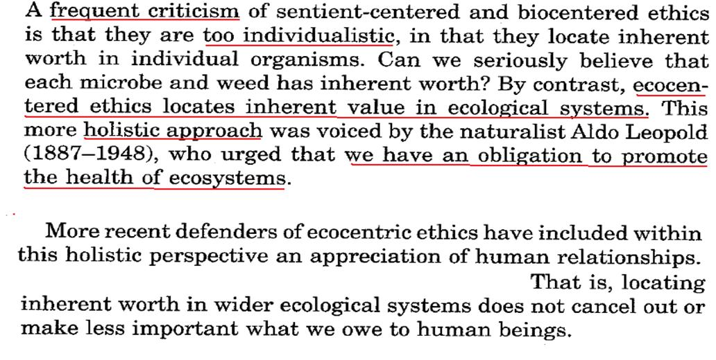
8.2.4 Ecocentric Ethics
The view that ecosystems have inherent worth.

Slide 42
8.2.5 Religious Prospective’s

Slide 43
Conclusion
The environment is no longer the concern of an isolated minority. Engineers, corporations, federal and state laws, local community regulations, market mechanisms, and social activists are among the many influences at work.
Given the complexity of the issues, we can expect controversy among viewpoints, and nowhere is there a greater need for ongoing dialogue and mutual respect.
There is no longer any doubt, however, about urgency and importance of the issues confronting all of us.

