Slide 1
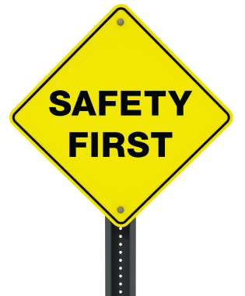
Ch5: Commitment to Safety
Dr. Mohammad O. Hamdan

Slide 2
Course Learning Outcomes
Identify ethical and professional issues pertaining to personal integrity, and professional conduct pertaining to the society and the environment [f].
Apply reasoning to ethically based discriminating decisions taking into account their subsequent legal implications and liabilities [f, d].

Slide 3
Contents
Safety and Risk
Assessing and Reducing Risk
Three Mile Island, Chernobyl, and Safe Exit

Slide 4
Engineering as Experimentation
“A ship in harbor is safe, but that is not what ships are built for”.
John A. Shedd

Slide 5
Risk and Safety
The most important duty of an engineer is to protect the safety and well-being of the public.
What is Safety and what is Risk?
Safety – the condition of being safe from undergoing or causing hurt, injury, or loss .
Risk – The possibility of suffering harm or loss.

Slide 6
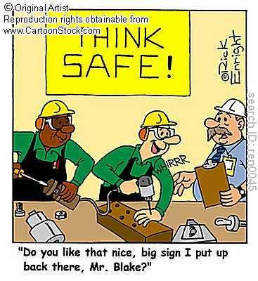
Risk vs. Safety
The definitions of safety and risk are linked
We engage in risky behaviour when we do something that is unsafe.
Something is unsafe if it involves substantial risk.

Slide 7
Safety and Risk
We demand safe products and services, but we also realize that we may have to pay for this safety. To complicate matters, what may be safe enough for one person may not be for someone else. Either because of different perceptions about what is safe or because of different predispositions to harm.
Absolute safety, in the senses of
Entirely risk-free activities and products, or
A degree of safety that satisfies all individuals or groups under all conditions, is neither attainable nor affordable.
Yet it is important that we come to some understanding of what we mean by safety.

Slide 8
Safety Definitions
Safety = Acceptable Risk
Safety = Absence of risk
Safety = Risks are fully known and are judged acceptable by a reasonable person.

Slide 9
The Concept of Safety Lowrance definition
William W. Lowrance: "A thing is safe if its risks are judged to be acceptable.”
This approach helps underscore the notion that judgments about safety are tacitly value judgments about what is acceptable risk to a given person or group.
Examples related to Lowrance definition:
First, a case where we seriously underestimate the risks of something, say of using a toaster we see at a garage sale.
Second, the case where we grossly overestimate the risks of something. For example, we irrationally think fluoride in drinking water will kill a fifth of the public. According to Lowrance's definition, the fluoridated water is unsafe, because we judge its risks to be unacceptable.
Third, there is the situation in which a group makes no judgment at all about whether the risks of a thing are acceptable or not-they simply do not think about it. By Lowrance's definition, this means the thing is neither safe nor unsafe with respect to that group.

Slide 10
The Concept of Safety
One option is simply to equate safety with the absence of risk. Because little in life, and nothing in engineering, is risk-free, we prefer to adopt a modified version of Lowrance's definition:
A thing is safe if, were its risks fully known, those risks would be judged acceptable by reasonable persons in light of their settled value principles.
Safety is often thought of in terms of degrees and comparisons. We speak of something as "fairly safe" or "relatively safe" (compared with similar things).
Using our definition, this translates as the degree to which a person or group, judging on the basis of their settled values, would decide that the risks of something are more or less acceptable in comparison with the risks of some other thing, and in light of relevant information
For example, when we say that airplane travel is safer than automobile travel, we mean that for each mile traveled it leads to fewer deaths and injuries.

Slide 11
Risk
We say a thing is not safe if it exposes us to unacceptable risk; but what is meant by "risk"?
A risk is the potential that something unwanted and harmful may occur.
William D. Rowe refers to risk as: "potential for the realization of unwanted consequences from impending events.“
Risk, like harm, is a broad concept covering many different types of unwanted occurrences. In regard to technology, it can equally well include dangers of bodily harm, of economic loss, or of environmental degradation.

Slide 12
Acceptability of Risk “Safety” and “free of risk”: Subjective
William D. Rowe says that: “A risk is acceptable when those affected are generally no longer (or not) apprehensive (worried) about it.“
Apprehensiveness depends to a large extent on how the risk is perceived. This is influenced by many factors as
Whether the risk is accepted voluntarily;
The effects of knowledge on how the probabilities of harm (or benefit) are known or perceived;
If the risks are job-related or other pressures exist that cause people to be aware of or to overlook risks;
Whether the effects of a risky activity or situation are immediately noticeable or are close at hand;
Whether the potential victims are identifiable beforehand.

Slide 13
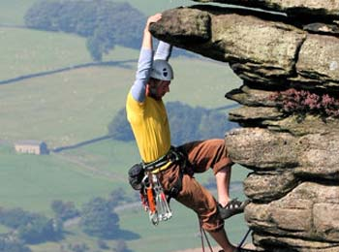
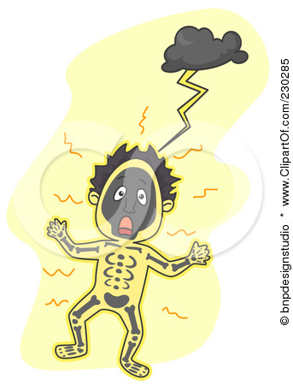
“Safety” and “free of risk”: Subjective
Voluntary vs. involuntary risk.
Short-term vs. long-term consequences.
Expected probability.
Reversible effects.
Delayed vs. immediate effects.

Slide 14
Voluntarism and Control
We are much less apprehensive about the risks to which we expose ourselves voluntarily than about those to which we are exposed involuntarily. In terms of our "engineering as social experimentation" people are more willing to be the subjects of their own experiments (social or not) than of someone else's.
Intimately (closely) connected with this notion (concept) of voluntarism is the matter of control.
Riding motorbikes, skiing, hang gliding, bungee jumping, horseback riding, boxing, and other hazardous sports are usually carried out under the assumed control of the participants.
Reason for not worrying so much about the consequences of these sports is that rarely does any one accident injure innocent bystanders.

Slide 15
Effect of Information on Risk Assessments
The manner in which information necessary for decision making is presented can greatly influence how risks are perceived.
Studies have verified that a change in the manner in which information about a danger is presented can lead to a striking reversal of preferences about how to deal with that danger.

Slide 16
Effect of Information on Risk Assessments (Example)
Imagine that the U.S. is preparing for the outbreak of an unusual Asian disease, which is expected to kill 600 people. Two alternative programs to combat the disease have been proposed. Assume that the exact scientific estimate of the consequences of the programs are as follows:
If Program A is adopted, 200 people will be saved.
If Program B is adopted, there is 1/3 probability that 600 people will be saved, and 2/3 probability that no people will be saved.
Which of the two programs would you favor?

Slide 17
Effect of Information on Risk Assessments (Example)
The researchers reported that 72 percent of the respondents selected program A, and only 28 percent selected program B. Evidently the vivid prospect of saving 200 people led many of them to feel averse to taking a risk on possibly saving all 600 lives.
The second group was given the same problem and the same two options, but the options were worded differently: "If Program C is adopted, 400 people will die. If Program D is adopted, there is 1/3 probability that nobody will die and 2/3 probability that 600 people will die. Which of the two programs would you favor?"
This time only 22 percent chose program C, which is the same as program A. Seventy-eight percent chose program D, which is identical to program B.

Slide 18
Effect of Information on Risk Assessments (Example)
One conclusion that we draw from the experiment is that options perceived as yielding firm gains will tend to be preferred over those from which gains are perceived as risky or only probable.
A second conclusion is that options emphasizing firm losses will tend to be avoided in favor of those with chances of success that are perceived as probable. In short, people tend to be more willing to take risks to avoid perceived firm losses than they are to win only possible gains.

Slide 19
Job-Related Risks
Often employees have little choice other than to stick with what is for them the only available job to do, as they are told. What they are often not told about is their exposure to toxic substances and other dangers that cannot readily be seen, smelled, heard, or otherwise sensed.
Unions and occupational health and safety regulations (such as right-to-know rules regarding toxics) can correct the worst situations. But standards regulating conditions in the workplace (its air quality, for instance) are generally still far below those that regulate conditions in our general (public) environment.

Slide 20
Magnitude and Proximity
A future risk is easily dismissed by various rationalizations including:
The attitude of "out of sight, out of mind,"
The assumption that predictions for the future must be discounted by using lower probabilities.
The belief that a countermeasure will be found in time.
Engineers face two problems with public conceptions of safety. On one hand, there is the overly optimistic attitude that things that are familiar, that have not hurt us before, and over which we have some control, present no real risks.

Slide 21
Assessing and Reducing Risk
Any improvement in safety as it relates to an engineered product is often accompanied by an increase in the cost of that product.
Product Cost = Primary + Secondary
The Primary Cost represents the manufacturing cost.

Slide 22
Assessing and Reducing Risk
Hence, products includes secondary costs which associated with:
Warranty expenses
Loss of customer goodwill and even loss of customers because of injuries sustained from the use of the product.
Lawsuit.
Possible downtime in the manufacturing process, and so forth.

Slide 23
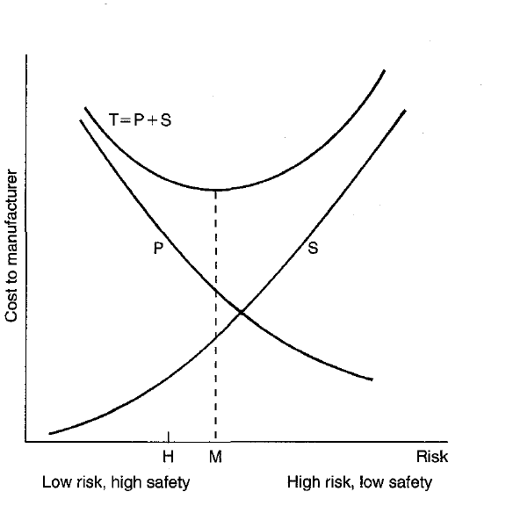
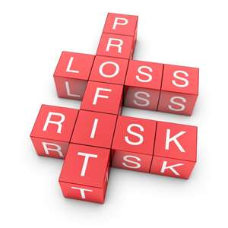

Slide 24
Four criteria to help ensure that engineers produce safe designs
Comply with applicable laws.
Meet the standard of accepted engineering practice.
Explore potentially safer alternative designs.
Attempt to foresee potential misuses of the product by the consumer, and design to minimize the risks associated with such misuse.

Slide 25
Designing for Safety
Define the problem, including the needs, requirements and constraints.
Generate several different solutions to the problem.
Analyse each solution to determine the pros and cons of each.
Test the solution.
Select the best solution.
Implement the chosen solution.

Slide 26
Uncertainties in Design

Slide 27
Uncertainties in Design
One would think that experience and historical data would provide good information about the safety of standard products. Much has been collected and published. However Risks remains because:
There are some industries where information is not freely shared-for instance, when the cost of failure is less than the cost of fixing the problem,
Problems and their causes are often not revealed after a legal settlement has been reached with a condition of nondisclosure, and
There are always new applications of old technology, or substitutions of materials and components, that render the available information less useful.
Risk is seldom intentionally designed into a product. It arises because of the many uncertainties faced by the design engineer, the manufacturing engineer, and even the sales and applications engineer.

Slide 28
Uncertainties in Design
Uncertainties in design could be due to Applications or Materials.
Engineers traditionally have coped with such uncertainties about materials or components, as well as incomplete knowledge about the actual operating conditions of their products, by introducing a comfortable "factor of safety".
That factor is intended to protect against problems that arise when the stresses caused by anticipated loads (duty) and the stresses the product as designed is supposed to withstand (strength or capability) depart from their expected values.

Slide 29
Uncertainties in Design
Factor of safety=C/D

Slide 30
Risk-Benefit Analysis
Risks and benefits of a project are assigned dollar amounts. Most favourable ratio between risks and benefits is pursued.
This is often a difficult task:
Difficult to assign appropriate dollar amounts.
Technique can be misused (dishonest and subject assignment of costs).

Slide 31
Risk-Benefit Analysis (Discussion Point)
Many large projects, especially public works, are justified on the basis of a risk-benefit analysis. The questions answered by such a study are the following:
Is the product worth the risks connected with its use?
What are the benefits?
A closer examination of risk-benefit analysis reveals some conceptual difficulties. Both risks and benefits lie in the future.
we should multiply the magnitude of the potential loss by the probability of its occurrence, and similarly with the gain.
But who establishes these values, and how?
If the benefits are about to be realized in the near future but the risks are far off, how is the future to be discounted in terms of, say, an interest rate so we can compare present values?

Slide 32
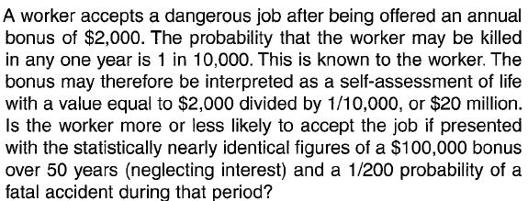
Risk-Benefit Analysis
Discussion Question

Slide 33
Risk-Benefit Analysis
It should be noted that risk-benefit analysis, like cost-benefit analysis, is concerned with the advisability (sense, suitability) of undertaking a project.

Slide 34
Safe Exits
It is almost impossible to build a completely safe product or one that will never fail. The best one can do is to assure that when a product fails:
It will fail safely,
The product can be abandoned safely, or-at least-
The user can safely escape the product.
Let us refer to these three conditions as safe exit. It is not obvious who should take the responsibility for providing safe exit.
But apart from questions of who will build, install, maintain, and pay for a safe exit system there remains the crucial question of who will recognize the need for a safe exit.
Providing for a safe exit is an integral part of the social experimental procedure-in other words, of sound engineering.

Slide 35
Case Study
Read:
Three Mile Island
Chernobyl

Slide 36
Quiz
Risk-benefit analysis, like cost-benefit analysis is concerned:
With increasing safety.
With the client.
With the advertisement.
With the advisability.
Warranty expenses is part of primary cost
True.
False.

Slide 37
Conclusions
Risk and Safety.
Effect of Information on Risk Assessments.
Assessing and Reducing Risk.
Uncertainties in Design.
Risk-Benefit Analysis.
Safe Exits.

Slide 38
Useful link
http://www.mech.utah.edu/ergo/pages/Educational/safety_modules/Safey_Factor/

