Slide 1
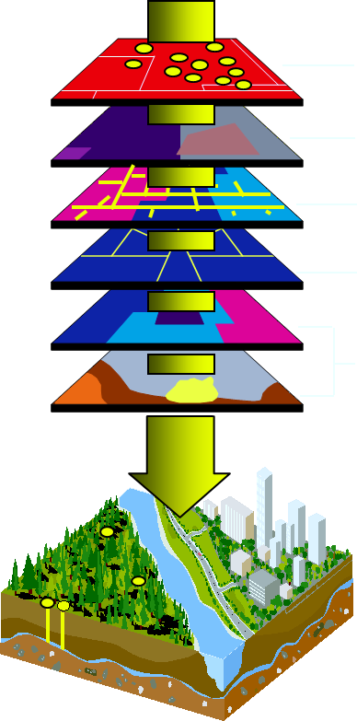
Geographic Information System
Dr. Ahmad BinTouq
abintouq@uaeu.ac.ae
http://faculty.uaeu.ac.ae/~abintouq
GEO440: GIS for Urban & Regional Planning

Slide 2
Overview
Course overview
What is GIS?
Advantages of GIS
Components of GIS
Selection of a GIS system
GIS functions
Database overview
Impact of internet on GIS

Slide 3
Course overview
The objective of this course is to introduce students to:
  The principles of GIS
  The principles of Database
  Environmental Applications of GIS
  By the end of the course the student must master ArcGIS

Slide 4
Course Description
This course provides an in depth introduction to the fundamentals of GIS including the history of automated mapping. The course will include a brief introduction to basic cartographic principles including maps scales, coordinate systems and map projections. An in depth review of the necessary hardware and software elements used in GIS will be made
Various applications of GIS technology used in environmental science, business and government will also be presented.

Slide 5
Course Description
Specific topics taught will include an understanding of GIS terminology, raster and vector data structures, data sources and accuracy, methods of data acquisition, conversion and input, requirements for metadata, working with spatial data databases (map features and attribute tables)

Slide 6
What is GIS?
GIS is any computerized information system that is designed to store, manipulate, retrieve, analyze, and display spatially referenced data.
Land Information System (LIS) is typical to GIS, but related primarily to large scale and parcel-based system such as Automated Mapping and Facilities Management (AM/FM)
GIS is collection, entry, processing and analysis, display, and output of geographic information and metadata for specific purposes .

Slide 7
What is GIS?
CAC -Computer Assisted Cartography: create maps from graphical objects combined with descriptive attributes (size, color), lacks analytical capability
CAD -Computer Aided Design: create maps from graphical objects (no attributes)-Architecture
Major difference : GIS - Adds the analytical capabilities (graphic+ attribute) while the other 2 (CAC and CAD) lack (graphic only)

Slide 8


What is GIS?
People
Hardware
GIS
Methods
Software
Information
Editing, analysis, production

Slide 9
Taxonomic classification of GIS
1. Spatial vs. nonspatial information
  GIS is spatial
2. Nongeographic vs. geographic (GIS)
  nongeographic - deals with geographic space but not geocoded
3. Other GIS vs. LIS
  Other GIS - nonland - economic, housing, market analysis
  LIS - most often used type of GIS - management and analysis of land surfaces
4. Non-parcel vs. parcel
  non-parcel - natural resource management, habitat evaluation, scientific investigation
  parcel - land ownership (cadastral)

Slide 10
Information system
Information System (IS)
Spatial IS
(x,y,z,t)
Non-spatial IS
e.g. accounting
Parcel-based
(LIS)
Other e.g.
Forest (GIS)

Slide 11
History of GIS
1963: Computing comes of age (Establishment of the Urban and Regional Information System Association URISA and and the first GIS Conference in Ottowa, Canada in 1963).
1964: Canada GIS-Roger Tomlinson “Father of GIS”
1964: Harvard Lab for Computer Graphics and Spatial Analysis
1970s: GIS software evolves rapidly (more GIS companies appeared e.g. Intergraph, ESRI, Governmental departments introduced GIS e.g. The US Bureau of the Census)

Slide 12
History of GIS
1980s GIS software advances significantly (more budget and human resources allocated for GIS, by the end of 1980s more than 4000 GIS/CAD software are introduced)
Digital data becomes available (TIGER, World Data Bank, DIME)
1990s (integration of Raster and Vector based systems, Multi-media GIS, software become more user friendly)
2000: Web-based GIS

Slide 13
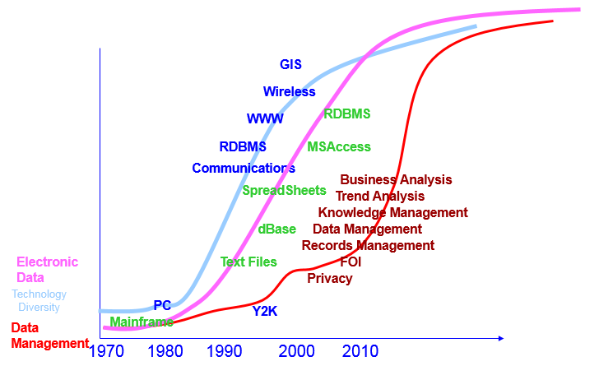
GIS get use of the Data Management Development
Notes:
Managing the Resource – Higher the cost the higher the ‘management’ of it.

Slide 14
Disadvantages of the manual methods
Long time for processing
Subject to human errors
Data can not be managed efficiently
Low cost/benefit ratio

Slide 15
Why GIS: Advantages of GIS
Time minimization
Accuracy improvement
Data can be managed efficiently
High cost/benefit ratio

Slide 16
Context and Content
Seeing the Whole
Managing Places
Patterns
Linkages
Trends
Watersheds
Communities
Neighborhoods
Ecosystems

Slide 17
GIS Centers Around the World
http://www.ncgia.ucsb.edu/ncgia.html University of California
http://ncgia.umesve.maine.edu/ University of Maine at Orono
http://www.utexas.edu/depts/grg/main.html Dept. of Geography- UT Austin
http://www.ensu.ucalgary.ca/ Geomatics at Univ. of Calgary
http://www.regis.berkeley.edu/ REGIS: Environmental Planning GIS at Berkeley
http://www.ccrs.nrcan.gc.ca/ccrs/ Canada Center for Remote Sensing
http://edac.unm.edu Earth Data Analysis Center- U. of New Mexico
http://www.geo.ed.ac.uk/home/giswww.html University of Edinburgh
http://giswww.kingston.ac.uk The Kingston Center for GIS
http://www.gisqatar.org.qa Center of GIS in Qatar
http://www.geom.unimelb.edu.au/cgism/ Center for GIS at The Univ. of Melbourne
http://www.gislinx.com Guide to GIS resources

Slide 18
People
People are essential part of GIS
Issues related to people are training, education, management, law, security, data sharing, coordination and ethics
GIS budget (cost of data, hardware, software, and maintenance)

Slide 19
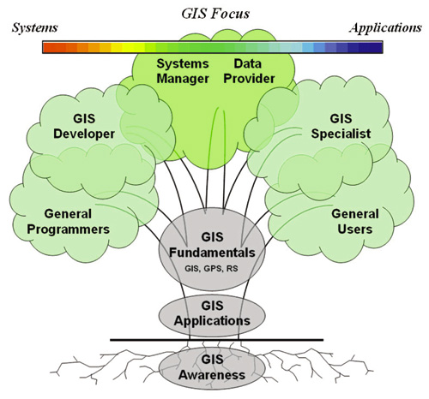


Interdisciplinary
Remote Sensing and GIS are Interdisciplinary fields

Slide 20
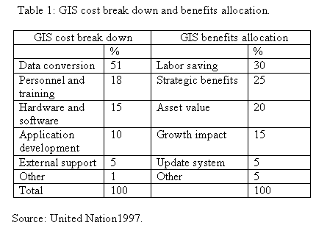
United Nation, 1997.Geographic Information Systems for Power Planning. New York: United Nation Publication.

Slide 21
Hardware
Input (Keyboard, mouse, digitizer, scanner, sound)
Processing (Central processing unit -CPU) Pentium II (400 MHz)
Storage (Magnetic and optical media -Hard disk 4GB, CD-ROM-650MB, Floppy 1.4 MB, Zip 100 MB)
Output (Screen, sound system, printer, plotter)
www.hp.com, www.calcomp.com

Slide 22
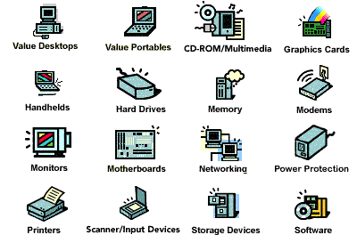
Hardware

Slide 23
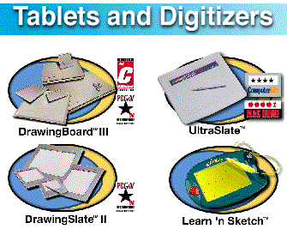
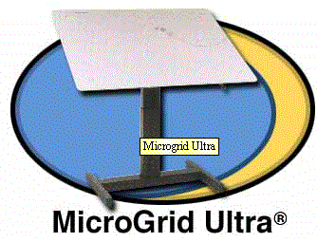
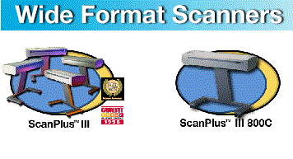
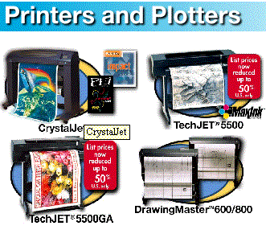

Slide 24
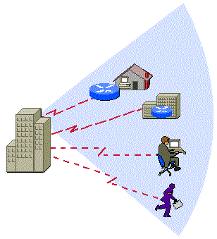
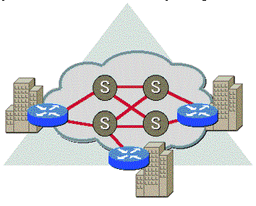
Networking
Remote
Wide Area Network (WAN)
Local Area Network (LAN)

Slide 25
Software
Operating System (OS) - WindowsY2K/NT
Graphic software (CAD, Microstation)
Database software (dBASE, Oracle)
Statistical packages (SPSS, SAS, Minitab)
Word processing (Ms Word, Word Perfect)
Image processing (IDRISI, ER Mapper)
GIS systems (Arc/Info, ArcView, MapInfo)
Presentation (Ms PowerPoint, Coral Draw)

Slide 26
Software integration
ODE

Slide 27
Selection of a GIS system
Selection of a GIS systems depends on many factors e.g. the budget, purpose, and functions of the system
For small companies and educational institutions, low cost systems are suitable e.g. ArcView and IDRISI
For big companies a GIS system that provides multi-functions is necessary this may be at a high cost e.g. Arc/Info NT 8.0

Slide 28
Information
There are two basic types of map information in a GIS: Spatial and Aspatial (DESCRIPITIVE-attribute)
Spatial refers to geographic features that are represented as POINTS, LINES, and POLYGONS
Aspatial or Descriptive refers to TABULAR DATA which records characteristics of the geographic features

Slide 29
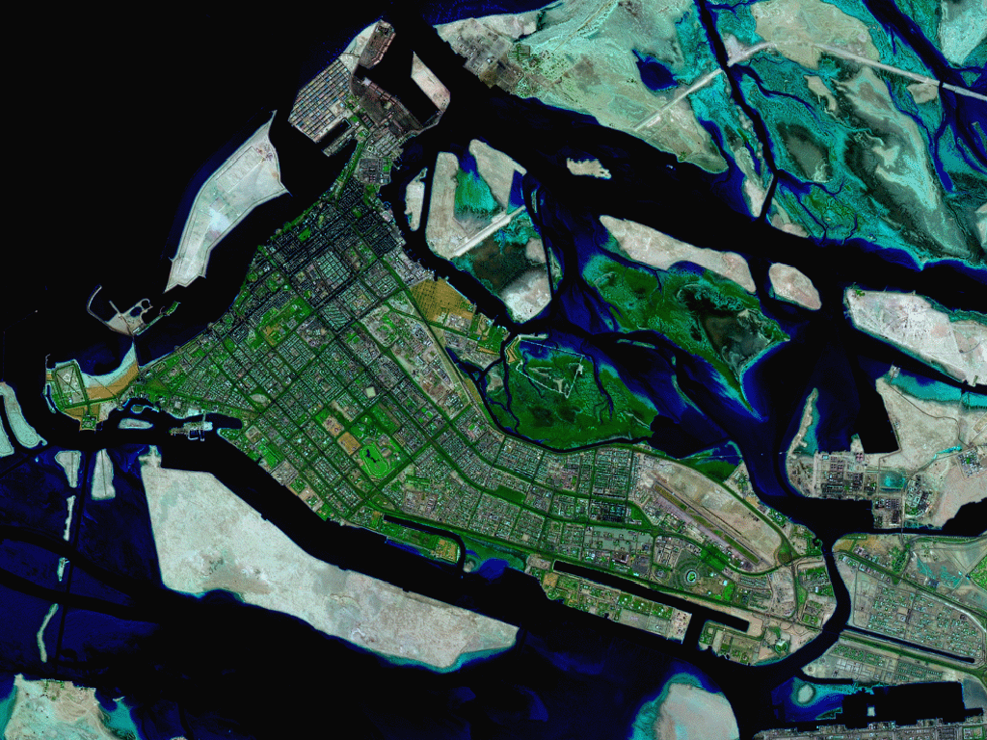
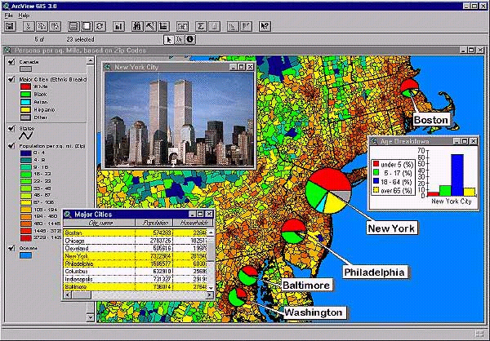


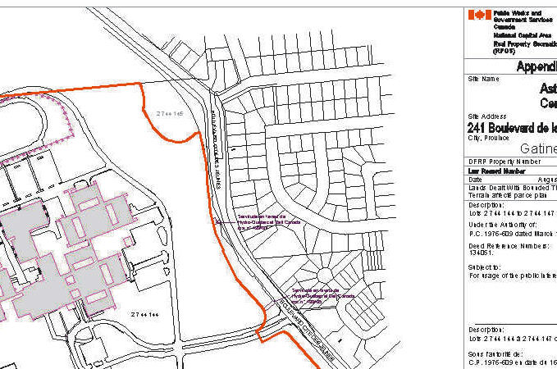
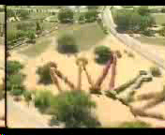
Data
Alpha
numeric
Attribute
Satellite image
Map
Photo
Video

Slide 30
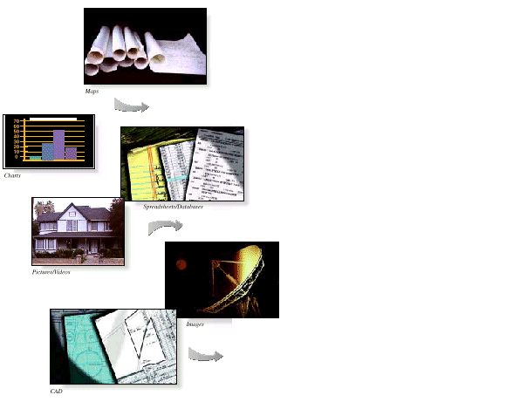
GIS can integrate various Data Maps, table, video, photo, etc.

Slide 31
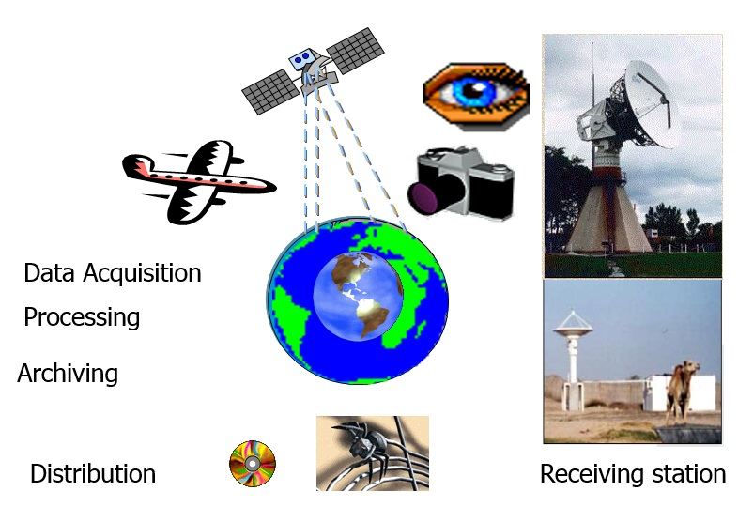
What is Remote Sensing?

Slide 32
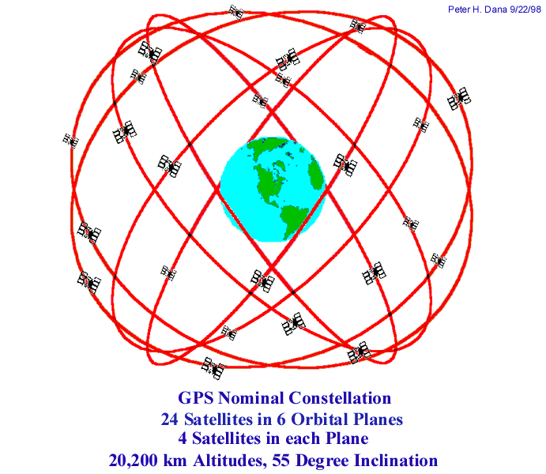

What is GPS?
Space Segment
Control Segment
User Segment
27 satellites: Altitude 20,200 Km
55 degree inclination
1/5/2000 the SA is removed

Slide 33
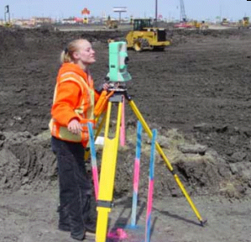
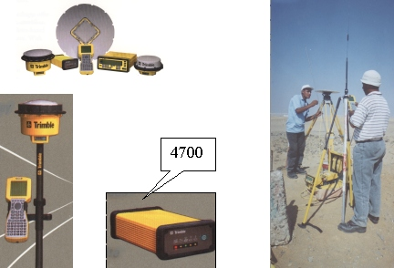
GPS receivers
Geodetic
Handheld
Checking

Slide 34

GPS for tracking cars, animals, and ships

Slide 35
GIS Information
SPATIAL OBJECT
SPATIAL OBJECT
ATTRIBUTE
SPATIAL
ATTRIBUTE
SPATIAL
DBMS
DBMS
GIS Database
GIS Database
(1)
(2)

Slide 36
GIS is a tool to see the whole
Social Factors
Biodiversity
Engineering
Land Use
Environmental
Considerations

Slide 37
GIS functions
Data acquisition/Input (spatial and non-spatial)
Data processing (manipulation ,data management)
Data analysis (Spatial & statistical analysis)
Data storage (Store data more efficiently)
Data output (Maps, graphs, tables, reports)

Slide 38
Data acquisition
GIS includes Spatial and descriptive data (Attribute)
Spatial data can be obtained from maps images or digital files
Attribute data can be obtained from reports, statistical outcomes, and written documents

Slide 39
Spatial data acquisition
There are two methods for spatial data acquisition
Primary methods Surveying, Photogrammetry, GPS, and Remote Sensing
Secondary methods Digitization, Automatic line following, and scanning

Slide 40
Aspatial: Tabular Databases
Tabular data (attribute, descriptive data) are essential part of GIS
Attribute data can be obtained from reports or written documents
Different database systems can be used for attribute input e.g. dBASE, Oracle, Informix
Most database systems are based on arranging attribute data in a form of tables, these tables consists of fields and records

Slide 41
Data format
The spatial data can be store in vector or raster format
Vector format represents data in a series of (X,Y) coordinates
Raster format represent data in a series of columns and rows-Matrix (Pixel, cell)
Vector data are accurate and takes less storage, but take long time e.g. digitization
Raster data are inaccurate and takes large storage, but takes short time e.g. scanning

Slide 42
Coordinate system
Distortion
Distance
Area
shape direction
Map projections express
3D in 2D
Sphere -Globe
Three-Dimension
Spherical coordinate
Latitude (Ø) and longitude (λ) (Ø, λ)
Plane-Map
Two-Dimension
Cartesian coordinate
(X,Y)

Slide 43
Data processing
Once the data is acquired the next step is to put it in a digital format.
Data processing may include conversion of the data to a common coordinate system.
Checking the accuracy of the spatial and attribute data.
Linking the spatial and attribute data.

Slide 44
Data analysis
Analysis is considered as the most important tool in GIS (Heart of GIS).
Spatial and statistical analysis can be done.
Spatial analysis includes map overlay, buffering, and map algebra.
Statistical analysis includes e.g. determination of maximum, minimum, and average values.
New data can be derived from existing data

Slide 45
Data analysis : Data layers can be joined to create new layers containing the characteristic of both

Slide 46
Data storage
GIS data can be store in different media. For example, Magnetic or optical media e.g. HD, floppy, and CD-ROM.
Backup of GIS data must be done on regular basis to a void loss of data due to hardware failure, virus, or data corruption.
Security measures must be taken e.g. at computer level (access right) and physical level (good locking and guard)

Slide 47
Data output: Visualization
Output from GIS can be in hardcopy or softcopy and in different formats.
Maps (2D, 3D) showing location and description.
Tables showing detailed description.
Reports showing summary of information.
Different forms of graphs including bar, pie, and line.

Slide 48
Impact of the Internet on GIS
Exchange and Sharing of ideas via- electronic mail (e-mail) and online lists
Online forum (video conferencing)
Data transfer (File Transfer Protocol- FTP)
Browsing (web sites)

Slide 49
GIS Applications
Foresters - timber inventory
Fire, police, ambulance - 999 and emergency vehicle routing
Military - logistics and battle plans
Telecommunications - siting cellular transmission towers
Local to national scale government - city planning, zoning, natural resources, etc.
Academia - used by many other disciplines outside of geography

Slide 50
Exercise
1. Define GIS
2. What is the difference between automated cartography, CAD, and GIS
3. What is the difference between GIS and LIS
4. Discuss briefly the main components of GIS
( People, Data, Hardware, and Software)
5. Write one page about the impact of internet on GIS
6. List ten GIS web sites that you have visited

