Slide 1
1st Exam Review
27-04-2014
Dr. Ahmad BinTouq
E-mail: abintouq@uaeu.ac.ae
URL: http://faculty.uaeu.ac.ae/~abintouq
GEO 440: GIS for Urban & Regional Planning

Slide 2
Overview
Topics included in the 1st exam
Exam format
Quizzes review

Slide 3
Topics
RS and GIS in Developing Countries: Case of the UAE
The Appropriateness Of GIS for Regional Planning in the Developing World
The application of GIS in urban and regional planning: (a review of the North American experience)

Slide 4
Topics
4. Chapter(1):Introduction: Need for GIS in Decision Support
5. Chapter(2):GIS in Decision Support Situations
6. Chapter(3): GIS Decision Support Methods and Workflow

Slide 5
Topics
7. Lab: Remote Sensing and GIS for Urban Population
8. Lab: Where is waste landfill in Al Ain? what type of waste management there is in Al Ain?
9. Lab: where is it best for the extension of Dubai-Alain road to go through CBD….?
10. Lab: Spatial Analysis

Slide 6
Definitions
What is Urban Planning? (Future wish-list for cities)
What’s GIS for Urban Regional Planning
Planning is the Art of the politically possible

Slide 7
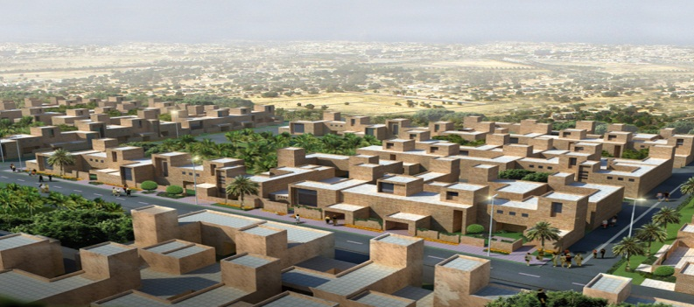
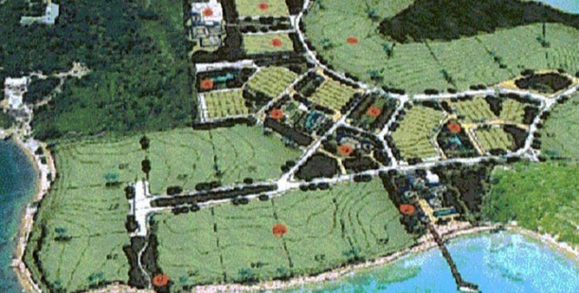
What is it UP
Urban planning refer to the process by which cities draw future goals and objectives…
Urban planning is a mixture of science and art. It encompasses many different disciplines and brings them all under a single umbrella.

Slide 8
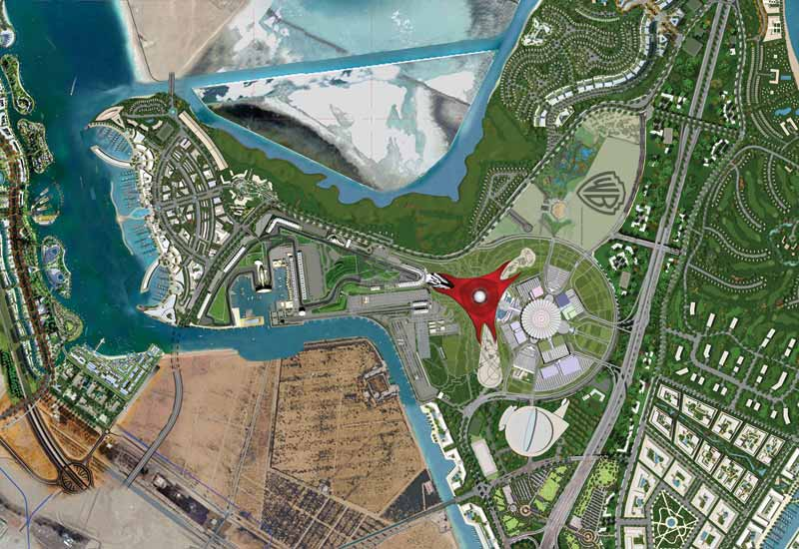
Simple Definition of Urban Planning
Location/allocation discussions/decisions
It is the organization of all elements of a town or other urban environment (region).

Slide 9
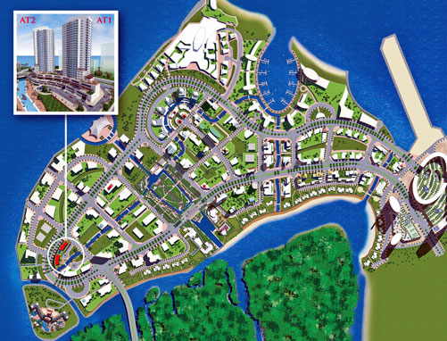
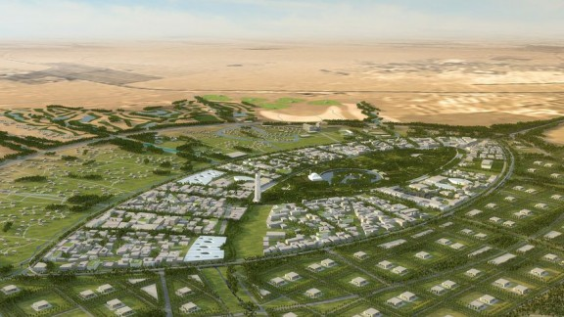
GIS for UP
Application of GIS for UP; 4 M
Monitoring
Measuring
Mapping or managing
Modeling

Slide 10
Exam format
Discuss applications of GIS for UP?
Explain the use of GIS in DS?
Describe workflow types and give example?
Evaluate the use of RS for urban planning

Slide 11
Exam format
Section A: Fill the blanks, Define.
Section B: List, Evaluate.
Section C: Explain, Describe, Discuss.

Slide 12
Quizzes review
What's the definition of “GIS for urban and regional planning"?
Identify of problems for GIS implementation within the UAE.
List the four components of the GIS technology “package” good for developing countries according to R.F. Klosterman?
List the scales of GIS use in planning applications in the USA?

Slide 13
Quizzes review
What are the three perspectives for defining GISystems?
What are the Conventional Approaches to Decision Support Situations?
What five dimensions might we use for integrating decision support situations?
List the GIS Capabilities?
The three types of GIS-based workflow are?

Slide 14
Questions

