Slide 1

GIS Decision Support Methods & Workflow
Chapter.03
Dr. Ahmad Bin Touq
abintouq@uaeu.ac.ae
http://faculty.uaeu.ac.ae/~abintouq
GEO 440: GIS for Urban & Regional Planning

Slide 2
Overview Chapter. 3
1.Overview of GIS Capabilities
Geocoding Tools,
Data Management Tools
Map Visualization Tools
Feature Analysis Tools
Grid Analysis Tools
Network Analysis Tools
2.Workflow in GIS Projects
Basic Workflow
Nuanced Workflow
Synthesizing Basic
3.Summary and Review Questions

Slide 3
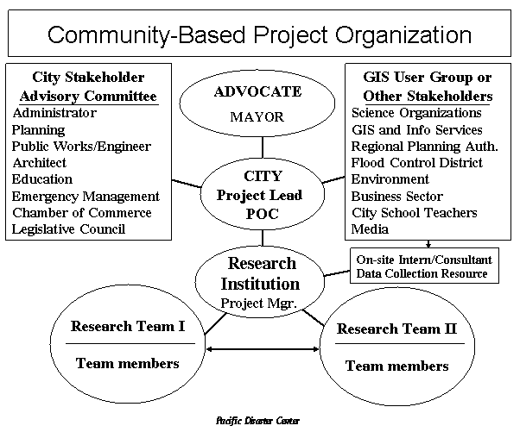
GIS Capabilities
- GIS is known for its ability to integrate various types of data to address complex decision problems.
- Difference between a GIS project and a community improvement project.
For example, a wastewater treatment facility is a community improvement project, but the process of sitting such a project, as presented in the case study, provides a step-by-step method for undertaking a GIS project.
Example

Slide 4
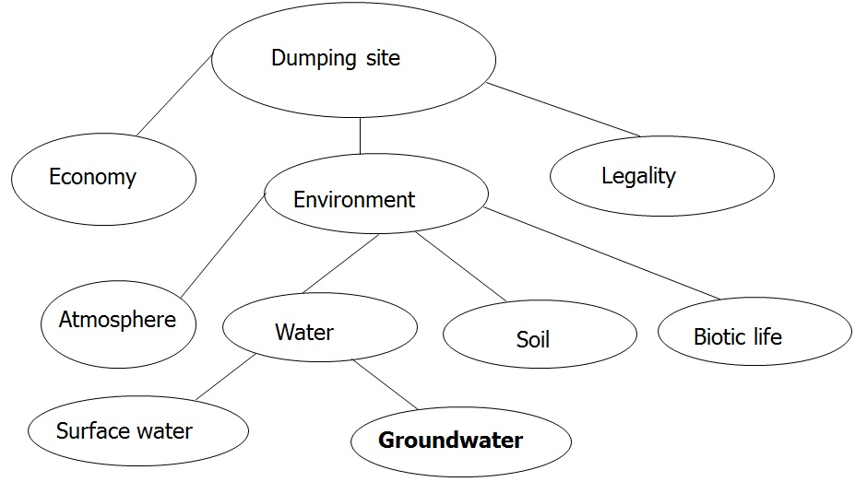
Dumping site
Economy
Legality
Environment
Atmosphere
Water
Soil
Biotic life
Surface water
Groundwater

Slide 5
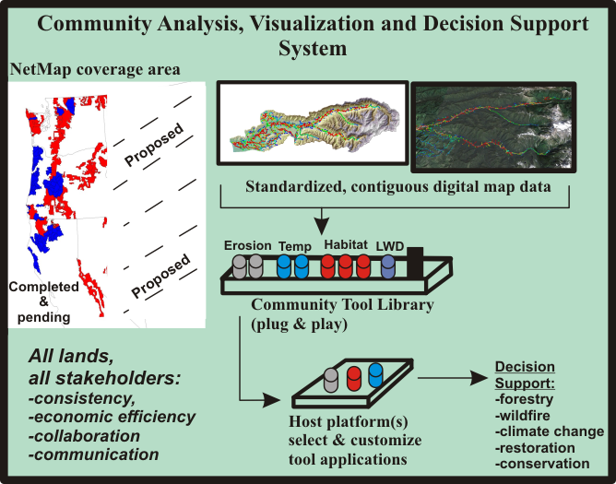
GIS Capabilities
GIS is a special information technology because it integrates capabilities from three fundamental technologies—
Data management capabilities
Spatial analysis capabilities
Map visualization capabilities

Slide 6
Geographical objects
Landuse
Topography
Soil type
Utility
Rivers
Roads
District
Lots

Slide 7
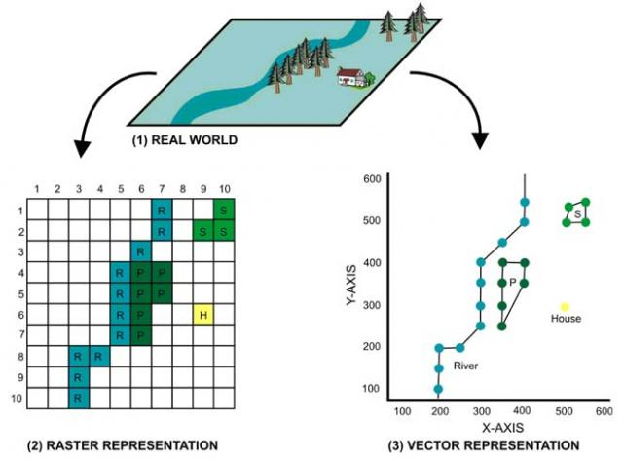
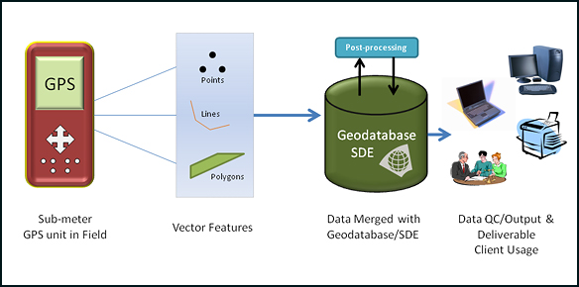
Data collection
Spatial + Attribute data
Geology, Groundwater
Rivers, Coastal line
Soil, Land use
Airport, Roads
Settlements, Hotels

Slide 8
Steps for data preparation
Digitization under
Import to ArcMap
AutoCad
Create topology
Build and Clean
Check feature
accuracy
Transform to real
Add attribute data
coordinate
Geographic database
ArcMap-
shape files
Geographic analysis

Slide 9
Perform spatial operations
Feature extraction from a GIS database (Reselect)
Map overlay (Intersect, Union, Mapjoin)
Proximity searches (Buffering)

Slide 10
Workflow
GIS workflows—simple, nuanced, and combined— to show that any two workflows, when compared, can generate at least one more workflow that perhaps might be more informed.
Four phases
Simple workflow (comprising four phases) is good enough to learn the basics of GIS.
Six phases
Another workflow that has shown considerable success in addressing complex landscape planning problems introduced by Steinitz (1990).
Seven phases
Third workflow is a synthesis of the other two, resulting in a seven-phase workflow.
Each phase is a special modelling step.
The main point is not simply to develop one more workflow, but to show that workflows can often take on emergent qualities to address special nuances of decision problems.

Slide 11
Basic Workflow for a GIS Project
This simplified workflow method assumes that a decision
problem can be solved by a single pass through a workflow, with limited testing of assumptions in each of four phases:
Identify project objectives,
Develop the database,
(3) Perform analysis, and
(4) Report the results.
It is useful and instructive because of the simplifying assumptions regarding water flow process and impacts, for example, land use, transportation, and/or water resource movement, over space and time.

Slide 12
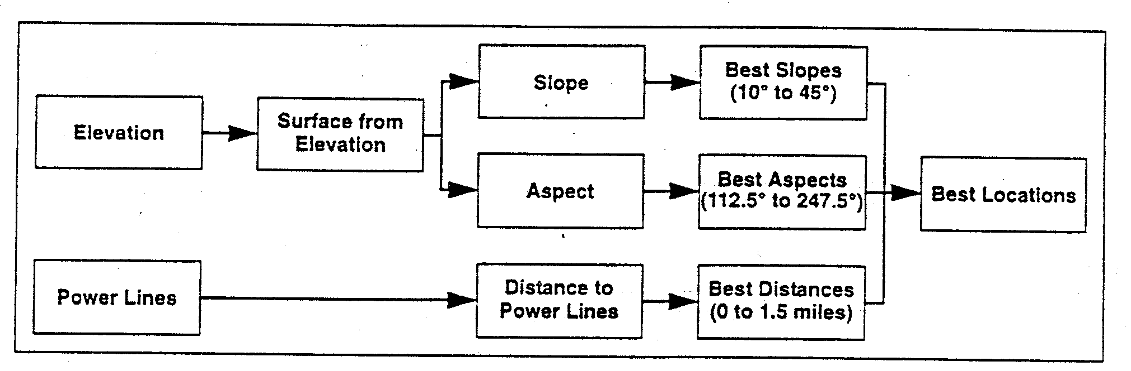
The flow chart outlines the solar energy station siting model that would be performed in this research project:

Slide 13
Example Project Steps
Layer 1:
Layer 2:
Layer 3:
Lake
Forest
Soil Drainage
Spread
Recode
Recode
Layer 6:
Layer 4:
Layer 5:
Near Lake
Loggable
Drained Soils
Species
Recode
Recode
Layer 7:
Layer 8:
Away From
Species And
Lake
Soils
OverLay
Layer 9:
Loggable
Sites

Slide 14
3.2 Workflow in GI S Projects
Suitable zones
Reselect
Geology
Land use
Soil
Rainfall
Buffer
Roads
Rivers
Intersect
suitable zones
for each factor
User interaction
The best zones

Slide 15
Chapter. 3 Summary
describing many of the general capabilities of software and the ways these capabilities address decision problems, and
(2) Presenting different GIS workflows that make use of capabilities.
Projects is in terms of how communities want to plan, program, and implement land use, transportation, and/or water resource activities to restore, redevelop, or otherwise improve quality of life.
Projects is in terms of how we make use of GIS in a decision situation—the so-called GIS project. GIS analysts undertake GIS projects, working with data to address community concerns about community projects.

