Slide 1
UAE GOVERNMENT STRATEGIES
UAE VISION 2021

Slide 2
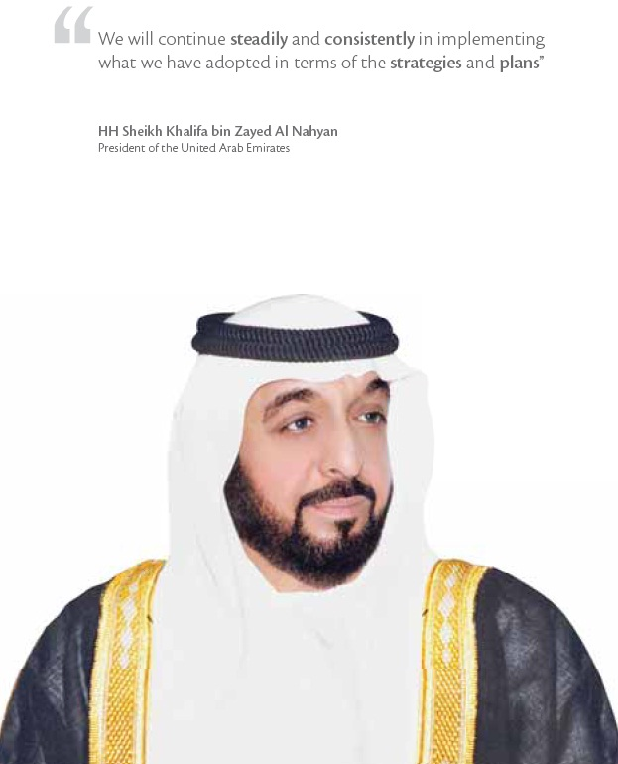
UAE GOVERNMENT STRATEGIES 2011-2013

Slide 3
UAE GOVERNMENT STRATEGIES 2011-2013

Slide 4
UAE GOVERNMENT STRATEGIES 2011-2013
The UAE Government Strategy 2011-2013 lays the foundations to achieve the UAE Vision 2021.
It forms the basis upon which the Federal Entities develop their strategic and operational plans, and consists of:
-The seven general principles steer the work of the UAE Government and apply across all strategic priorities and strategic enablers.
-The seven strategic priorities are the themes that define the priorities of the UAE Government over the coming three years.
-Finally, the seven strategic enablers direct how the machinery of the UAE Government must operate in order to fulfil its strategic priorities.

Slide 5
UAE GOVERNMENT STRATEGIES 2011-2013
General Principles that Guide the UAE Government Strategy:
Enhance the role of Federal Entities in devising effective regulations and integrated policies by successful planning and enforcement.
Enhance effective coordination and cooperation among Federal Entities and with Local Governments.
Focus on delivering high-quality, customer-centric and integrated government services.
Invest in human resource capabilities and develop leaders.
Promote efficient resource management within Federal Entities and leverage dynamic partnerships.
Pursue a culture of excellence through strategic thinking, continuous performance improvement, and superior results.
Enhance transparency and accountable governance mechanisms throughout Federal Entities.

Slide 6
UAE GOVERNMENT STRATEGIES 2011-2013
Strategic Priorities of the UAE Government:
Cohesive Society and Preserved Identity .
First-Rate Education System.
World-Class Healthcare .
Competitive Knowledge Economy.
Safe Public and Fair Judiciary.
Sustainable Environment and Infrastructure.
Strong Global Standing.

Slide 7
UAE VISION 2021

Slide 8
UAE VISION 2021

Slide 9
United In Responsibility
United In Destiny
United In Knowledge
United In Prosperity

Slide 10
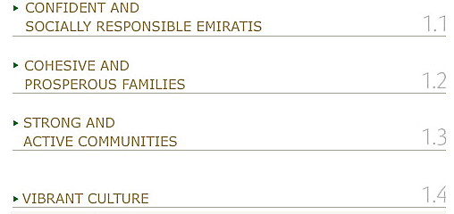
United In Responsibility

Slide 11
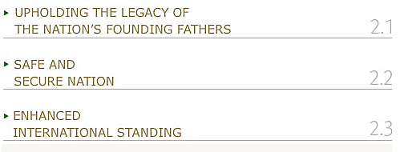
United In Destiny

Slide 12
United In Knowledge

Slide 13
United In Prosperity

Slide 14
UAE GOVERNMENT STRATEGIES 2011-2013
www.uaecabinet.gov.ae UAE VISION 2021
www.vision2021.ae

