Slide 1
Remote Sensing and Geographic Information Systems in Developing Countries: Case of the United Arab Emirates (UAE)
Dr. Ahmad Bin Touq
abintouq@uaeu.ac.ae
http://faculty.uaeu.ac.ae/~abintouq
GEO 440: GIS for Urban & Regional Planning

Slide 2
Overview
First week we discusses GEOG 440 class syllabus.
What’s (GIS for Urban Planning) refers to?
Today, Why’s there GIS growth in the UAE?

Slide 3
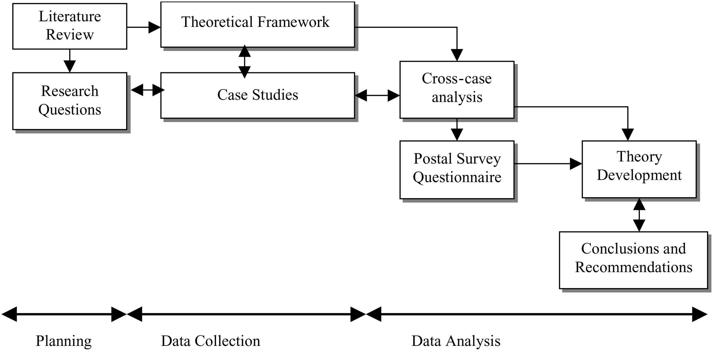
Research paper outline

Slide 4
GIS in the UAE
The paper suggests that growth in GIS applications in the UAE is due to:
Cheap hardware and easy to use soft wares
Impediments to the use of GIS in the UAE:
1-The cost of hardware.
2- The complexity of software.
3. There is high demand for GIS staff in the UAE
4. Thus, the case of the GIS education in the UAE

Slide 5
The most important reasons for the spread of GIS and remote sensing:
Need to know about the spatial data to support decision-making process.
Using English for GIS.
Expanded the capabilities of the Internet.
Increased knowledge.

Slide 6
RS and GIS education in the UAE
More universities and colleges are seeking information on how to begin RS and GIS programs and some of the reasons are:
The mandate for universities and colleges to upgrade technological education.
The need for universities and colleges to find new sources of funding.
Advances in hardware and software.
- The demand for more professionals trained in GIS by government and the private sector.

Slide 7
PENETRATION OF RS AND GIS IN THE UAE market
-The objectives of privatization are: performance, efficiency, and quick return.
-It was recognized that GIS abilities help in achieving privatization objectives by use GIS as a system that provides:
An integration framework, speeds, customer services, makes the masses of information held in databases more accessible, and provides a strong foundation for executive decision support.

Slide 8
RS and GIS implementation in the UAE
Since RS and GIS are multidisciplinary fields, their application in the UAE is evident in various departments, including:
telecommunication, municipalities, health, water, electricity, oil, agriculture, and environment.

Slide 9
RS and GIS implementation in the UAE
Few cases on GIS implementation in the UAE:
1- Emirates Telecommunication Corporation (Etisalat)
2- Abu Dhabi Water and Electricity Authority (ADWEA)
3- Dubai Municipality

Slide 10
Table 2. GIS software and hardware at some governmental departments in the UAE (Numbers in () are the number of licences).
Number of:
C = Computers
D = Digitizers
Pl= Plotters
Pr = Printers
S = Scanners
* NDC: National Drilling Company (Ground Water Research Program)

Slide 11
Global cooperation between UAE and international bodies
Cooperation between UAE and:
- The United States Geological
- The Center for Remote-Sensing at Boston University
- The Groupement pour le développement de la télédétection aérospatiale
- The Japan Oil Development Company (JODCO)
- Purdue University

Slide 12
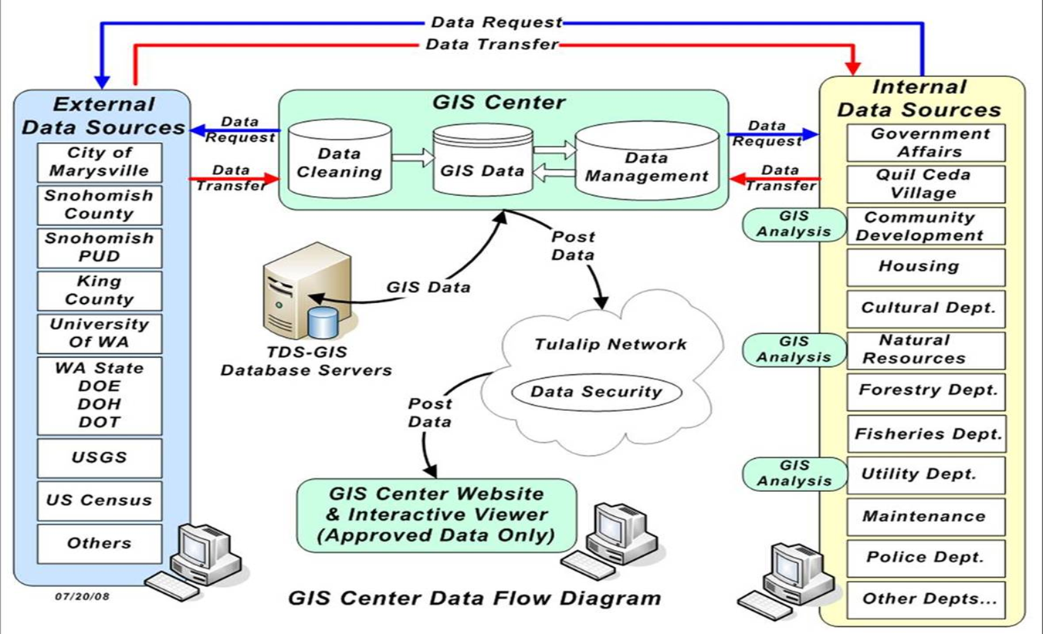
Identifications of problems and solutions for GIS implementation within the UAE?

Slide 13
Problems related to RS and GIS in the UAE
Staff
Data availability and sharing
Budget constraints
Coordinate system and map projection
Software

Slide 14
Exercise
Discuss the growth of GIS in the UAE?
Assess the need of GIS education in the UAE?
Evaluate Problems and solutions of GIS implementation in the UAE

Slide 15
Next week
Quiz 2
Reading 2, at the class website and email
Thank You

