Slide 1
Infrastructure Management; Storm Water and Waste
Dr. Ahmad Bin Touq
abintouq@uaeu.ac.ae
http://faculty.uaeu.ac.ae/~abintouq
GEO 440: GIS for Urban & Regional Planning

Slide 2
Overview
Infrastructure Management part of Urban Planning
How can we use GIS, when, where and why?
What is Storm Water?
What is Waste?

Slide 3
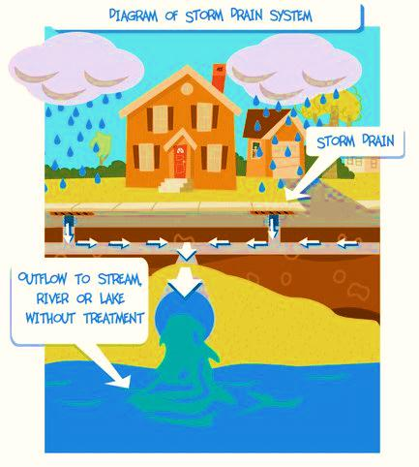
Storm Water
Stormwater is rainwater that flows directly across external surfaces
Underground it is called drainage system

Slide 4
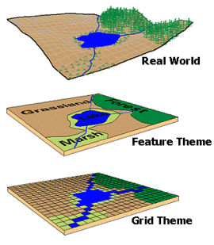
Waste: Refuse, Misuse, and Reuse‏
Vector
Raster

Slide 5
GIS for landfill Management
Urban planning and development applications of GIS--edited by Said Easa and Yupo Chan.
Information storage and retrieval systems -- City planning.
Geographic information systems for drainage system
Sitting and managing a landfill

Slide 6
GIS and Waste
Community participation
Education
Monitoring of discharge

Slide 7
GIS and Waste
GIS has improved waste management by providing:
Find new sites for landfills
Create new/modify waste management programs
Reroute garbage trucks for more efficiency
Educate the public on the necessity of improved waste management

Slide 8
GIS and Waste
Logistics Management and Spatial Planning for Solid Waste Management System using Geographic Information System (Map Asia 2003)
GIS – MIS - GPS for solid waste management (Map India 2002)
Notes:
38
38
35

Slide 9
Water and GIS
Unexpected Benefits from GIS in a Water District (Map Asia 2007)
A GIS based water demand analysis for municipal application (Map India 2003)

Slide 10
Water and GIS
Practical solution to Monsoonal Water Stagnation in Chennai with RS, GIS and GPS (Map Asia 2003)

Slide 11
Vector Data: Disadvantages
Storm water Program -- Waste Discharge Law
General Permits (stormwater)
Individual Permits (general materials)

Slide 12
Stormwater Management
http://www.environment.nsw.gov.au/sustainbus/foundrystormwater.htm

Slide 13
What is Stormwater Runoff?
http://www.epa.govweatherchannel/stormwater.html

Slide 14
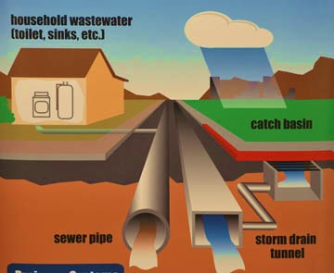
Separate Sewers

Slide 15
Exercise
Home :: Water & Waste Management :: Stormwater Quality :: Stormwater Quality
Herzog and Labadie's chapter 9
Survey stormwater and Wastewater
Integrated solid-waste management system
Hazard-waste management

Slide 16
Exercise
What is multi-criteria decision analysis?
How it is related to the need to respond to multiple stakeholders with different aspirations?
Chapter 9 discussed Real-time GIS applications and 3 key features of GIS? What are those?

Slide 17
Exercise
1) Spatial modeling (map ematics)
2) Overlay of 2 layers
3) Buffer distance from objects
Thank You

