Slide 1


Al GHARBIA Plan 2030
Dr. Ahmad Bin Touq
abintouq@uaeu.ac.ae
http://faculty.uaeu.ac.ae/~abintouq
GEO 440: GIS for Urban & Regional Planning

Slide 2

Al GHARBIA Plan 2030

Slide 3
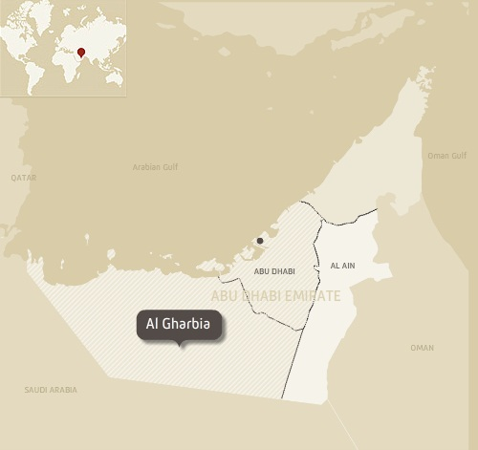
Al GHARBIA Plan 2030

Slide 4
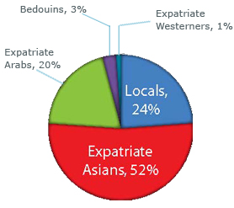
Al GHARBIA Plan 2030
The Vision of Plan Al Gharbia 2030
Plan Al Gharbia 2030 is designed to aid in moving Al Gharbia toward the future with managed, responsible growth. Environmental respect, social health, cultural identity and economic development all share equal status and provide the opportunity to leverage economic growth without sacrificing the cultural and historic significance of the region for future generations.
Key Statistics
Al Gharbia is 60,000 square kilometres: 83% of Abu Dhabi Emirate's landmass.
Al Gharbia has a population of c.115,500 people (2006).
Al Gharbia generates 40% of the Emirate's GDP - over AED 115 billion annually from its industries.
Table 1: Population Estimates

Slide 5

Manuals and Guidelines
Al GHARBIA Plan 2030

Slide 6



Slide 7
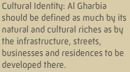
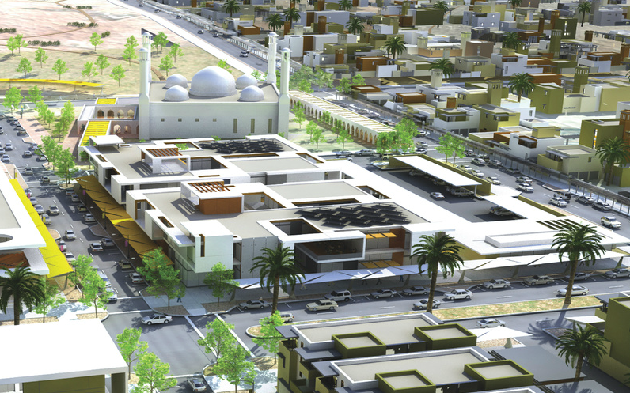




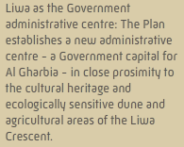
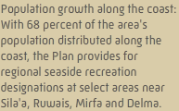
Principles Of Al GHARBIA Plan 2030

Slide 8

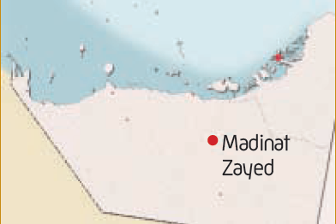
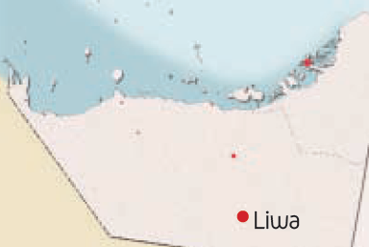
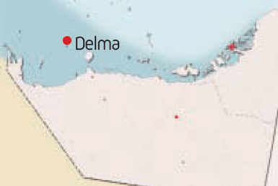
Proposed projects
Residential development
Solar Power facility
Government and Civil Defence projects
Proposed projects
Tourism-related projects
Community facilities and amenities
Proposed projects
Water Taxis
Community facilities and amenities
TAMM building & Delma Hospital
Residential housing & Government services
Tourism development

Slide 9
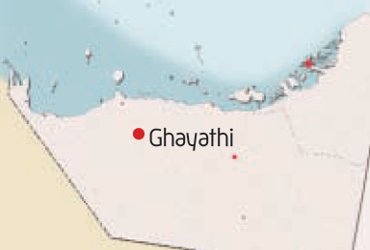
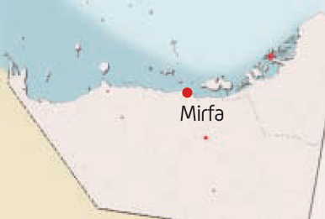
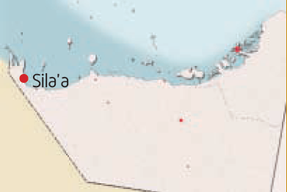
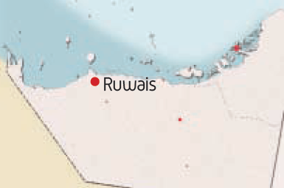
Proposed projects
Housing
Community facilities and amenities
Government services
Proposed projects
Sports centres, maritime centre, abattoir and sheep farmyards, mosques, grand mosque and corniche facilities, education facilities for boys and girls, police department, central souk
ADNOC nitrogen plant
Mirfa hotel expansion & Food distribution centre
Proposed projects
Recreational facilities, municipal services and bus station, schools for boys and girls, fire station
Educational facilities & Health facilities
Housing & Tourism
Proposed projects
Multiple oil and gas projects and expansions
Airport expansion
Multiple industrial projects

Slide 10
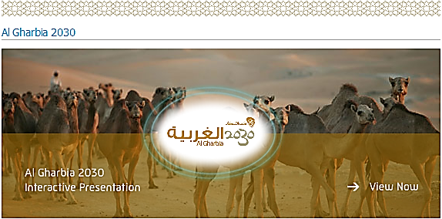
Al GHARBIA Plan 2030

Slide 11
Question
What‘s the aim of Al GHARBIA 2030 plan?
Evaluate Al GHARBIA 2030 Plan?
List The main points of Al GHARBIA 2030 Plan ?
http://www.upc.gov.ae/

