Slide 1
Abu Dhabi Plan 2030
Dr. Ahmad Bin Touq
abintouq@uaeu.ac.ae
http://faculty.uaeu.ac.ae/~abintouq
GEO 440: GIS for Urban & Regional Planning

Slide 2
Abu Dhabi Plan 2030

Slide 3
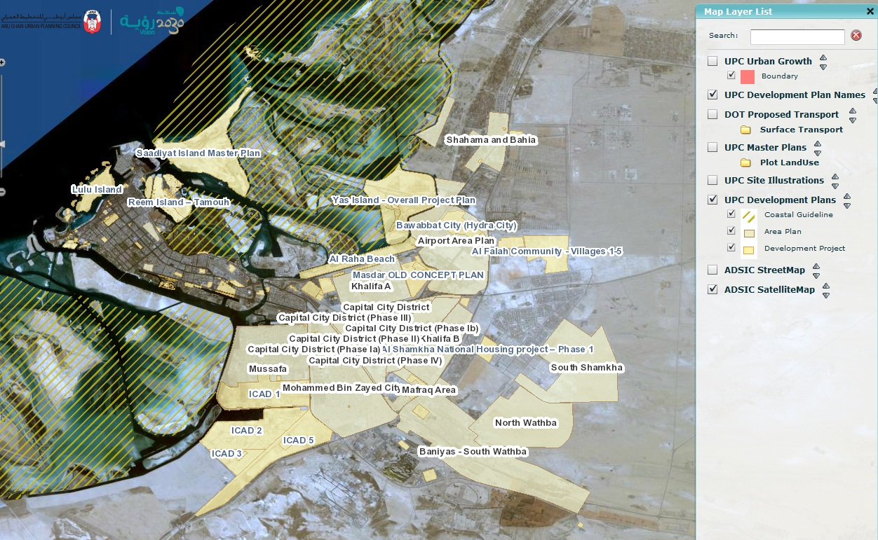
Abu Dhabi Plan 2030
https://gis.upc.gov.ae/PublicMapViewer/

Slide 4
Manuals and guidelines
Abu Dhabi Plan 2030
Coastal Development Guidelines
Al Bateen Waterfront Design Guidelines
Urban Street Design Brochure
Urban Street Design Manual
Neighbourhood Planning
Estidama Brand Guidelines

Slide 5
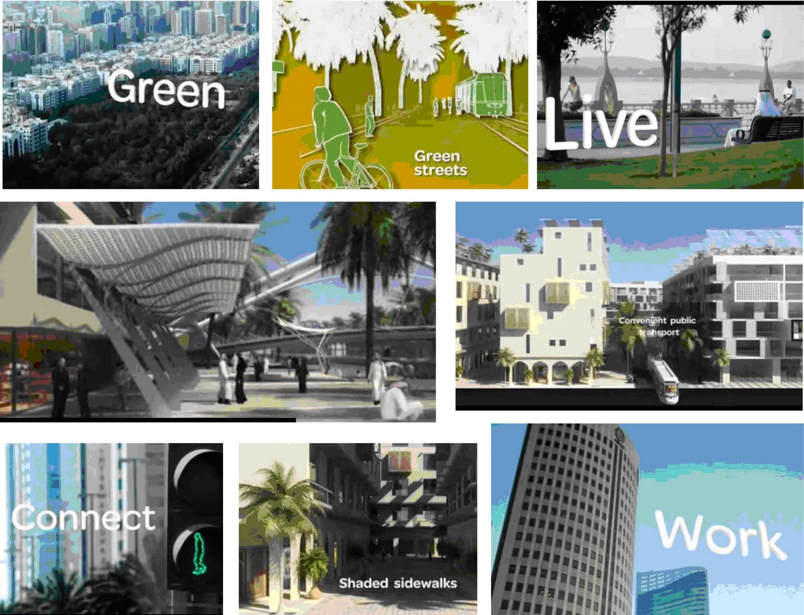
Abu Dhabi Plan 2030

Slide 6
Abu Dhabi Plan 2030
http://www.upc.gov.ae/abu-dhabi-2030/capital-2030.aspx?lang=en-US

Slide 7
Question
What‘s the aim of AD 2030 plan?
Evaluate Abu Dhabi 2030 Plan?
List The main points of Abu Dhabi 2030 Plan ?
http://www.upc.gov.ae/

