Slide 1
Chapter2: GIS in Decision Support Situations
Dr. Ahmad BinTouq
E-mail: abintouq@uaeu.ac.ae
URL: http://faculty.uaeu.ac.ae/~abintouq
GEOG440: GIS and Urban Planning

Slide 2
Overview
What is Decision Support DS?
Planning-Focused Decision Situations
Improvement Programming-Focused Decision Situations

Slide 3
Overview
Comparing Growth Management and Sustainability Management
(5) Five techniques for DS?
(5) major dimensions for PPI decision?
Conventional Approaches to Decision Support Situations
Review Questions

Slide 4
1. what’s DS?
Conventional Approaches to Decision Support Situations:
Community plans: 10- to 20-year horizon, multiple scales and focus.
Subdivision regulations and plans: developer plans required when land is subdivided.
Capital improvement programs: infrastructures to serve the public (e.g., streets,parks, waterways, public buildings).
Zoning ordinances: the most common regulatory instrument.
Public participation: collecting feedback from people about their concerns.

Slide 5
2. Planning-Focused DS?
Because use of GIS is so pervasive across cities, counties, and regions, the result is often a “map-based vision” of what a future could be in regard to land use, transportation, and/or water resource functionality for those jurisdictions.
This map-based plan tends to be jurisdiction-wide.

Slide 6
3. Improvement Programming-Focused DS?
The five major dimensions for integrating planning, programming, and implementation decision situations include:
1. Functional activities.
2. Community conditions.
3. Decision process scales.
4. A spatial scale.
5. A temporal scale.

Slide 7
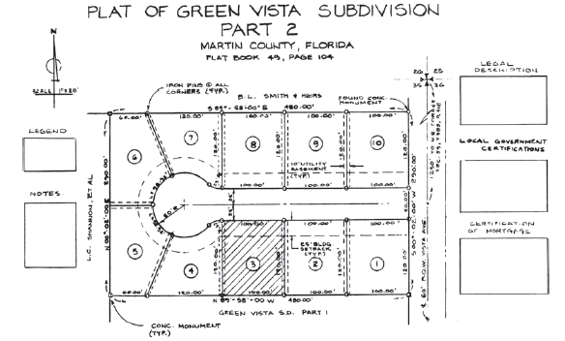

Slide 8
4. Implementation-Focused Decision Situations?
A project implementation decision situation is one in which a detailed economic and/or social, and/or environmental assessment is performed.
At this level of decision situation, individuals (planners or consultants, etc.) who are responsible for the detailed analysis only have to consider the impacts related to a specific project.
Given that the focus is narrow (in space and time), much more energy can be spent examining details of how a particular project might impact a community.

Slide 10
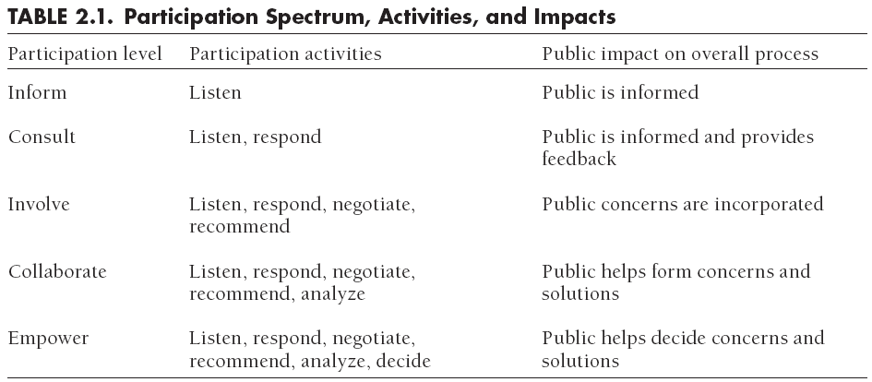
4. Implementation-Focused Decision Situations?

Slide 11
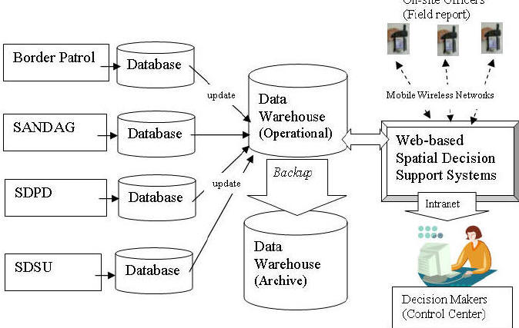

Slide 12
4. Implementation-Focused Decision Situations?
Hopkins (2001) suggests five benefits of participation:
Participation of more persons and more diverse persons increases •• group capabilities to make plans.
Participation of decision makers increases the likelihood that they will use the plan.
Participation of all constituencies avoids later resistance to chosen actions.
Participation outside of formal democratic processes complements these processes by giving different people access and, consequently, representation.
The experience of participating helps to foster the kinds of individuals necessary to operate a democracy.

Slide 13
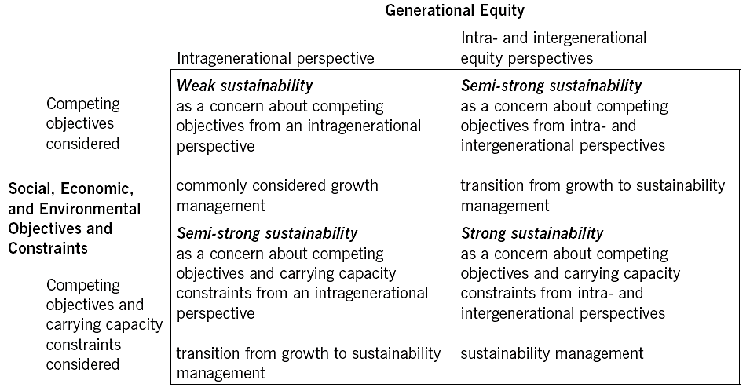
5. Comparing Growth Management and Sustainability Management

Slide 14
Summary
In Chapter 2 outlines the planning, programming, and project implementation decision situations that frame the substantive issues in this book.
Public and private organizations participate in such situations around the world, with some situations more prevalent in some countries than in others.
Also, contextualize the types of decision situations using three topical themes: land (use) development, transportation, and water resources.

