Slide 1
Need for Geographic Information Systems in Decision Support
Dr. Ahmad BinTouq
E-mail: abintouq@uaeu.ac.ae
URL: http://faculty.uaeu.ac.ae/~abintouq
GEO 440: GIS for Urban & Regional Planning

Slide 2
Purpose
Overview
Regional and Urban GIS A Decision Support Approach:
Timothy L. Nyerges and Piotr Jankowski
Comprehensive survey of geographic information system (GIS) for decision support Chapter 1 of the textbook
Chapter summary due on blackboard
Next week Chapter 2, summary due before class
Notes:
More on the aerotropolis model shortly

Slide 3
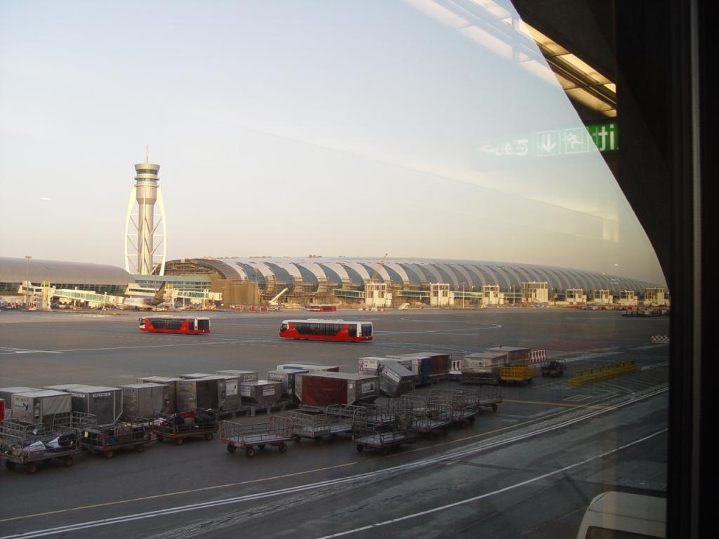
Decision Support
Refers to the tools and information provided by or to people during all aspects of their decision making processes.

Slide 4
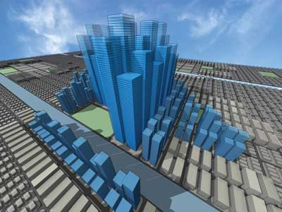
Thematic Areas
Applicable for social services improvement or ecological habitat rehabilitation
Land
Transportation
Water resources

Slide 5
Toward that end, this text applies concepts from: (1). Planning, (2). Programming, (3). Implementation (PPI) efforts to inform GIS use to various human–environment and environment–society decision situations.

Slide 6
Policy statements are formulated by organizational decision makers to establish a direction for work activity within the organization or across multiple organizations.
Example:
Abu Dhabi 2030
Al Ain 2030

Slide 7
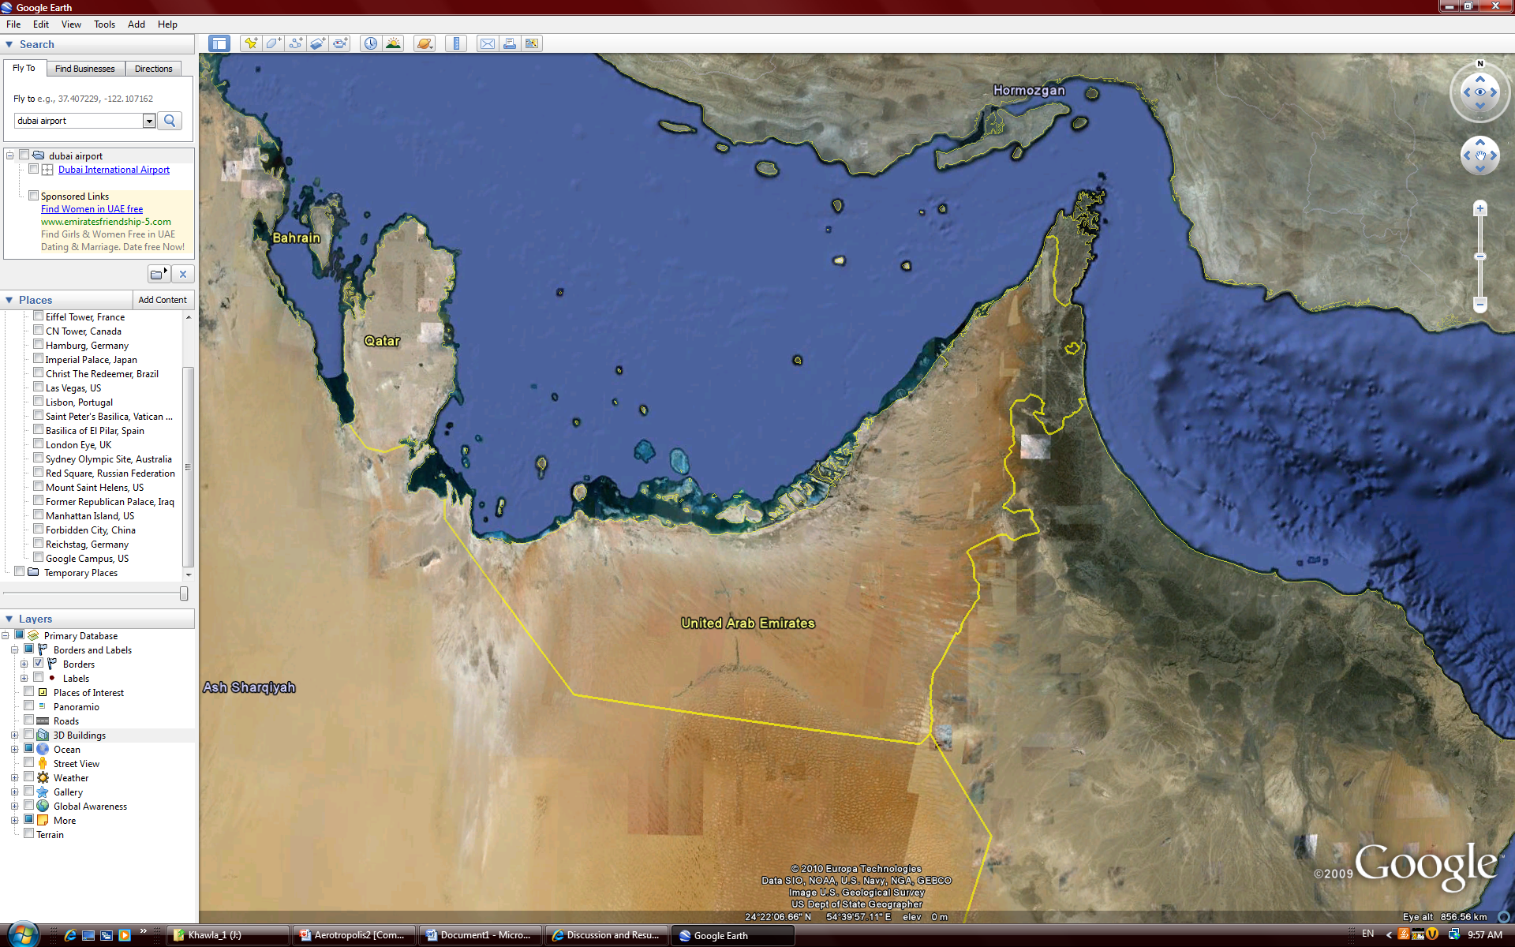
Discussion

Slide 8
How geographic information systems (GIS) can guide decision making about complex community and environmental problems.

Slide 9
Step-by-step introduction to GIS-based decision analysis methods and techniques covers important urban and regional issues (1) land, (2) transportation, and (3) water resource management and Decision processes 1) planning improvement 2) programming, and 3) implementation

Slide 10
Real-world case studies demonstrate how GIS-based decision support works in a variety of contexts, with a special focus on community and regional sustainability management.
Notes:
Now we turn to an examination of the major urban developments within 3 to 15 miles of the Abu Dhabi Airport.

Slide 11
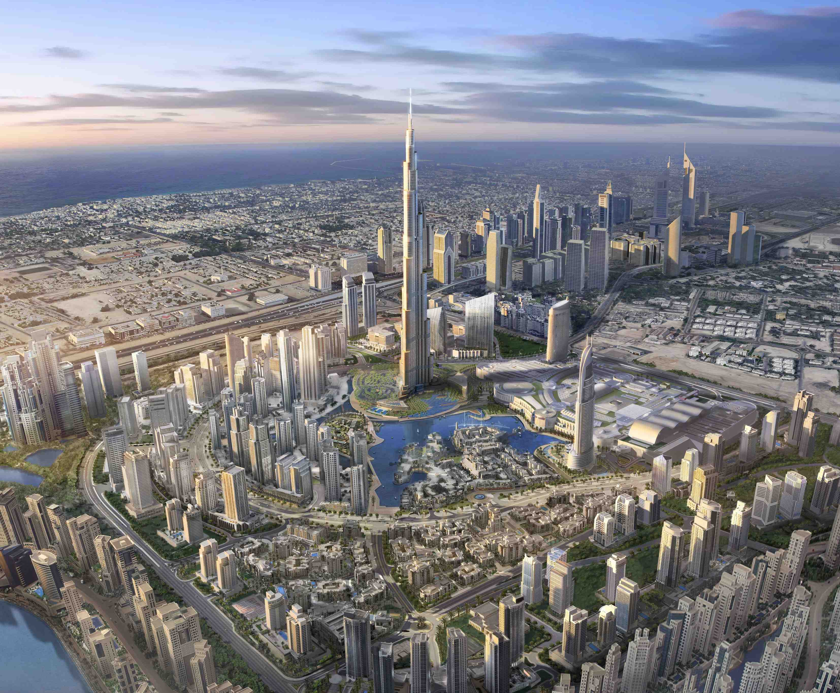
1. Introduction: Need for Geographic Information Systems in Decision Support

Slide 12
The context for urban–regional decision-making processes in this book is planning, capital improvement programming, and project-level implementation decision support situations that address LTWR concerns.

Slide 13
Decision problems about urban–regional environments are among the most vexing problems facing communities worldwide, as the world becomes more urban.

Slide 14
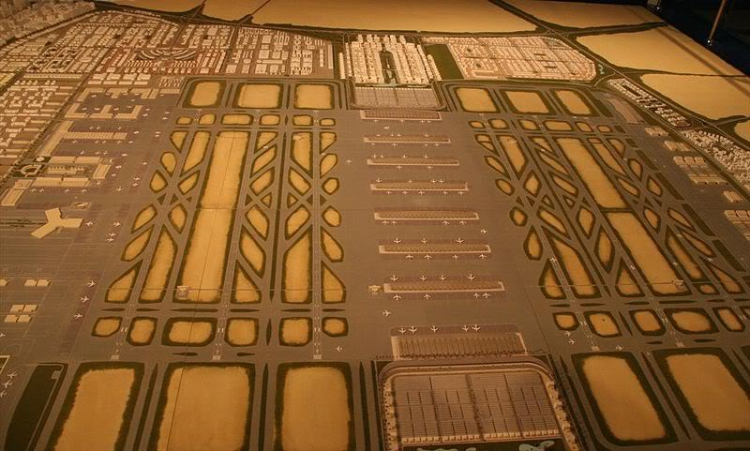
Question at the end of Chapter 1
Lab Tuesday
Quiz#3 Oct 09, 2012
Regional and Urban GIS A Decision Support Approach
Chapter 2 next week.

Slide 15
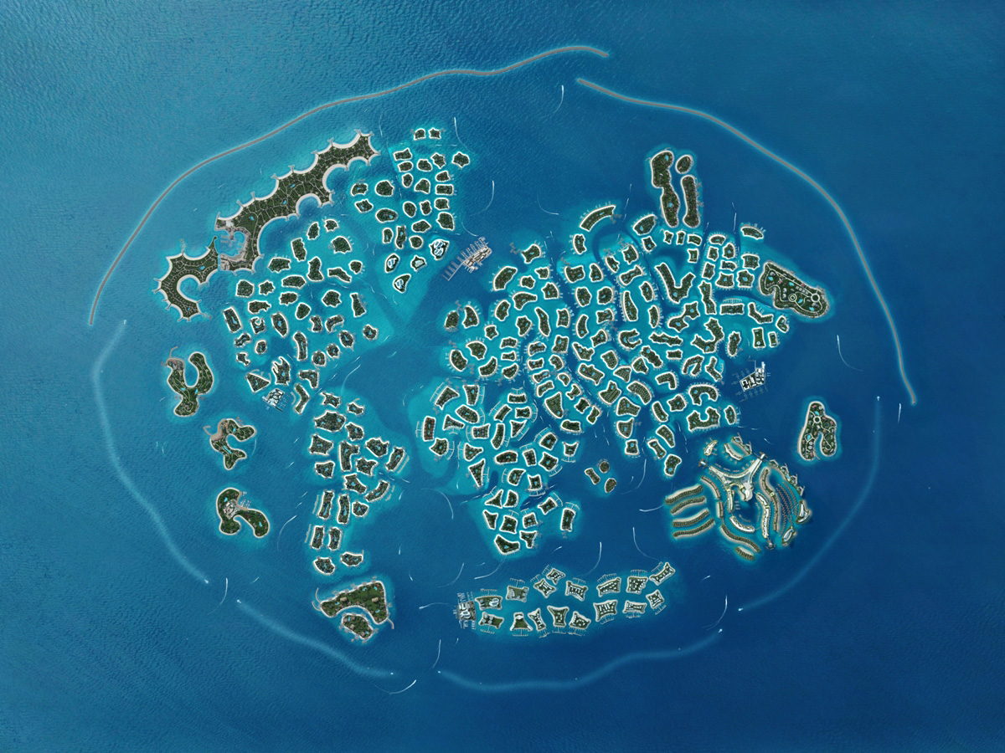
Thank You

