Slide 1
Remote Sensing and Geographic Information Systems in Developing Countries
Dr. Ahmad Bin Touq
abintouq@uaeu.ac.ae
http://faculty.uaeu.ac.ae/~abintouq
GEO 440: GIS for Urban & Regional Planning

Slide 2
Overview
What’s (GIS for Urban Planning) refers to?
What’s GIS? What’s Urban? What’s Planning?
How can we use GIS, when, where and why?
Organizational and political issues connected with GIS.
Today, Why’s there GIS growth in the UAE?
Why GIS growth in the US?

Slide 3
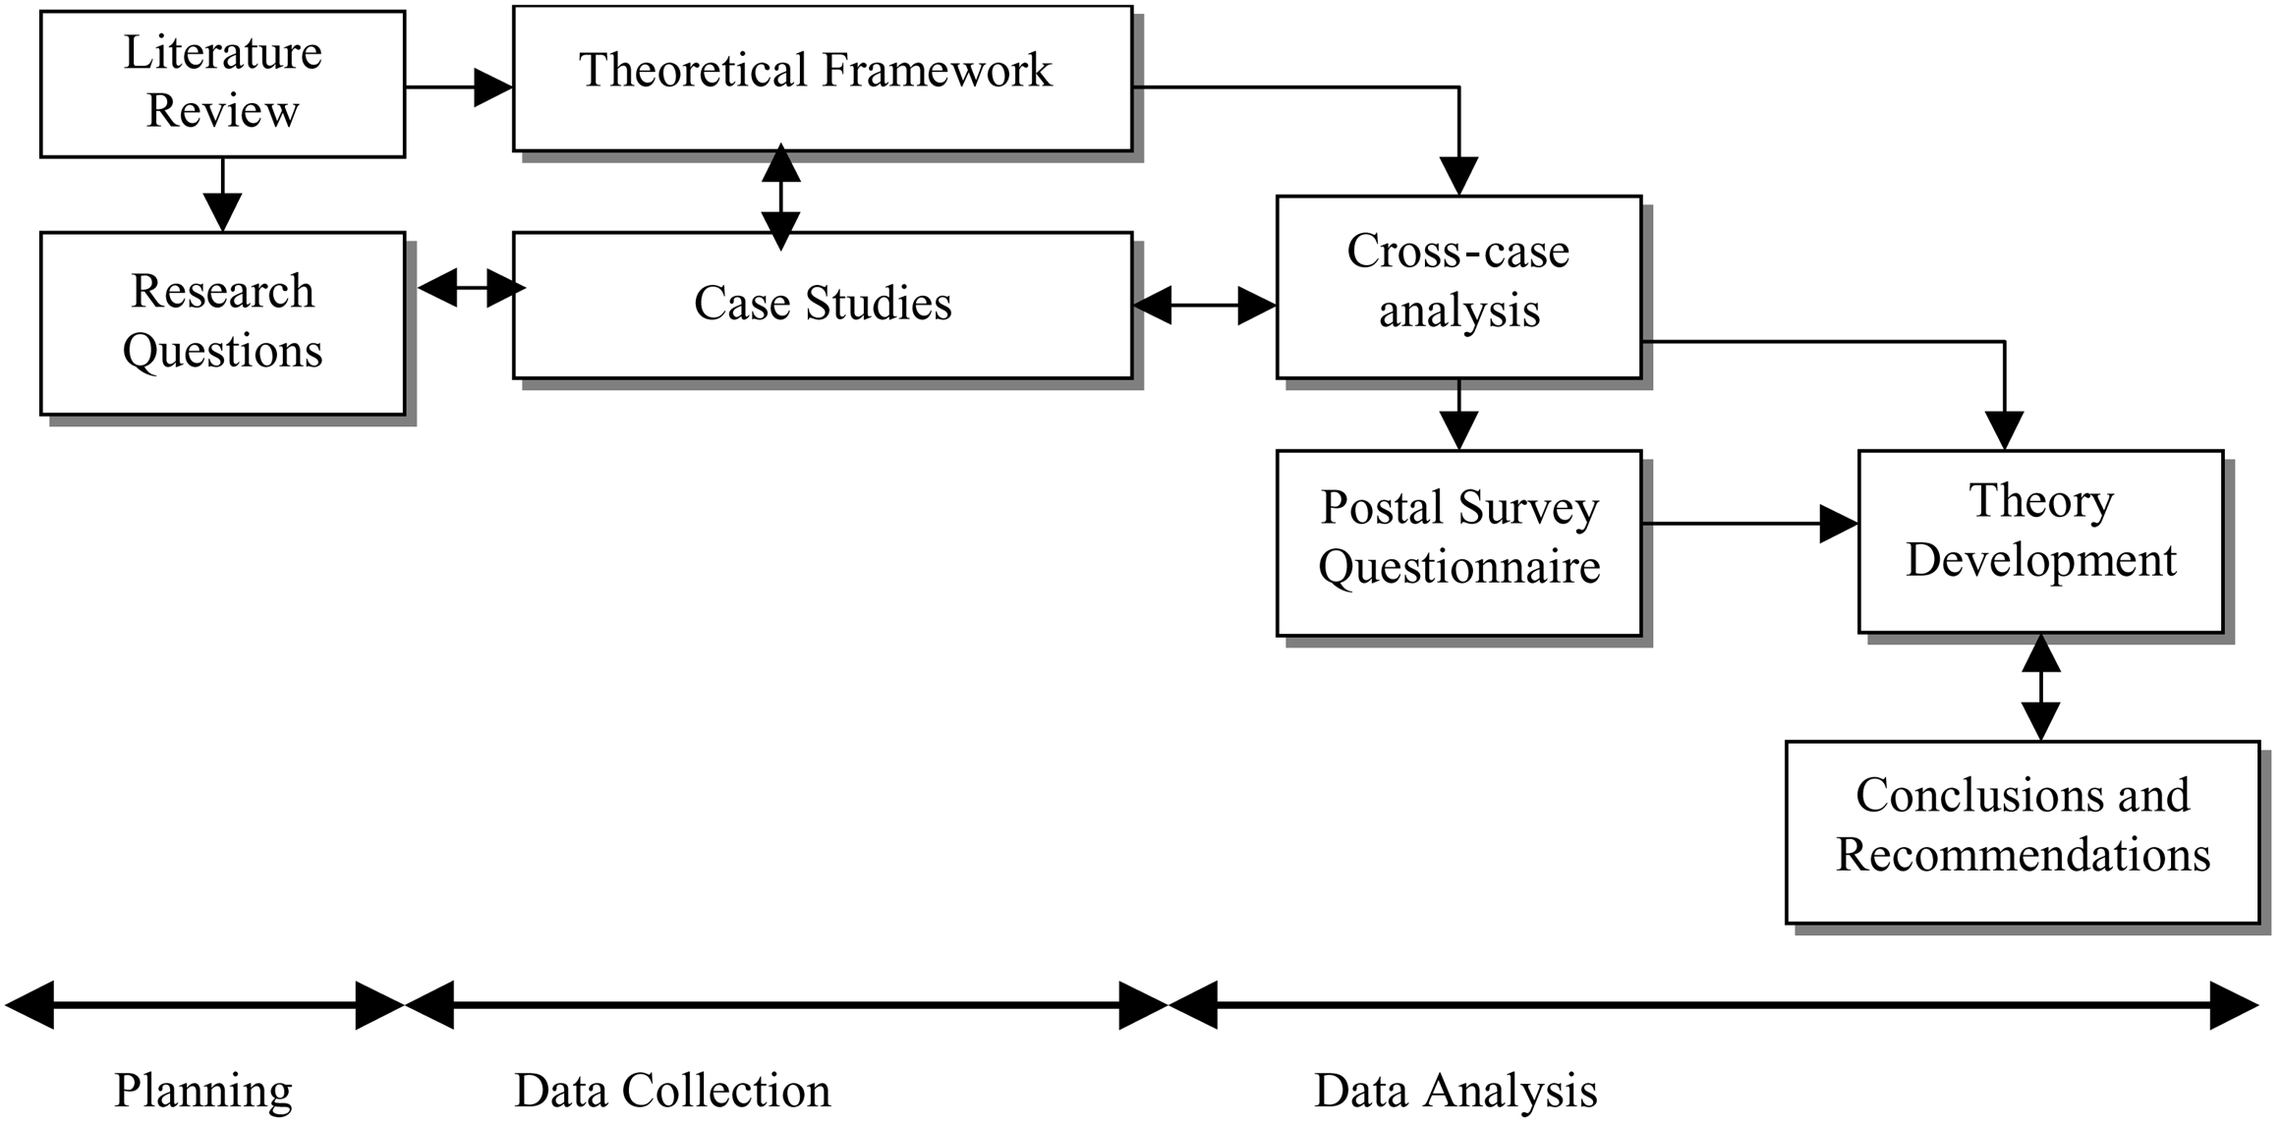
Research paper outline

Slide 4
GIS in the UAE or else where
The paper suggests that “appropriate technology” for the developing world does not have to be old-fashioned or unsophisticated;
It just has to be cheap, effective, reliable, and easy to use.

Slide 5
GIS in the UAE
The paper suggests that growth in GIS applications in the UAE is due to:
Cheap hardware and easy to use soft wares.
Impediments to the use of GIS in the UAE:
The cost of hardware.
The complexity of software.

Slide 6
GIS in the UAE
There is high demand for GIS staff in the UAE
Thus, the case of the GIS education in the UAE
The most important reasons for the spread of GIS and remote sensing:
Need to know about the spatial data to support decision-making process.
Using English for GIS.
Expanded the capabilities of the Internet.
Increased knowledge.

Slide 7
GIS in the UAE
Few cases on GIS implementation in the UAE:
Etisalate
ADWEA
Dubai Municipality

Slide 8
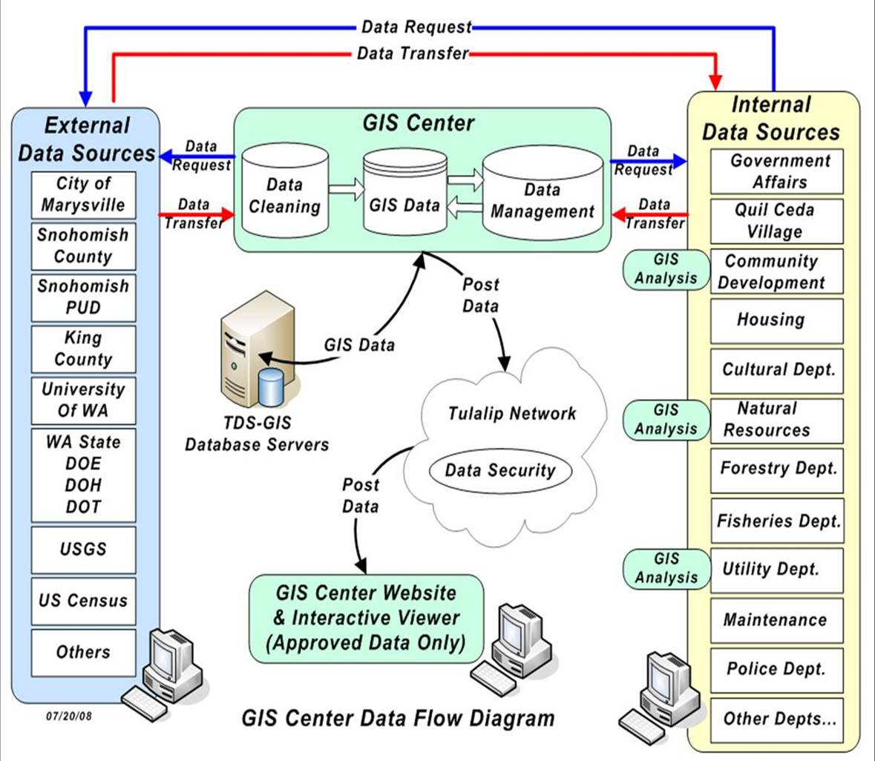
Identifications of problems and solutions for GIS implementation within the UAE?

Slide 9
GIS in the USA
The paper suggests that growth in GIS planning applications in the US is due to:
Growing awareness
Institutional acceptance
Falling system costs
Product diversity

Slide 10
GIS in Planning Applications in the USA
Geographical scale is the dominant influences shaping GIS utilization in planning:
National, Regional, Trans-regional, Metropolitan and Neighborhood scales.

Slide 11
GIS In The Developed World
Klosterman, Richard: The Appropriateness of Geographic Information Systems for Regional Planning in the Developing World. Comput., Environ., and Urban Systems: Akron, OH. 1995.
Four components of the GIS technology “package”: suitable equipment, appropriate information, proper organization, and available expertise.

Slide 12
Components of the GIS technology
In Suitable Equipment section, the author supplies the reader with the relatively inexpensive costs of GIS and the microcomputers needed to operate the new technology.
The Appropriate Information section, describes how developing nations will have many obstacles in collecting data and will inherently have a need for an incremental system-development strategy.

Slide 13
Components of the GIS technology
In collecting data in the developing world, pre-existing data is often unavailable and after data is collected, it can become restricted from public use due to political pressures. The incremental system-development strategy caters to smaller, simpler GIS that will be more useful to developing countries when the technology is first installed.
The Author does a good job of showing all the technical, political and socio-economic factors that go into creating GIS.

Slide 14
Components of the GIS technology
The Proper Organization portion illustrates how the technology is dependent upon the proper management and coordination of its resources in creating a GIS. Good communication between management, technicians and planners is crucial to the success of any GIS.
Klosterman adequately explains how human interactions can lead to successful, or unsuccessful, GIS applications. However, he does not really offer a solution for political impacts that may deter the establishment of GIS.

Slide 15
Components of the GIS technology
The Available Expertise section shows the need for information and training of experts that will work for the public sectors of developing countries. Developing countries often lack the financial incentives to keep skilled technicians from being lured away to more lucrative jobs in developed countries.
This absence of technical expertise often delays the implementation of GIS. The author mentions key points as to why developed nations have such a scarcity of skilled technicians.

Slide 16
Unfortunately, the Author lacks an answer as to how such an instrumental technology can be implemented in developing countries where pre-existing political and socio-economic ideals are more influential than technical ones. It explains all the interdependent parts that go into creating useful GIS.

Slide 17
Exercise
Discuss what we mean by “GIS for Urban Planning” and give example?
What’s “good GIS for developing world”?
Discuss the growth of GIS in the UAE?
What are some GIS applications in planning?
What are the main features of appropriate GIS for developing countries according to Klosterman?

Slide 18
Next week
Quiz 3
GIS Lab.2, at the class website
Thank You

